Slide 1
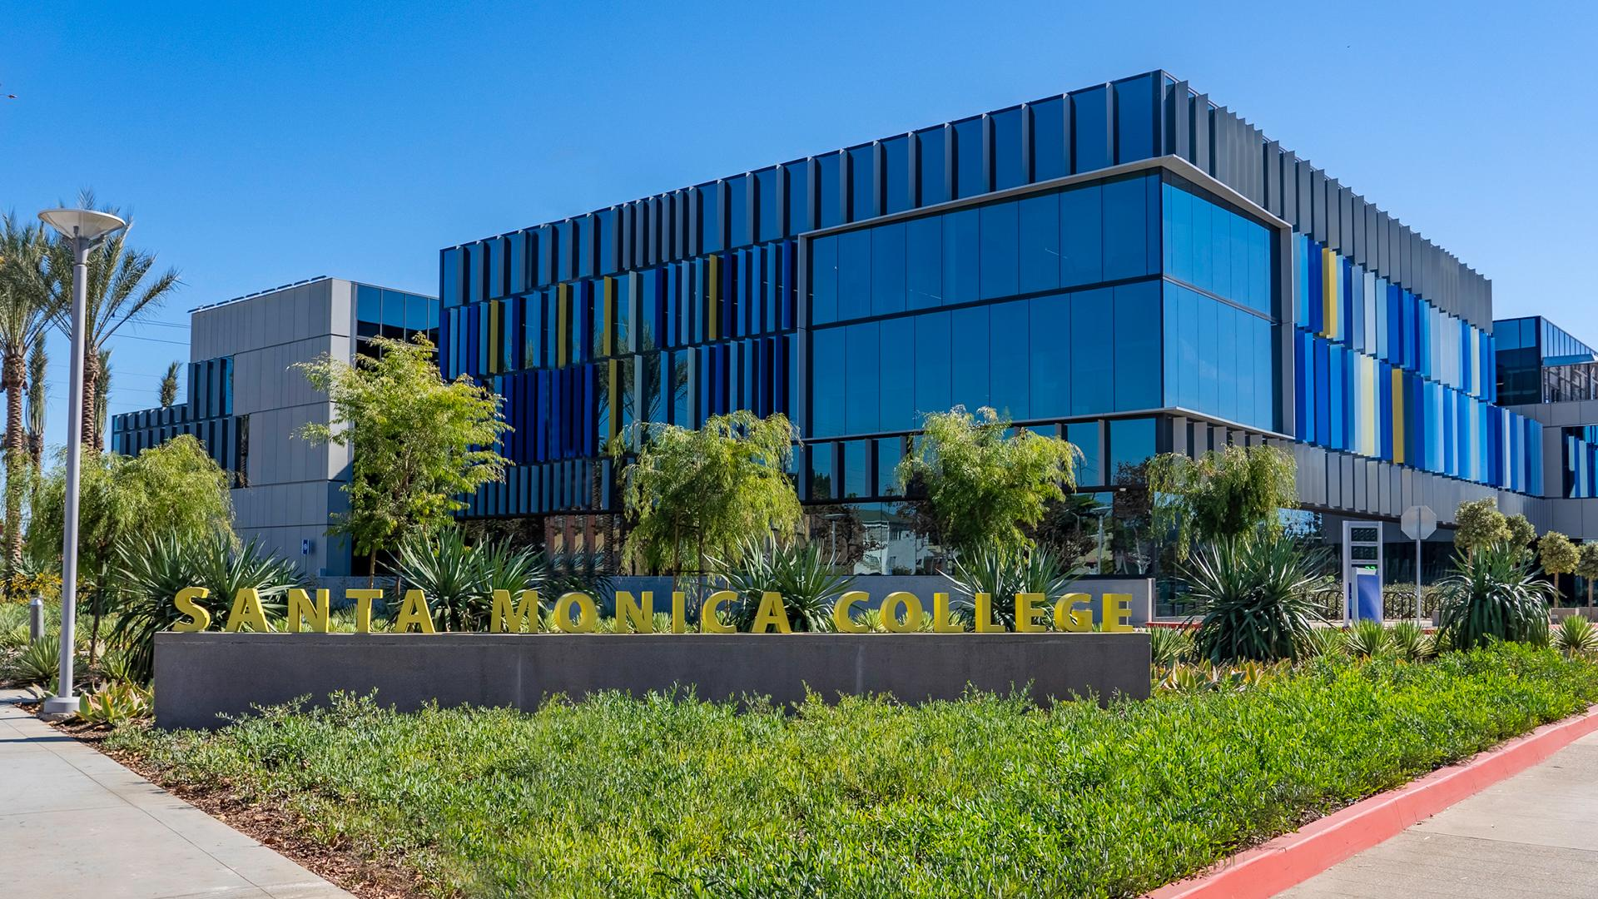
Santa Monica College Grants Office
Grant Approval Process Training
Presented by
Tracy Beidleman
Director of Grants

Slide 2
Overview
SMC Grants Office
SMC Foundation
Grants Office Roles and Responsibilities
Grants and Contracts
Grant Approval Process
Grant Approval Process (GAP)
Grant Approval Process Form
Grant Advisory Committee (GAC/Committee)
Seeking Grant Funding
Funding Agencies

Slide 3
SMC Grants Office
The Grants Office is responsible for submittal of all grants on behalf of the College District
SMC’s Grant Office:
Supports the mission of the College and is responsible for all pre-and post-award grant activities
Responsible for grant writing, proposal development and application submission (with some exceptions)
Provides technical assistance to Project Managers throughout the life of the grant
Liaison between Project Manager and funding agency concerning major scope changes and budget modifications

Slide 4
SMC Foundation
Separate, non-profit, tax-exempt 501(c)3 organization
Primarily pursue private grant funds to support the College's mission
Grants Office is located within the Foundation Office to better align the fund seeking efforts of the institution
Private grants are sought, submitted, approved and managed by the SMC Foundation

Slide 5
Grants and Contracts
If an individual, faculty or staff member submits a grant proposal, or any contractual agreement, without approval of the College, by law they are fiscally liable for any amount awarded
What is a grant?
A grant is:
a way the federal, state, or local agency funds your ideas and projects
A legal contract between the funding agency and the District
Sets forth the terms and conditions of the award

Slide 6
Roles and Responsibilities
Grant Manager
(project manager, project director or principal investigator)
Superintendent/
President
Director of Grants
Represents the College as the Authorized Organizational Representative (AOR)
Responsible for authorizing new grant applications and signing grant award agreements
Approves and signs all subcontract agreements and any other formal grant documents
Coordinates the pre-award and post award grant activities with the Grant Manager (i.e., Project Manager, Project Director or Principal Investigator)
Serves as the principal author for certain proposals
Works closely with individuals in the development of grant proposals providing review and edits to applications
Serves as a designated AOR and submits grant proposals to funding sources
Serves as the liaison between the College and the funding agency
Serves as the lead administrator responsible for overseeing the grant
Coordinates all grant activities and ensures on time completion within budget
Coordinates with the Grants Office and Fiscal Services through the life of the grant regarding scope changes, period of performance extensions and performance and expenditure reporting and other grant administration activities

Slide 7
Roles and Responsibilities, cont.
Individuals may not apply for grants on behalf of
Santa Monica College

Slide 8
Authorized Organizational Representative
The Authorized Organizational Representative (AOR) is the individual authorized to submit grants on behalf of the College
Representatives include:
Dr. Kathryn E. Jeffery, Superintendent/President
Christopher Bonvenuto, Vice President of Business and Administration
Tracy Beidleman, Director of Grants

Slide 9
Principal Investigator Role
Principal Investigator (PI):
Defined as Faculty and Staff
Responsible for
Preparing, conducting, and administering research grants, cooperative agreements, training or public service project, contract, or other sponsored projects
Scientific or technical direction of the project
Projects led by PI’s must have an Administrative Co-PI (includes college dean director or project manager)
Individual is recognized as ultimately responsible for the overall management of the project/program, completion of all required reports and deliverables, and who will serve as the primary technical point of contact

Slide 10
Grants Approval Process

Slide 11
Grant Approval Process
The Grant Approval Process (GAP) is a framework designed to gain institutional support and pre-approval for your grant proposal early in the development process, prior to submission to a potential funding agency
The GAP form has been designed to ensure proposed projects are aligned with institutional priorities, are appropriate and feasible based on capacity and resources, and have the support required for success once funded
Only applications that have received approval from the Grant Advisory Committee may be submitted to a funding agency for consideration

Slide 12
Grant Approval Process, cont.
Grant Approval Process Flowchart
Develop Your Idea
Identify Funding Source(s)
Grant Submitted by Grants Office
Final approval by Area Vice President
Coordinate with Grants Office in the Development of the Proposal
Obtain GAC Review and Authorization to Proceed
Prepare GAP
Schedule Scoping Meeting

Slide 13
Grant Approval Process, cont.
GRANT ADVISORY COMMITTEE Meets 1st Thursday of each month
Dr. Kathryn E. Jeffery | Superintendent/President
Dr. Bradley Lane | Vice President, Academic Affairs
Teresita Rodriguez | Vice President, Enrollment Development
Christopher Bonvenuto | Vice President, Business and Administration
Michael Tuitasi | Vice President, Student Affairs
Lizzy Moore | President, SMC Foundation/Dean, Institutional Advancement
Dr. Hannah Lawler | Dean, Institutional Research
Jamar London | President, Academic Senate
Ruth Casillas | Program Coordinator, Workforce and Economic Development
Tracy Beidleman | Director of Grants

Slide 14
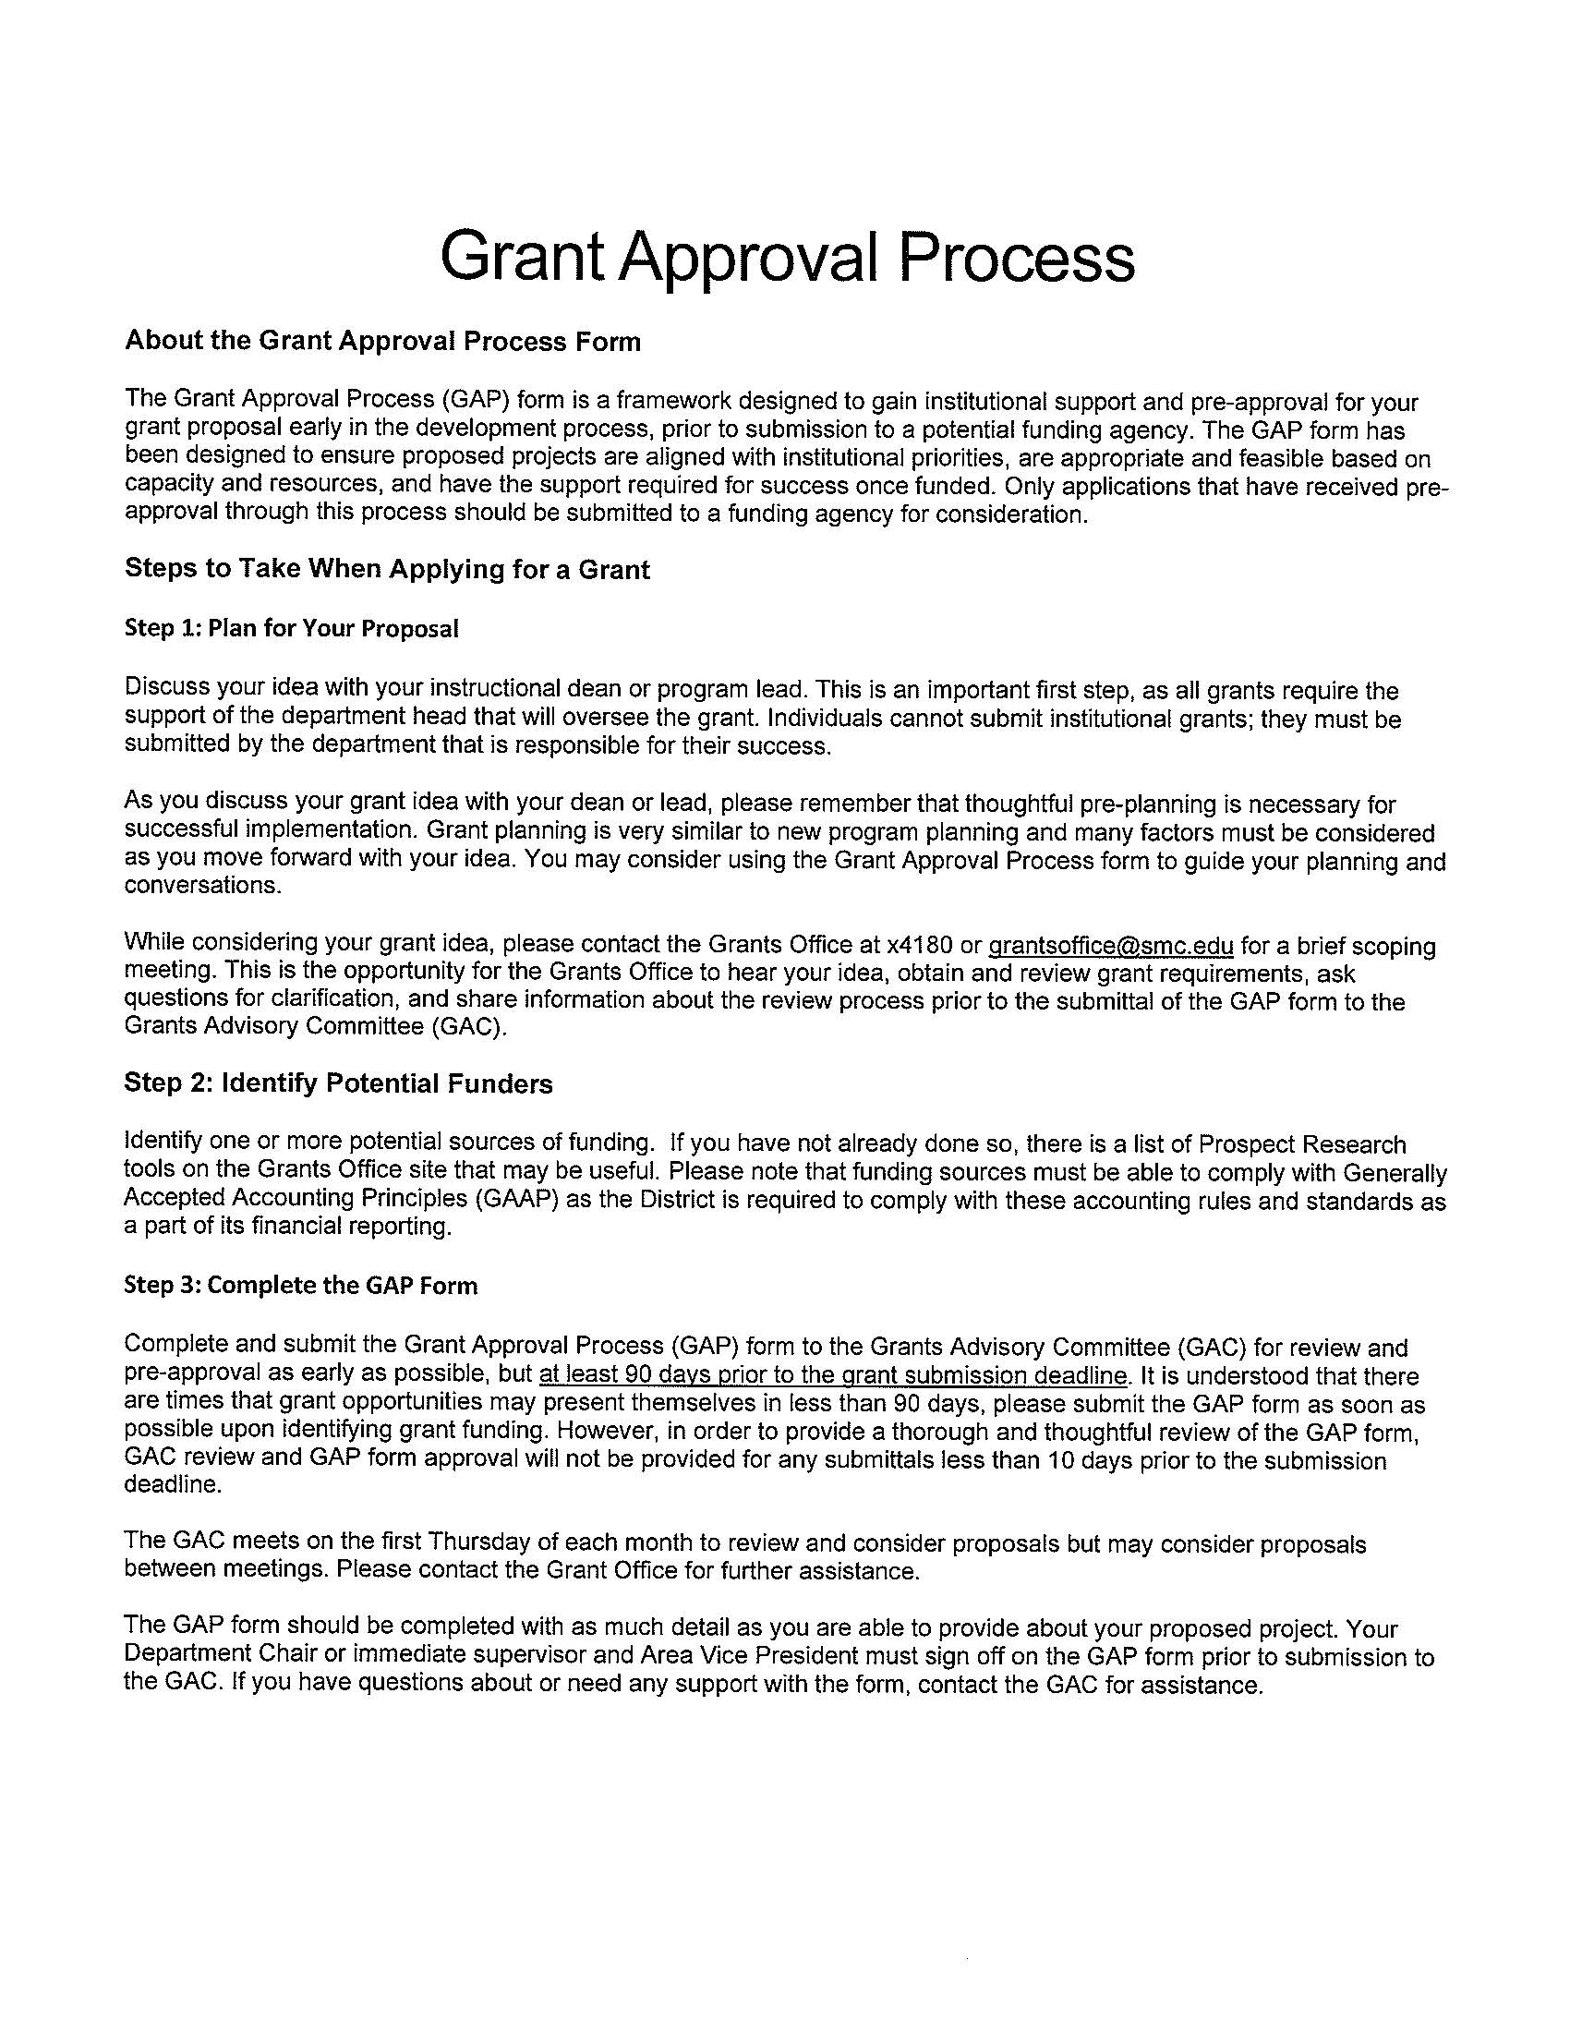
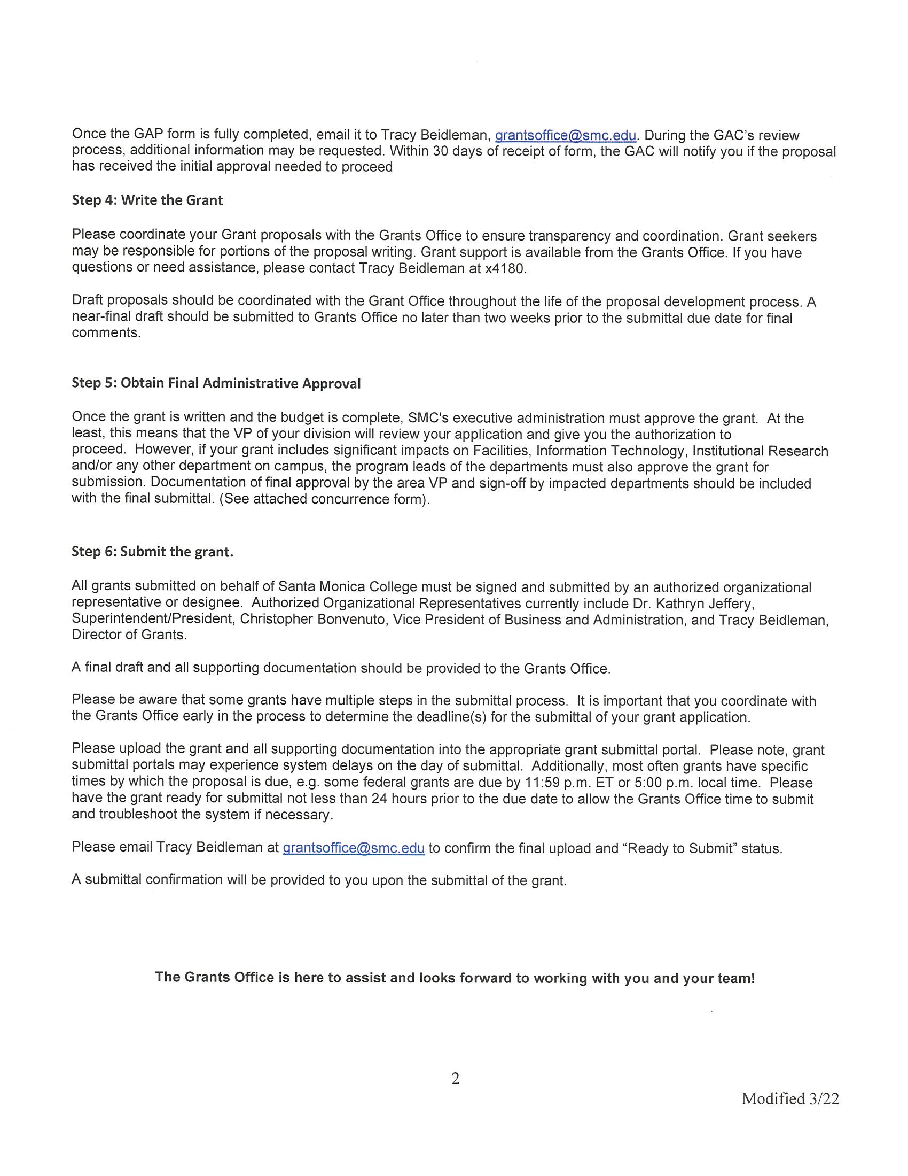
Grant Approval Process Form

Slide 15
Grant Approval Process Form

Slide 16
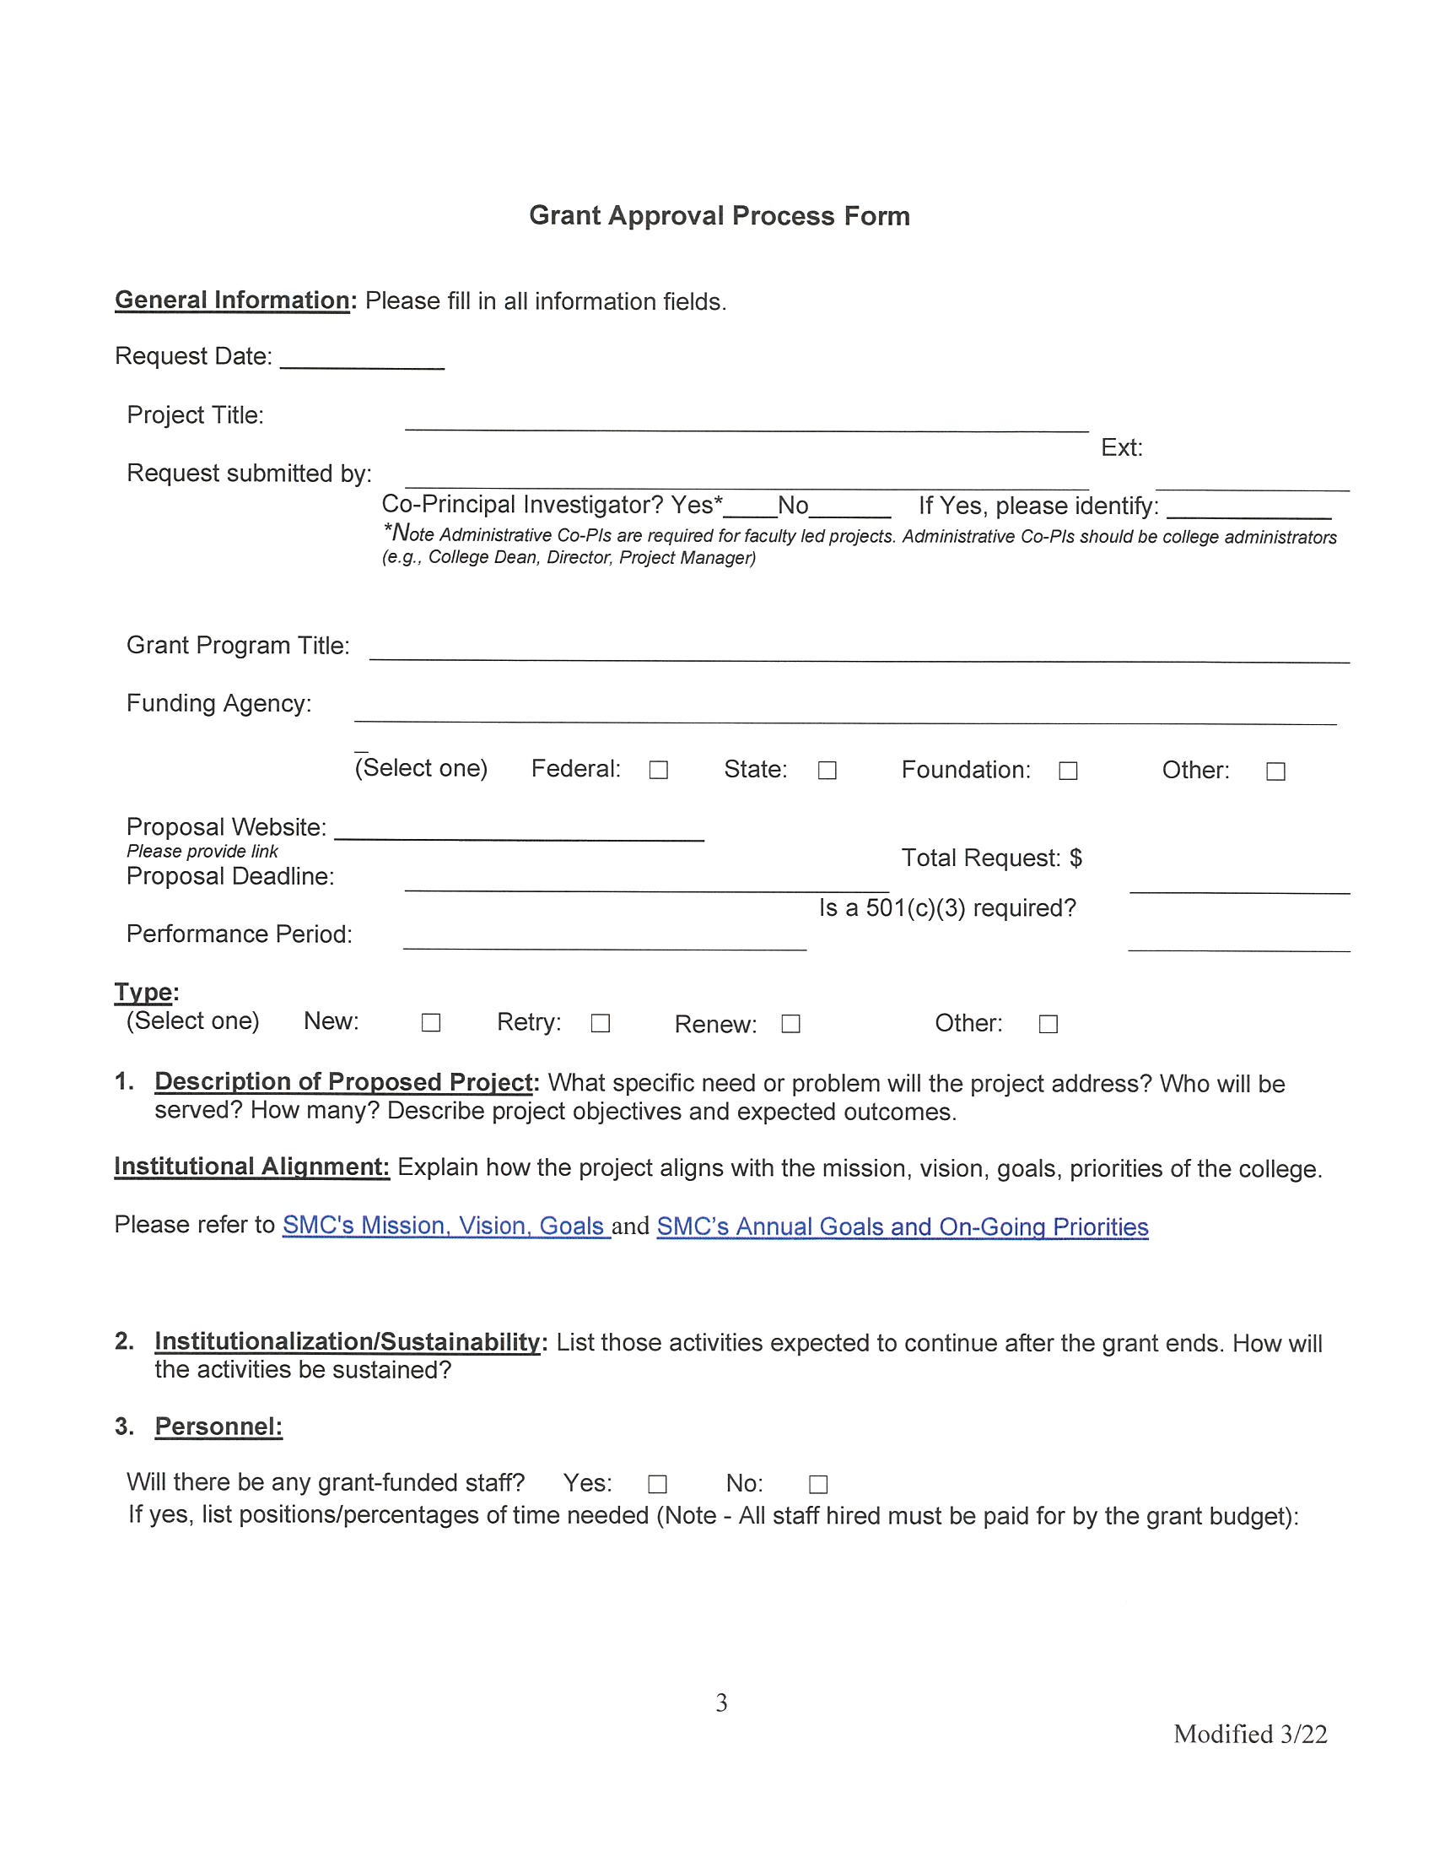
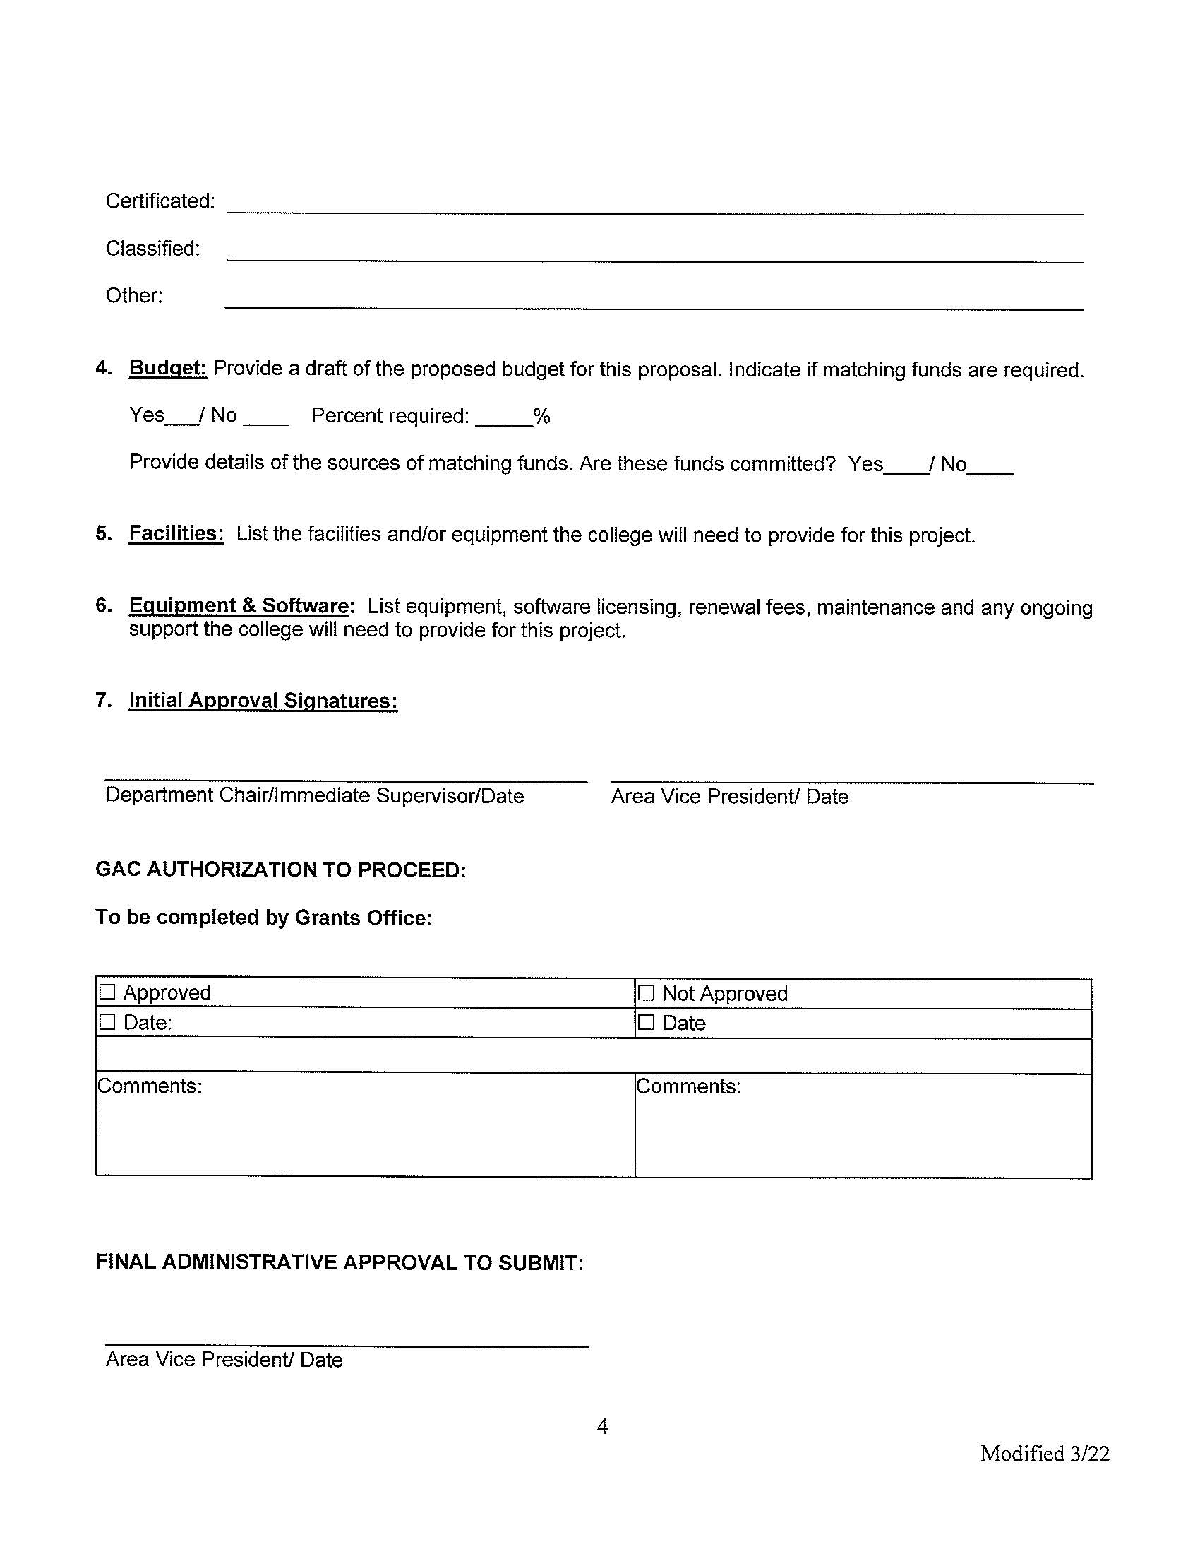
Grant Approval Process Form, cont.

Slide 17
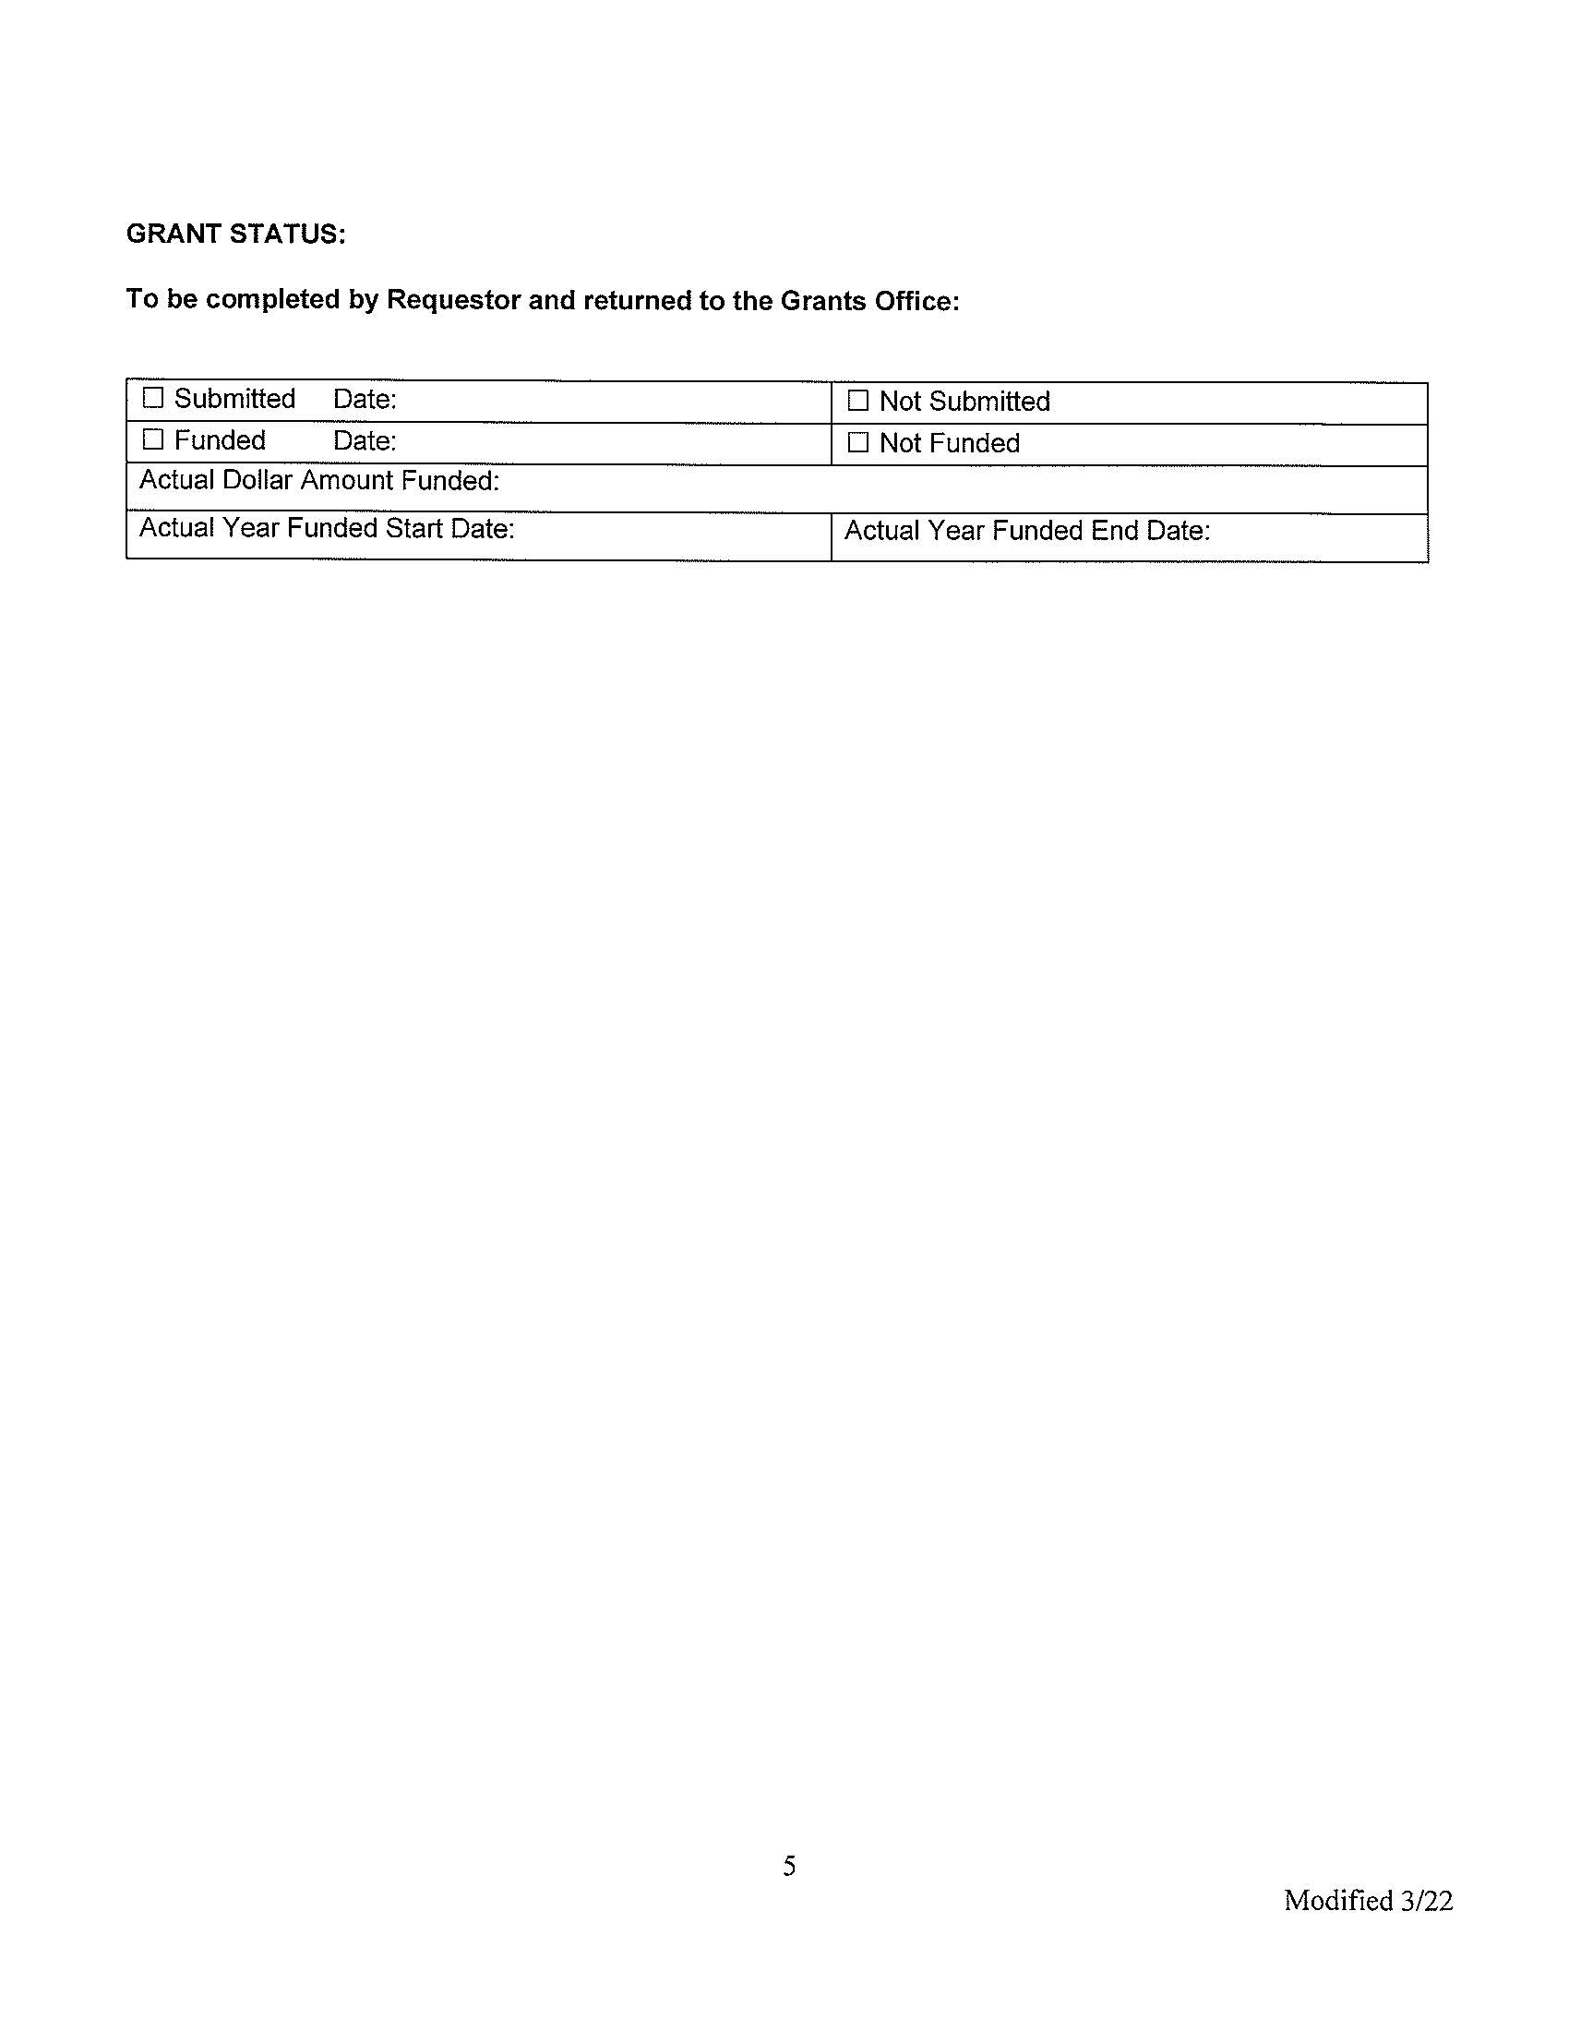
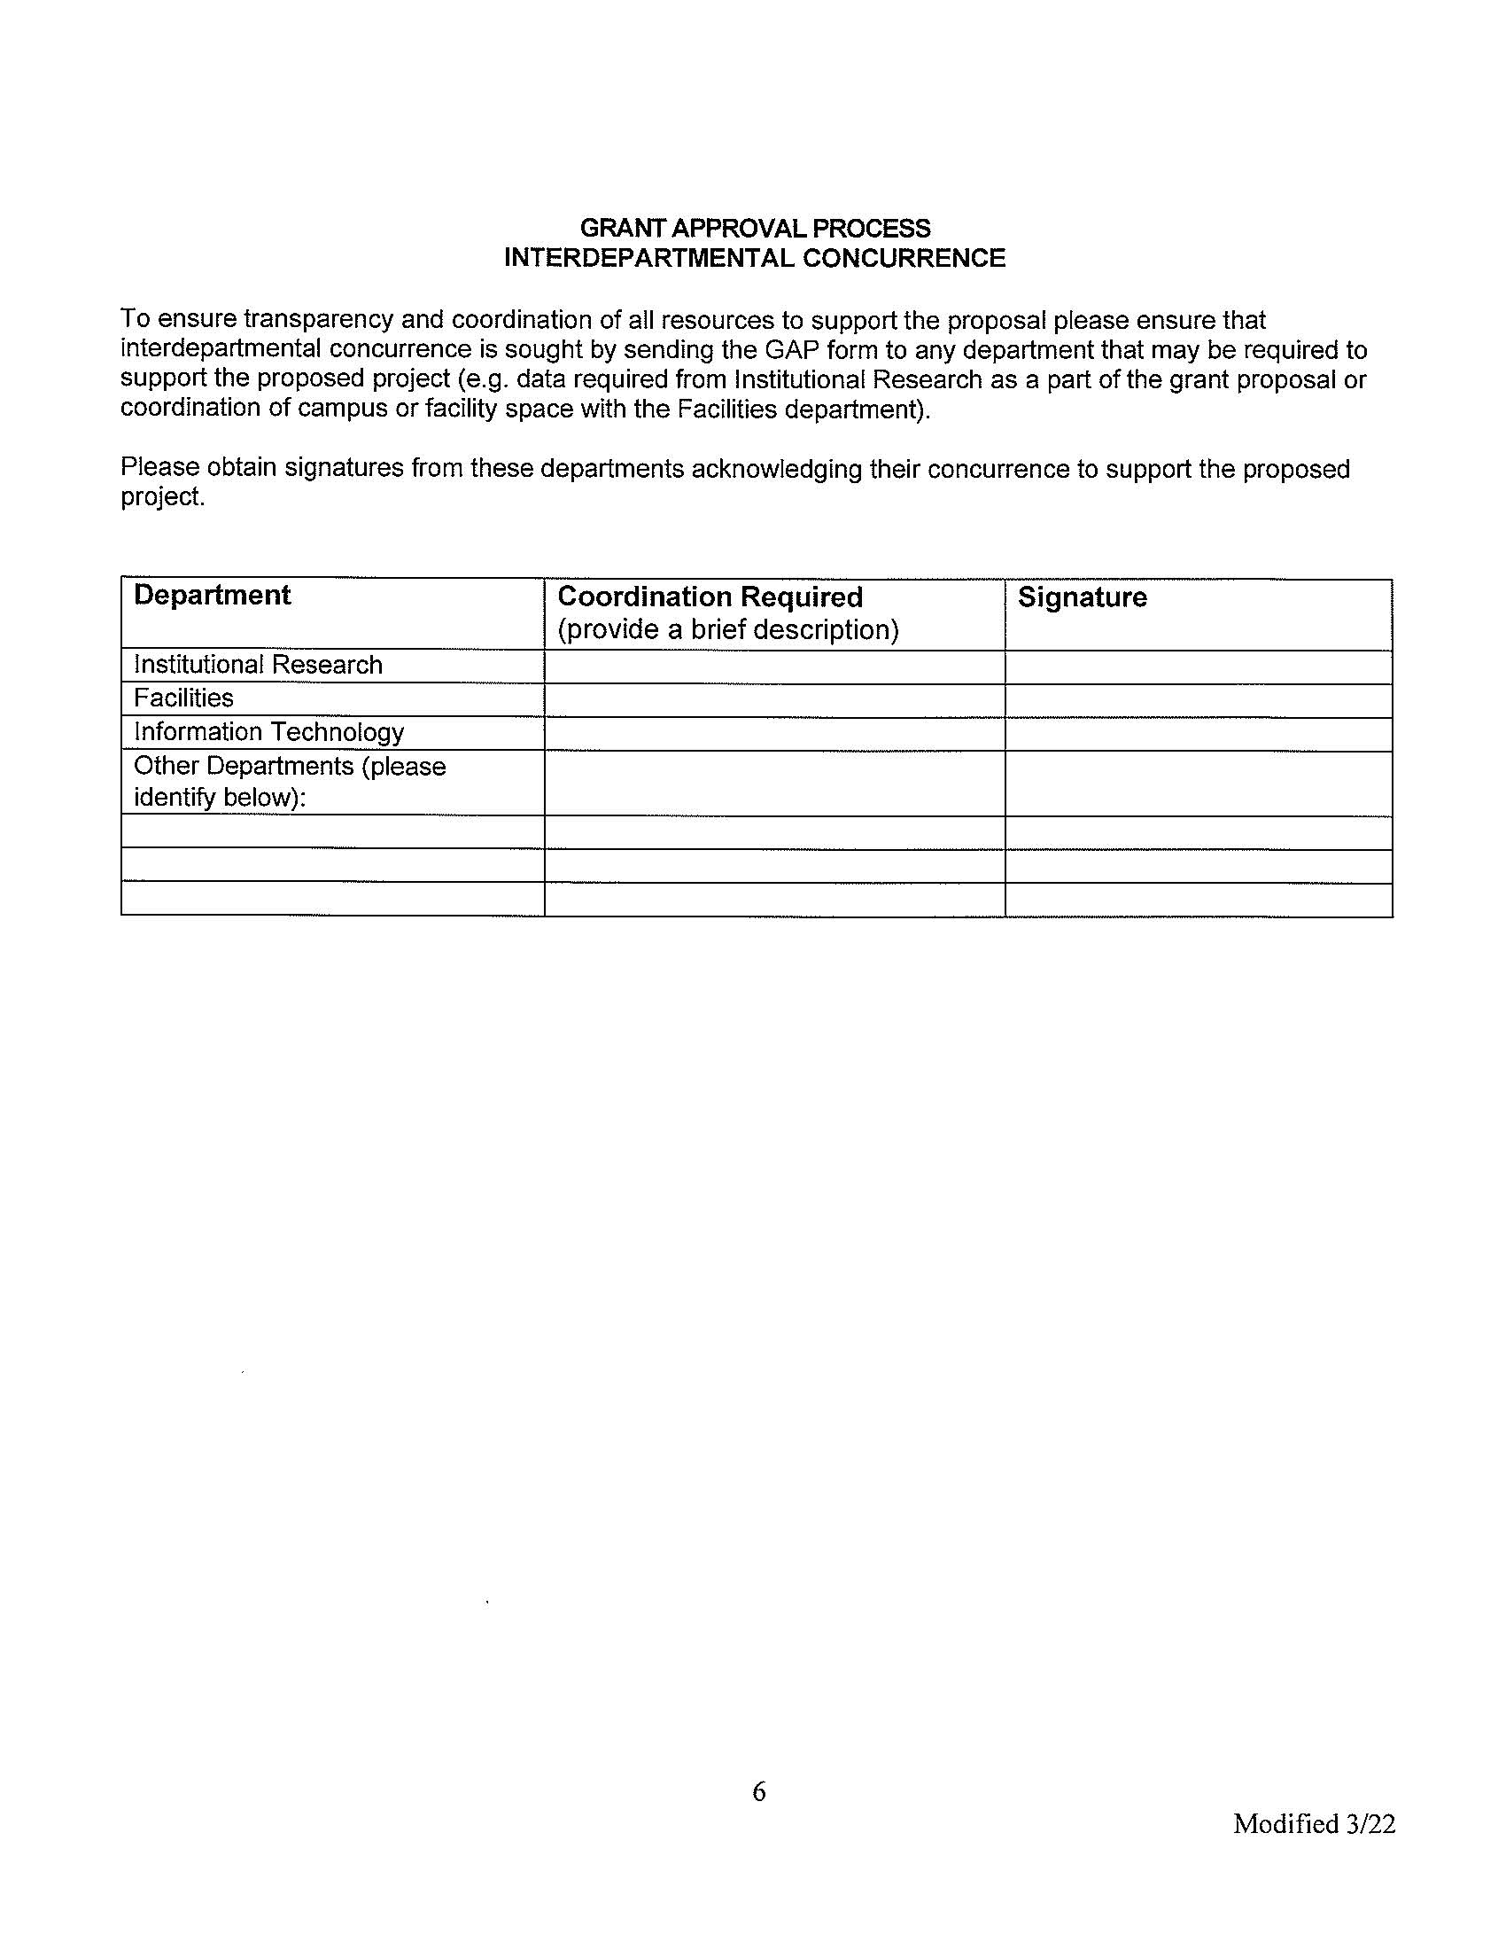
Grant Approval Process Form, cont.

Slide 18
Grant Seeking Process
Grant Approval Process, cont.
Grant Approval Process Form
Grants Office Website

Slide 19
Seeking Grant Funding

Slide 20
Seeking Grant Funding
National Science Foundation - Where Discoveries Begin

Slide 21
Thank You!
For questions:
Tracy Beidleman
310-434-4180
beidleman_tracy@smc.edu

