Slide 1



Grant Writing 101:
Understanding the Basics
Tracy Beidleman • Director of Grants
Nane Zadouri • Project Manager, Grants
Fall Professional Development Day
August 28, 2025
HyFlex Session - HSS 151
2:45 - 3:45 pm
SMC FOUNDATION GRANTS TRAINING | 2025
Notes:
Tracy/Nane
Introductions
Housekeeping:
Alonzo - Begin Recording!
We are recording this webinar and will share afterwards
There will be time for Q & A at end
Please drop Questions into Chat Box
Chat will be monitored during workshop
Alonzo - Monitor Zoom, Chat, Tech issues, Waiting room, Audio/Video

Slide 2
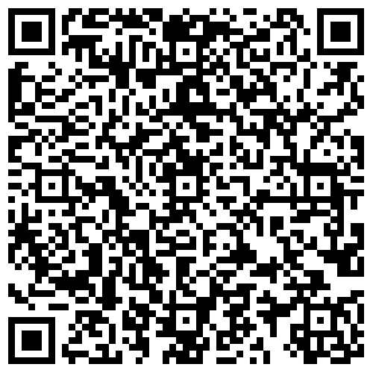
Sign in
Please use this QR code and enter your name and SMC email address.
Select from the list: Grant Writing 101
Thank you!
SMC FOUNDATION GRANTS TRAINING | 2025
Notes:
Tracy/Nane
Sign in sheet for PD day.
"In an effort to better track our metrics and measure impact, we have created sign in QR codes for each breakout session. Attendees only need to go to the form, enter their name and SMC email address, then select the workshop they are attending from a list of all workshops at that time slot"
In person can scan the QR code with phone and enter information.
Alonzo drop link into chat:
https://docs.google.com/forms/d/e/1FAIpQLSdCusAGMnnDUyOra16LH0NsamUmU6Opl8Q25vFRbgCWOqsLGQ/viewform

Slide 3


Agenda
Objective
Getting Started
SMC’s Grant Approval Process
Successful Grant Writing Tips
Common Mistakes
Researching the Funding Sources
Q & A
Resources
This session is hyflex.
We are recording and will post and share this session.
SMC FOUNDATION GRANTS TRAINING | 2025
Notes:
Tracy
Agenda
-Objectives of workshop
-Workshop topic areas
- Q & A - There will be time for Q & A at end

Slide 4

Objective
To provide an overview of successful grant writing tips, researching funding sources and avoiding some common grant development mistakes.
SMC FOUNDATION GRANTS TRAINING | 2025
Notes:
Tracy
Objective of Workshop

Slide 5

Participant Poll
What is your role at SMC?
Have you ever written a grant application before?
SMC FOUNDATION GRANTS TRAINING | 2025
Notes:
Tracy/Nane
Alonzo to do Poll Questions via Zoom Chat Box.
#1 – What is your role at SMC?
-Administrator/Manager
-Classified Professional
-Faculty
#2 – Have you ever written a grant application before?
- Yes
- No

Slide 6


Getting Started
SMC FOUNDATION GRANTS TRAINING | 2025
Notes:
Tracy

Slide 7

Terminology
Code of Federal Regulations (CFR)
Grants Advisory Committee (GAC)
Letter of Inquiry (LOI)
Notice Inviting Application (NIA)
Notice of Funding Opportunity (NOFO)
Request for Applications (RFA)
Request for Proposals (RFP)
SMC FOUNDATION GRANTS TRAINING | 2025
Notes:
Tracy
Terminology

Slide 8


Supplement vs. Supplant
SUPPLEMENT
SUPPLANT
Funds must supplement (increase, add to, enhance, expand, or extend) the programs and services offered with federal, state, and local funds
Funds are not permitted to be used to supplant (take the place of, replace) the federal, state, and local funds used to offer those programs and services
SMC FOUNDATION GRANTS TRAINING | 2025
Notes:
Tracy
Supplant vs. Supplement

Slide 9


What is a Grant?
A grant is:
A way the federal, state, or local agency funds your ideas and projects
A legal contract between the funding agency and the District can only be entered into by the Authorized Organizational Representative (AOR)
Sets forth the terms and conditions of the award
If an individual, faculty, or staff member submits a grant proposal, or any contractual agreement, without approval of the College, by law they are fiscally liable for any amount awarded.
SMC FOUNDATION GRANTS TRAINING | 2025
Notes:
What is a grant?
SMC policies on Grants includes:
Awards = SMC is the Lead
Contracts = SMC agrees to perform work based on a scope
Subaward Agreements via MOU
Subcontracts via Lead/Prime/Host Institutions
Sometimes there are other partnerships such as:
Letter of Support
Letter of Partnership

Slide 10


SMC’s Grant Approval Process
SMC FOUNDATION GRANTS TRAINING | 2025
Notes:
Section Break

Slide 11
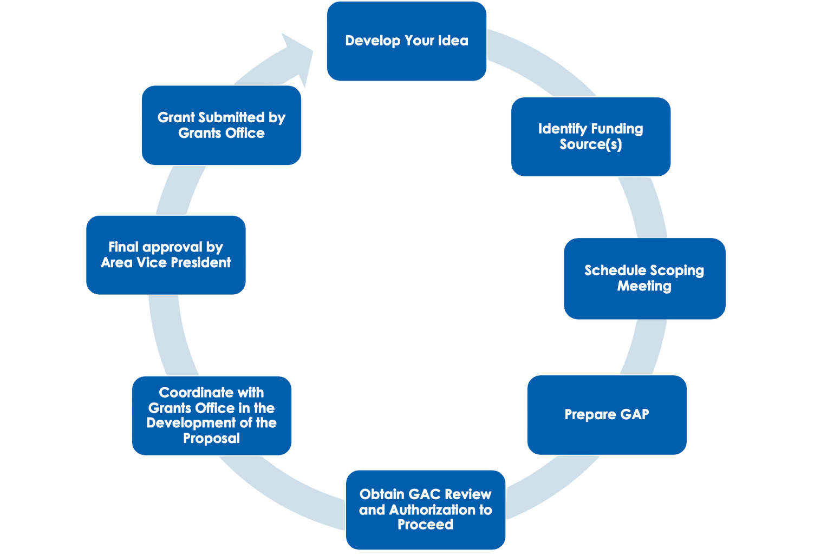


Grant Development Cycle
SMC FOUNDATION GRANTS TRAINING | 2025
Notes:
Tracy
Process Steps
Reminder to have discussions with area VP first
Supervisor approval

Slide 12
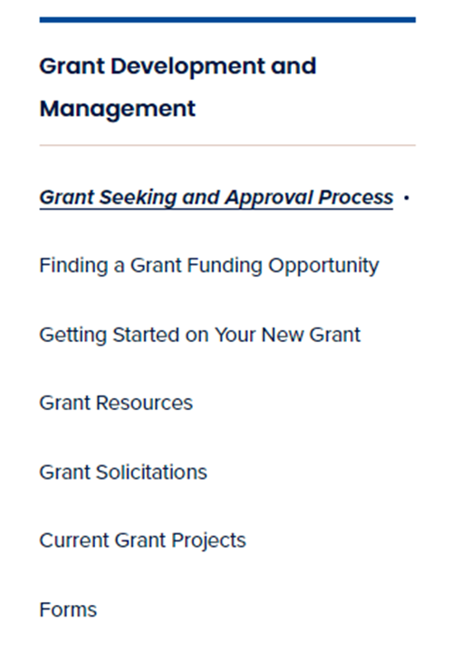


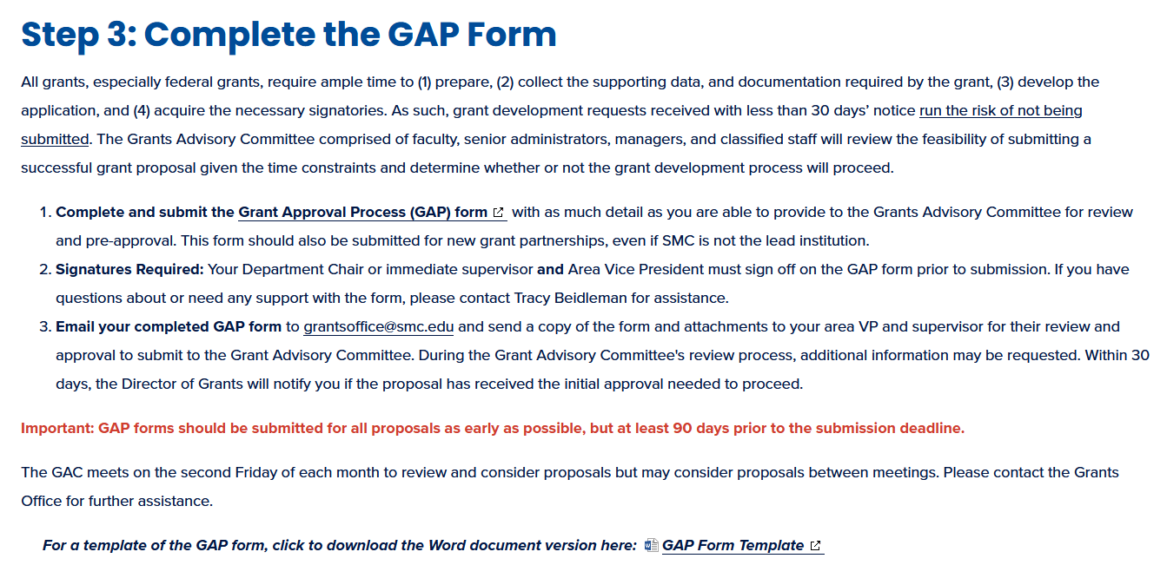

SMC’s Grant-Seeking Process
Snapshot of SMC Website
SMC FOUNDATION GRANTS TRAINING | 2023
SMC FOUNDATION GRANTS TRAINING | 2025
Notes:
Tracy

Slide 13
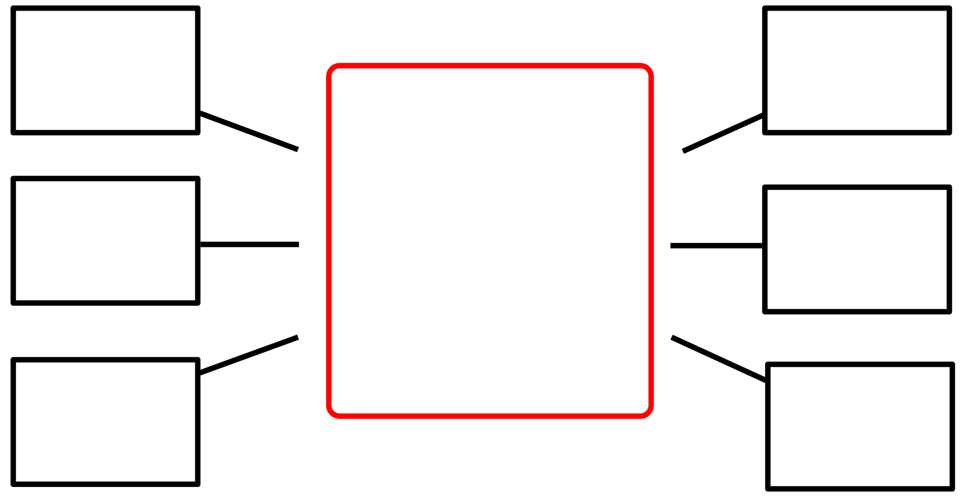


Developing the Ideas
What is the timeline and scope of the project?
Who will it serve?
What is the goal of the project/program/initiative?
What is the innovation/transformative value of the proposal?
What is the impact to the college community?
What resources will be needed?
What are the intended outcomes of the project?
What happens when grant funding ends?
SMC FOUNDATION GRANTS TRAINING | 2025
Notes:
Tracy

Slide 14

Successful Grant Writing Tips
SMC FOUNDATION GRANTS TRAINING | 2025
Notes:
Section Break

Slide 15

Successful Grant Writing Tips
Become familiar with the program requirements
Determine if the program is aligned with the mission/goals
of the funding source
Tell your story
Pay attention to the details
Seek feedback
Be concise
Use visual aids - charts, tables, maps, and graphs
Convey enthusiasm
Provide sufficient details for evaluation
Use active language
SMC FOUNDATION GRANTS TRAINING | 2025
Notes:
Tracy

Slide 16

Notice of Funding Opportunity (NOFO)
SMC FOUNDATION GRANTS TRAINING | 2025
Notes:
Section Break

Slide 17

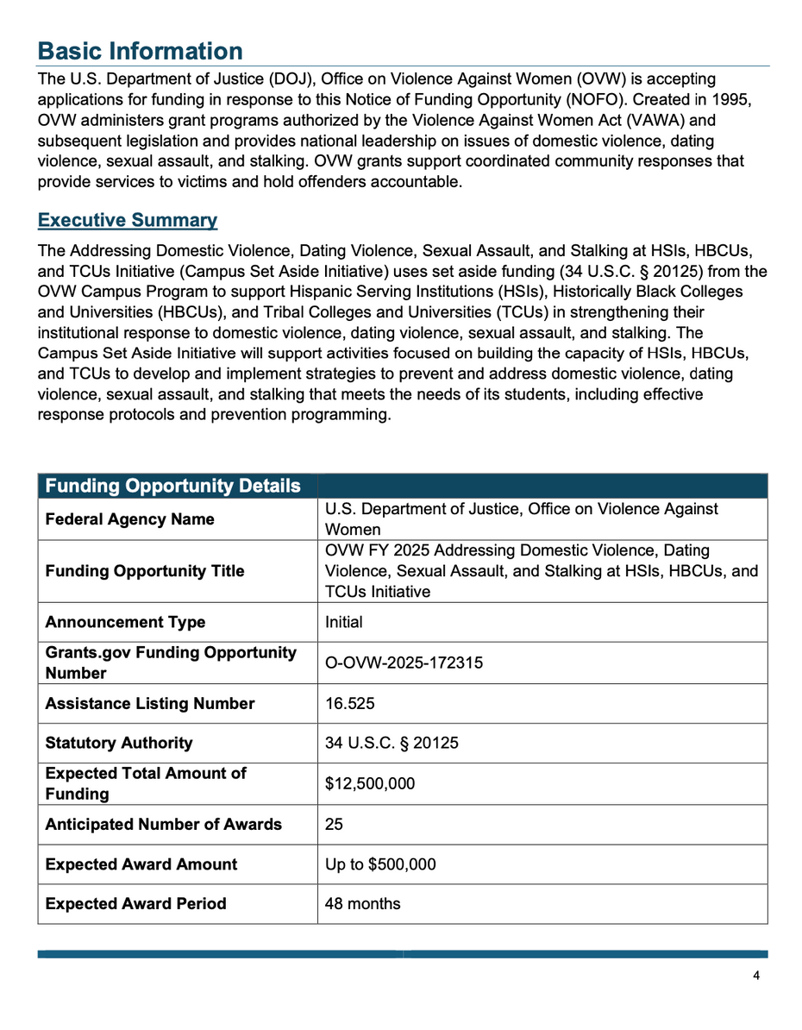

Department of Justice NOFO
SMC FOUNDATION GRANTS TRAINING | 2025

Slide 18



Sample Scoring Rubric
Selection Criteria | Maximum Points
Need for the Project | (20 Points)
Quality of the Project Design | (25 Points)
Quality of Project Services | (30 Points)
Quality of the Management Plan | (15 Points)
Quality of the Project Evaluation | (10 Points)
Sub Total | 100 POINTS
Absolute Priority 1 | (0 Points)
Absolute Priority 2 | (0 Points)
Competitive Priority | (Up to 10 Points)
Total | (Up to 110 Points)
Understanding the U.S. Department of Education’s (ED) Scoring System
SMC FOUNDATION GRANTS TRAINING | 2025
Notes:
Section Break

Slide 19

What are the eligibility criteria?
College or Foundation 501 (c) 3
Institutions of Higher Education (IHEs)
Community Colleges
Hispanic Serving Institutions (HSI)
Minority Serving Institutions (MSI)
SMC FOUNDATION GRANTS TRAINING | 2025
Notes:
Tracy
Terminology

Slide 20

What is the goal?
What is the purpose of the grant program?
What are the priorities of the program?
How does your project align with the goals of the grant program?
SMC FOUNDATION GRANTS TRAINING | 2025
Notes:
Tracy
Terminology

Slide 21

What is the award range?
What is the total program funding?
What is the minimum/maximum award?
What is the average size of the award?
How many awards are planned?
What is the earliest funding will be available?
Matching required?
SMC FOUNDATION GRANTS TRAINING | 2025
Notes:
Tracy
Terminology

Slide 22

What are the resources?
Attend the Pre-Bidders Conference
Participate in webinars
Review prior grant awards from the specific funding agency
Review program abstracts
Contact the Program Manager
SMC FOUNDATION GRANTS TRAINING | 2025
Notes:
Tracy
Terminology

Slide 23

Developing the Proposal:
Content and Application Form
In general, your application will include:
Project Narrative
Project Budget
Project Timeline
May include:
Abstract
Absolute Priorities
Management Plan
Project Evaluation
Letters of Collaboration/Support
SMC FOUNDATION GRANTS TRAINING | 2025
Notes:
Tracy
Terminology

Slide 24

Developing the Proposal:
Project Narrative
Clear
Concise
Compelling
Reflect an “Innovative” or “Transformative” Concept
Include Measurable Outcomes
SMC FOUNDATION GRANTS TRAINING | 2025
Notes:
Tracy
Terminology

Slide 25



Telling Your Story Example
The Santa Monica College (SMC) Chemistry department seeks to enhance student learning by providing workforce ready skills lab courses. SMC is seeking funding through this grant for the purchase of a new NMR spectrometer equipment in order to provide students with the skills they will need to be ready to enter the workforce in STEM and Aquaculture Technology careers. This funding will support 200 students in the Chemistry Department and the affiliated 20 faculty using the equipment.
SMC wants brand new laptops for chemistry classrooms with wireless internet data so SMC students are connected virtually to learn.
SMC FOUNDATION GRANTS TRAINING | 2025
Notes:
Tracy

Slide 26

Developing the Proposal:
Project Abstract
Provide a concise description of the proposed project objectives, activities, and intended outcomes.
Why is this problem important?
What will your project do to try to solve the problem?
What is the problem that your project will try to solve?
What are the expected outcomes of your work?
SMC FOUNDATION GRANTS TRAINING | 2025
Notes:
Tracy
Terminology

Slide 27
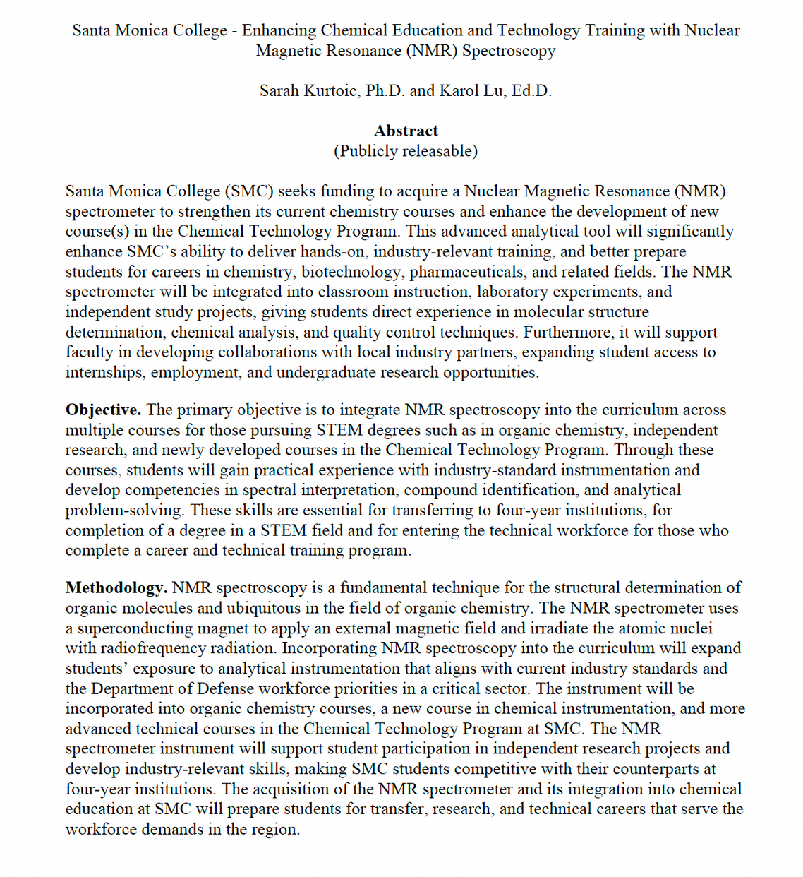
Project Abstract Example
SMC FOUNDATION GRANTS TRAINING | 2025
Notes:
A template spreadsheet that is available on the website for use
Based on SMC & Chancellor’s Office object codes
Aligns with NOVA online system budget section for programs and projects
Screenshot here
Grant Budgets Should:
Be based on the period of performance for the grant
If it is a multi-year grant, budget per year
Based on proposed activities and planned expenditures

Slide 28




Pay attention to the details
Multi-part prompts and questions
Prompt and question details
Prompt 2b: Describe the current innovative EEO practice(s) you wish to enhance.
• Outline the project goal, purpose, and scope, highlighting the current challenges and how the proposed intervention might improve them. Include supporting data and evidence and justify why this program was selected.
• Explain how the proposed enhancement will address EEO faculty and staff diversity needs at your institution.
1. Describe the current innovative EEO practice(s) you wish to enhance. 2. Outline the project goal.
3. Purpose. 4. Scope.
5. Highlighting the current challenges.
6. How the proposed intervention might improve them.
7. Include supporting data and evidence.
8. Justify why this program was selected.
9. Explain how the proposed enhancement will address EEO faculty and staff diversity needs at your institution.
Notes:
Tracy

Slide 29

Developing the Budget
Travel
Equipment
Budget development for grants requires working with the Budget Department
Contact: Veronica Diaz, ext. 4224
Fringe
Personnel
What’s in a
Grant Budget?
Other
Supplies
Contractual
Construction
SMC FOUNDATION GRANTS TRAINING | 2025

Slide 30

Budget Justification
The narrative supports the numbers
Link each item back to the grant activity
Show the calculations
Discuss necessity & reasonableness
SMC FOUNDATION GRANTS TRAINING | 2025

Slide 31
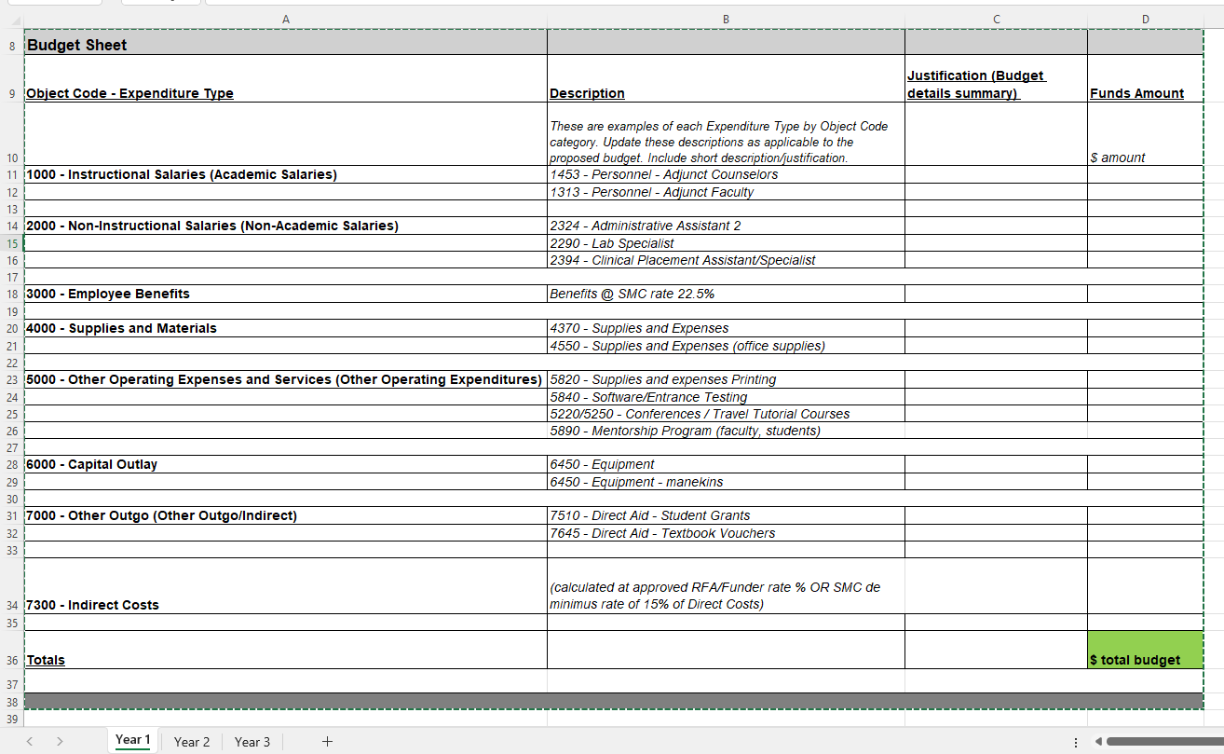

State Budget Spreadsheet
Notes:
A template spreadsheet that is available on the website for use
Based on SMC & Chancellor’s Office object codes
Aligns with NOVA online system budget section for programs and projects
Screenshot here
Grant Budgets Should:
Be based on the period of performance for the grant
If it is a multi-year grant, budget per year
Based on proposed activities and planned expenditures

Slide 32
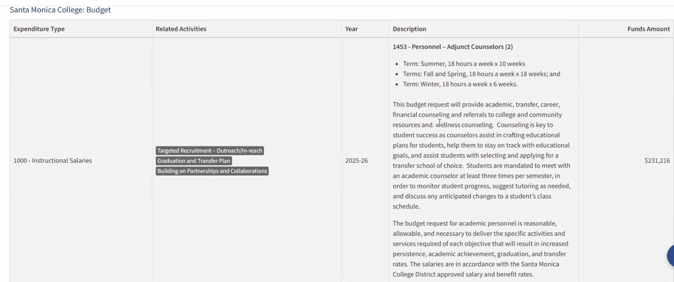


State Budget Example
Body
SMC FOUNDATION GRANTS TRAINING | 2025

Slide 33
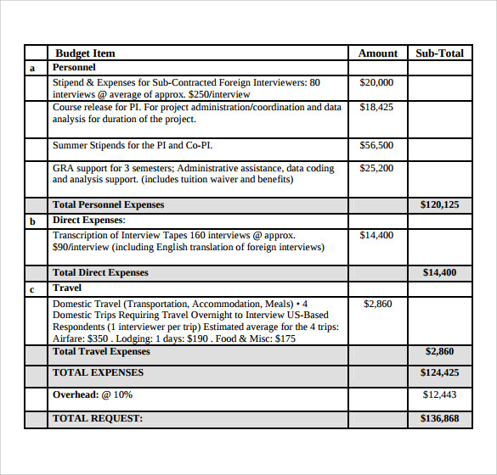

Federal Budget Example
SMC FOUNDATION GRANTS TRAINING | 2025
Notes:
A template spreadsheet that is available on the website for use
Based on SMC & Chancellor’s Office object codes
Aligns with NOVA online system budget section for programs and projects
Screenshot here
Grant Budgets Should:
Be based on the period of performance for the grant
If it is a multi-year grant, budget per year
Based on proposed activities and planned expenditures

Slide 34

Indirect Costs Rate
Important:
As of Spring 2025, all grant budgets must include Indirect Costs Rate.
The purpose is for administrative and overhead costs.
Indirect Cost Rate (a de minimis rate) is currently 15%
Unless otherwise indicated in the RFA/RFP/NOFO utilize the indicated rate
SMC FOUNDATION GRANTS TRAINING | 2025
Notes:
NANE
"For budget estimates for new grant applications, Veronica would be the contact."
"If questions come up regarding activities for a new grant proposal, they can contact Ann Le or Irma Haro.
Indirect Rate reminder as of Spring 2025 is 15% of direct costs
Compliance CFR section
indirect cost rate under 2 CFR 200 allows recipients and subrecipients without a current Federal negotiated indirect cost rate to elect to charge a de minimis rate of up to 15% of modified total direct costs (MTDC).
Link: https://www.ecfr.gov/current/title-2/subtitle-A/chapter-II/part-200/subpart-E/subject-group-ECFRd93f2a98b1f6455/section-200.414

Slide 35
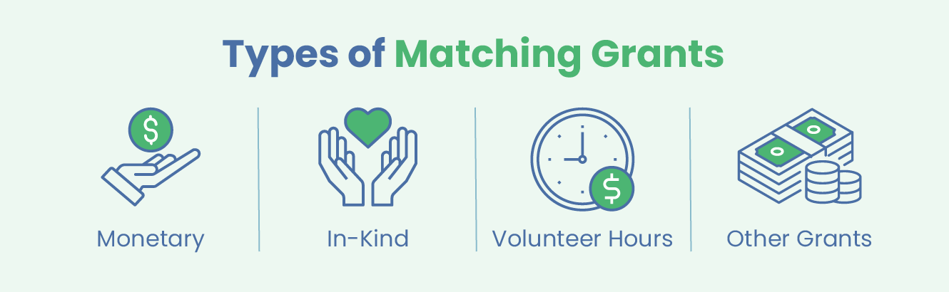
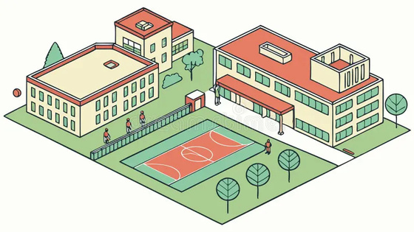

Matching
Some grants may require a match to obtain the grant funds.
Match rates can vary.
Cash
Facilities
Staff time
Materials
SMC FOUNDATION GRANTS TRAINING | 2025

Slide 36


Partnerships & Collaborations
Q: Does the grant require partnerships?
A: It depends; check with the Grants Office.
Q: Are there other colleges, universities, industry organizations involved in these types of activities?
A: Check with the Grants Office.
Q: How can we collaborate with local, regional, and national partners?
A: Check with your department chair and area Vice President.
SMC FOUNDATION GRANTS TRAINING | 2025

Slide 37
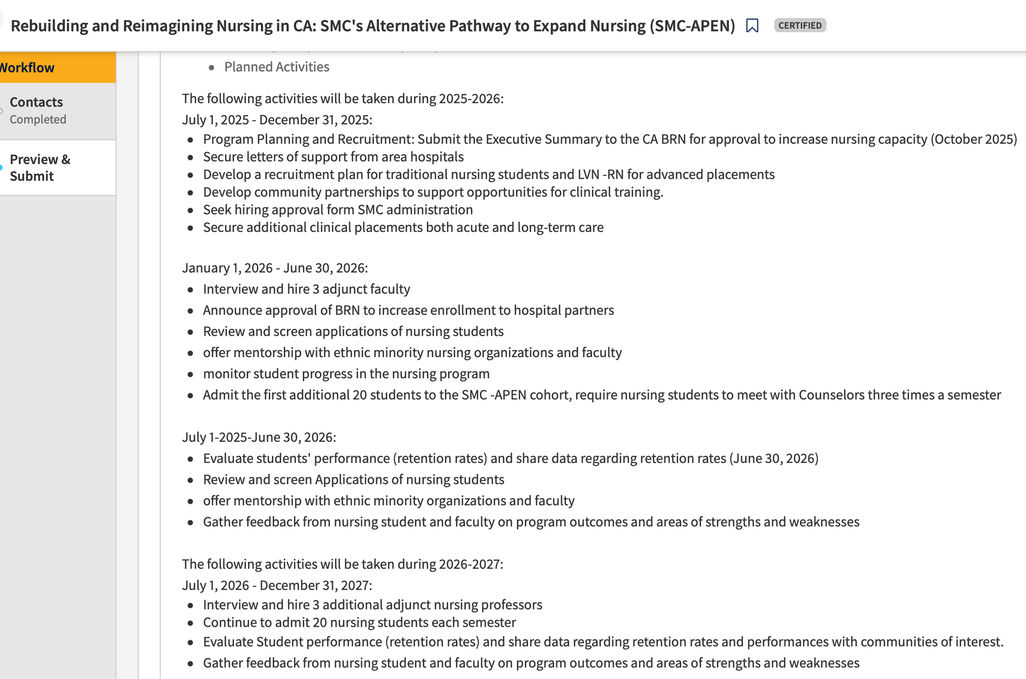
Project Timeline Example
SMC FOUNDATION GRANTS TRAINING | 2025

Slide 38
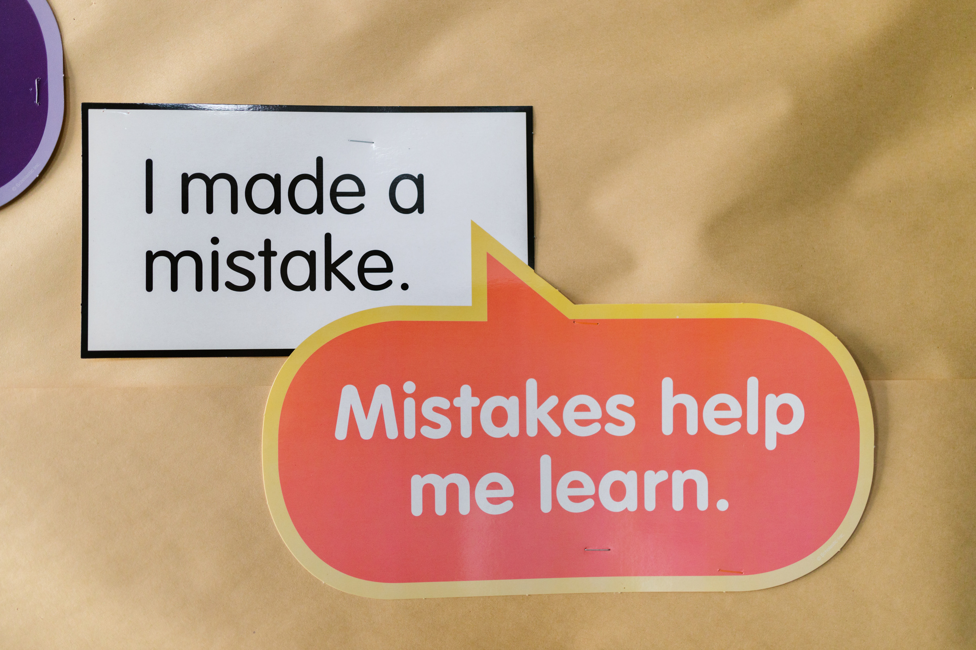
Common Mistakes
SMC FOUNDATION GRANTS TRAINING | 2025
Notes:
Tracy

Slide 39


Common Mistakes
Did not fully address all items in the criteria
Stronger connection between proposed
project & district goals
Proposal lacks
innovation
Proposal lacked significance
Overambitious goals
Need a more detailed timeline
Program not fully described or justified
Needs stronger
examples
Unrealistic
budget
SMC FOUNDATION GRANTS TRAINING | 2025

Slide 40

Researching the Funding Sources
SMC FOUNDATION GRANTS TRAINING | 2025
Notes:
Tracy

Slide 41
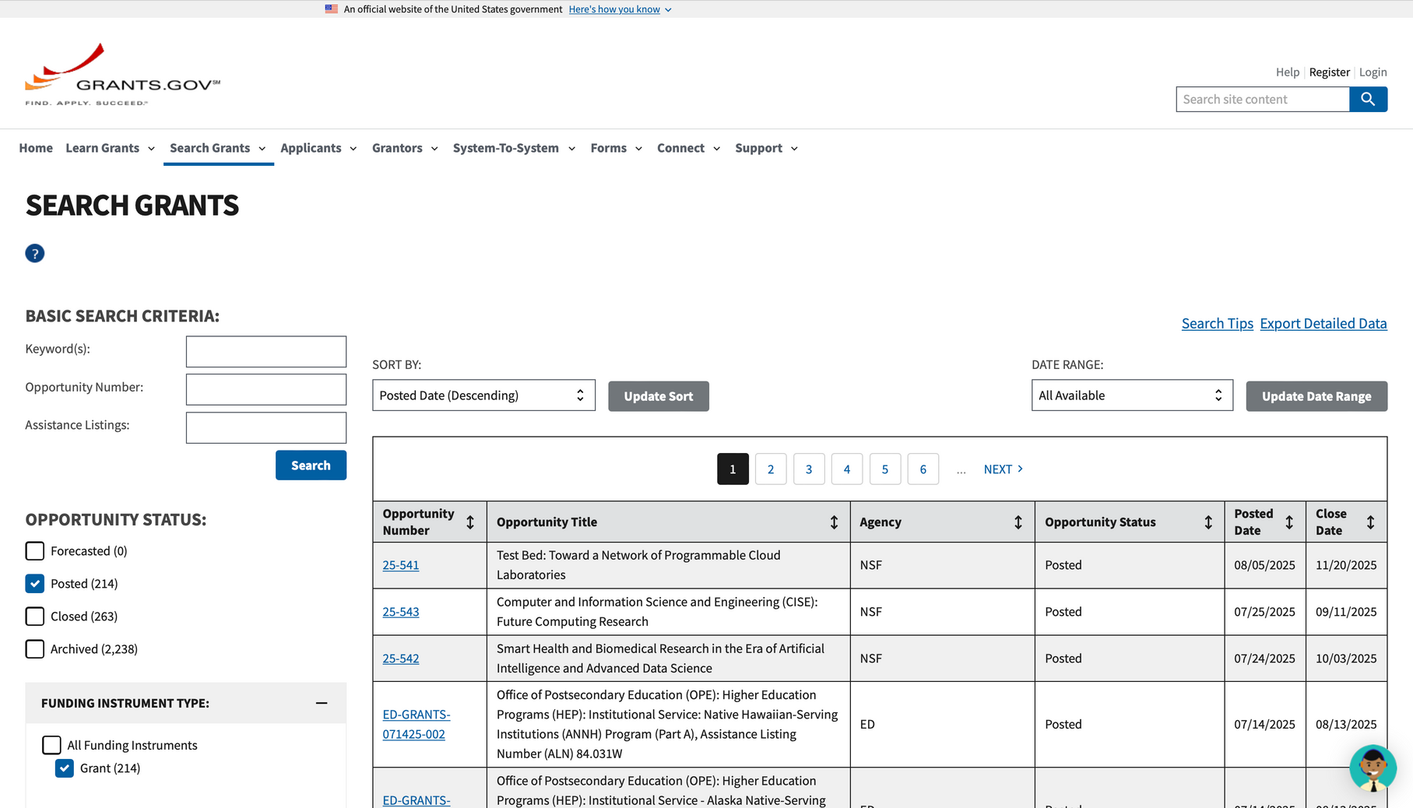

Grants.gov
SMC FOUNDATION GRANTS TRAINING | 2025
Notes:
Tracy/Nane
2-3 minute walk through grants.gov
classic search
select NSF, Education
https://grants.gov/search-grants

Slide 42




Funding Sources
Federal
State
County
Local
SMC FOUNDATION GRANTS TRAINING | 2025
Notes:
Section Break

Slide 43
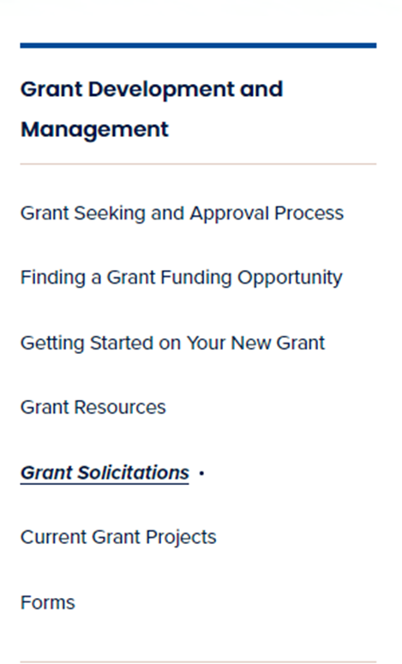
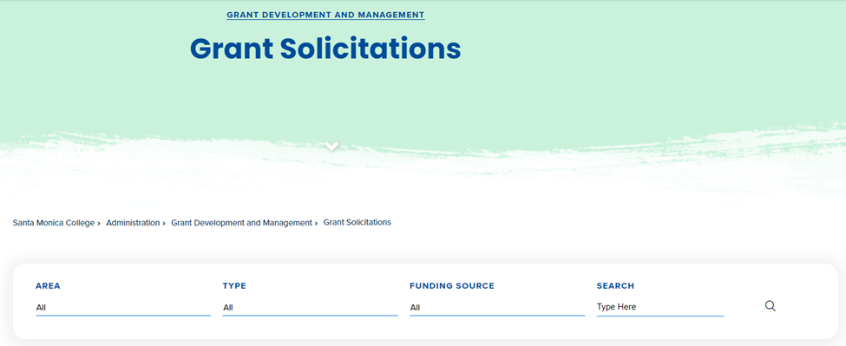
Grant Solicitations
SMC FOUNDATION GRANTS TRAINING | 2025
Notes:
NANE
Grant Solicitations
https://admin.smc.edu/administration/grant-development/grant-solicitations.php
Can be found on SMC Grants Office Website
Navigate to left panel
Click and are able to search by areas and or can filter by funder type.
Example walk through of an upcoming opportunity.

Slide 44

Audits
Each fiscal year the District is required to have an annual audit of its financial statements. The auditors' objectives are “to obtain reasonable assurance about whether the financial statements as a whole are free from material misstatement, whether due to fraud or error, and to issue an auditor’s report that includes our opinions.”
SMC FOUNDATION GRANTS TRAINING | 2025
Notes:
Tracy/Nane

Slide 45
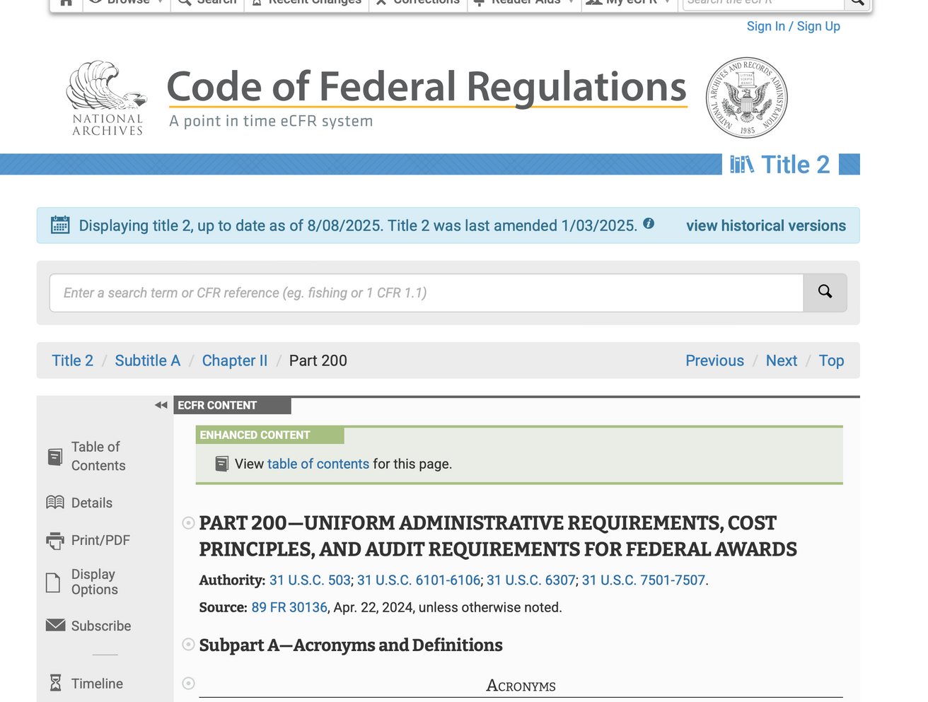
2 CFR PART 200 – Uniform Administrative Requirements, Cost Principles and Audit Requirements for Federal Awards
SMC FOUNDATION GRANTS TRAINING | 2025
Notes:
Tracy/Nane

Slide 46
Reminder - Sign in
Please use this QR code and enter your name and SMC email address.
Select from the list: Grant Writing 101
Thank you!
SMC FOUNDATION GRANTS TRAINING | 2025
Notes:
Tracy/Nane
Sign in sheet for PD day.
"In an effort to better track our metrics and measure impact, we have created sign in QR codes for each breakout session. Attendees only need to go to the form, enter their name and SMC email address, then select the workshop they are attending from a list of all workshops at that time slot"
In person can scan the QR code with phone and enter information.
Alonzo drop link into chat:
https://docs.google.com/forms/d/e/1FAIpQLSdCusAGMnnDUyOra16LH0NsamUmU6Opl8Q25vFRbgCWOqsLGQ/viewform

Slide 47


SMC FOUNDATION GRANTS TRAINING | 2025
Notes:
Nane to monitor Chat Box for Questions/Comments and will read aloud in order
TRACY & NANE responses to any questions
Q & A time last 5 minutes

Slide 48


Resources
SMC Grants Office Website
Grant Solicitations
SMC FOUNDATION GRANTS TRAINING | 2025
Notes:
Additional Resources
SMC Grants Office
SMC Solicitations Page

Slide 49



THANK YOU!
Contact Tracy Beidleman
310.434.4180 (Direct)
beidleman_tracy@smc.edu
Contact Nane Zadouri
310.434.4247 (Direct)
zadouri_nane@smc.edu
Come Visit Us! 1516 Pico Boulevard
SMC FOUNDATION GRANTS TRAINING | 2025
Notes:
Tracy/Nane
Thank you slide with contact information.
Please reach out for 1 on 1 and/or additional training requests.

