Slide 1



Grant Approval Process Workshop
Tracy Beidleman • Director of Grants
Nane Zadouri • Project Manager, Grants
May 16, 2025
SMC FOUNDATION GRANTS TRAINING | 2025

Slide 2

Participant Poll
SMC FOUNDATION GRANTS TRAINING | 2025

Slide 3


WHAT IS A GRANT?
A grant is:
  A way the federal, state, or local agency funds your ideas and projects
  A legal contract between the funding agency and the District
  Sets forth the terms and conditions of the award
If an individual, faculty, or staff member submits a grant proposal, or any contractual agreement, without approval of the College, by law they are fiscally liable for any amount awarded.
SMC FOUNDATION GRANTS TRAINING | 2025

Slide 4




WHO CAN APPLY?
Principal Investigator (PI):
  Defined as Faculty and Staff
  Responsible for preparing, conducting, and administering research grants, cooperative agreements, training or public service project, contract, or other sponsored projects
  Scientific or technical direction of the project
  Projects led by PI’s must have an Administrative Co-PI identified (includes College Dean, Director, or Project Manager)
  The Administrative Co-PI is responsible for the overall management of the project/program, completion of all required reports and deliverables, and who will serve as the primary technical point of contact
SMC FOUNDATION GRANTS TRAINING | 2025

Slide 5

ROLES & RESPONSIBILITIES
Project Manager/Principal Investigator
  Serves as the lead implementing the grant activities
  Coordinates all grant activities and ensures on time completion within budget
  Coordinates with the Grants Office and Fiscal Services through the life of the grant regarding scope changes, period of performance extensions and performance and expenditure reporting and other grant administration activities
Superintendent/President
  Represents the College as the Authorized Organizational Representative (AOR)
  Responsible for authorizing new grant applications and signing grant award agreements
  Approves and signs all subcontract agreements and any other formal grant documents
Director of Grants
  Serves as a designated AOR and submits grant proposals to funding sources
  Works closely with individuals in the development of grant proposals providing review and edits to applications
  Coordinates the pre-award and post award grant activities with the Grant Manager (i.e., Project Manager, Project Director or Principal Investigator)
SMC FOUNDATION GRANTS TRAINING | 2025

Slide 6
SMC’s Grant Approval Process
SMC FOUNDATION GRANTS TRAINING | 2025

Slide 7
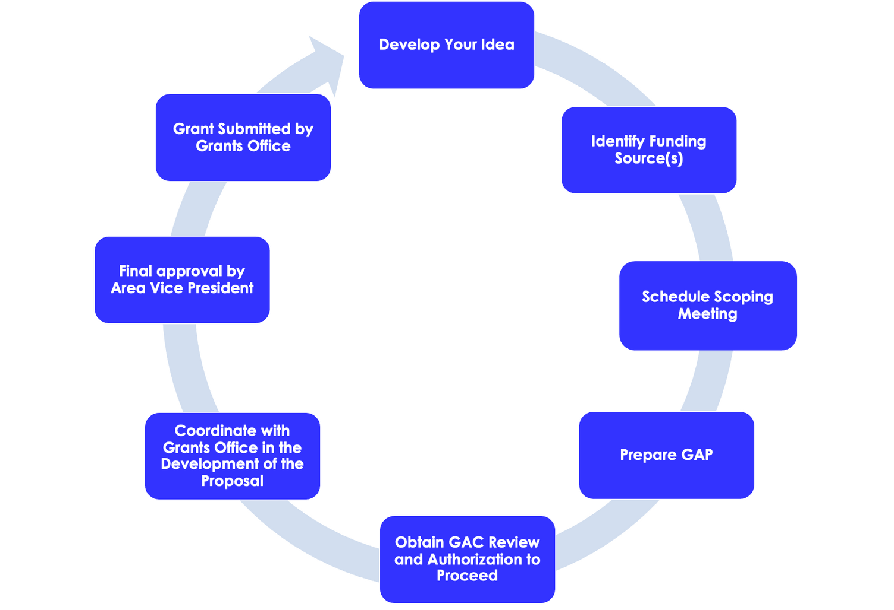
GRANT DEVELOPMENT PROCESS
SMC FOUNDATION GRANTS TRAINING | 2025

Slide 8
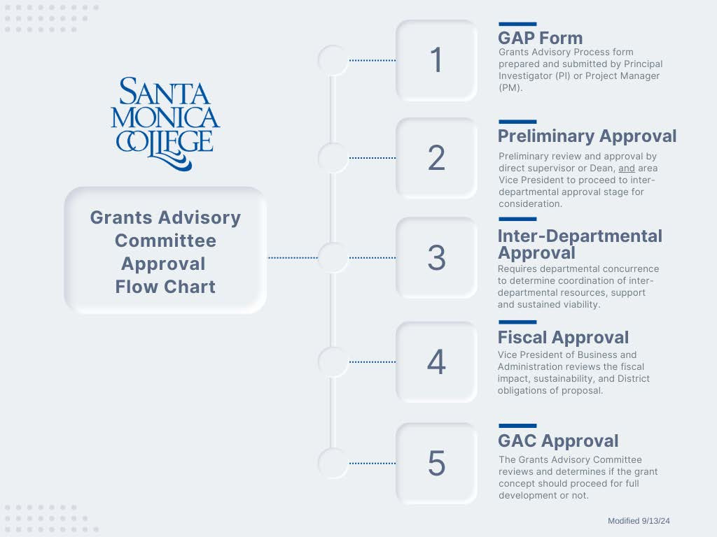



GRANTS ADVISORY COMMITTEE
Approval Flow Chart
SMC FOUNDATION GRANTS TRAINING | 2025

Slide 9
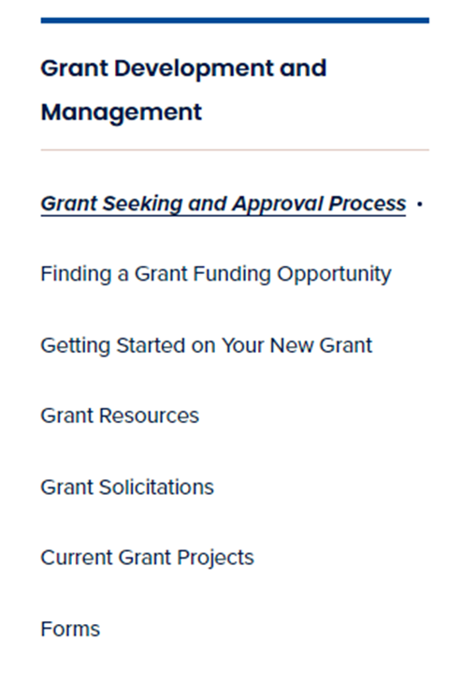

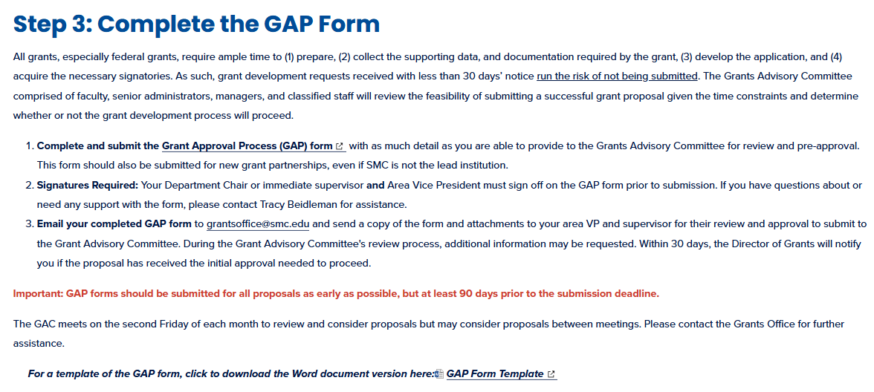

SMC GRANT-SEEKING PROCESS
Snapshot of SMC Website
SMC FOUNDATION GRANTS TRAINING | 2023
SMC FOUNDATION GRANTS TRAINING | 2025

Slide 10
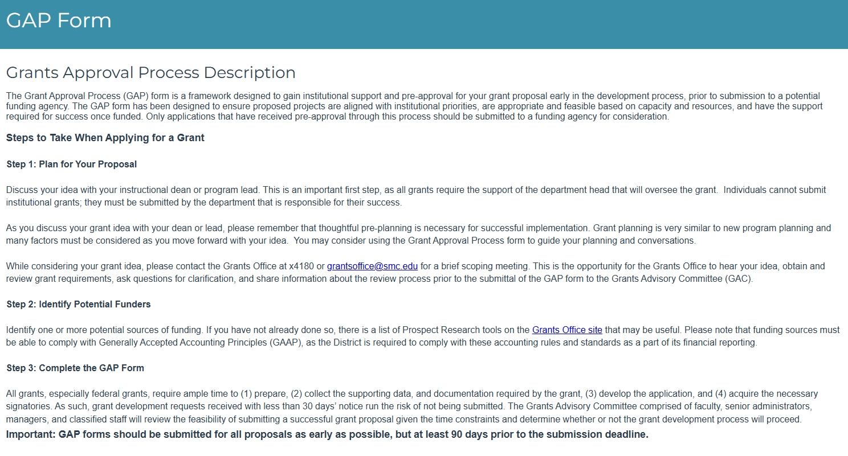

GRANT APPROVAL PROCESS FORM
SMC FOUNDATION GRANTS TRAINING | 2025

Slide 11

BUDGET DEVELOPMENT
Budget development for grants requires working with the Budget Department
  Contact: Veronica Diaz, ext. 4224
IMPORTANT UPDATES:
As of Spring 2025, all grant budgets must include (as allowed by the funder):
  Indirect Cost Rate (a de minimis rate) currently 15%
SMC FOUNDATION GRANTS TRAINING | 2025

Slide 12
GRANTS ADVISORY COMMITTEE
Approval Flow Chart
SMC FOUNDATION GRANTS TRAINING | 2025

Slide 13





REQUIRED DEPARTMENTAL CONCURRENCE
Considerations:
1. This project requires engagement with the department to fulfill the goals of the proposed project.
2. The department has the resources available to support this project and can incorporate the proposed grant activities into our current department priorities.
  ACCOUNTING/FISCAL
  MARKETING
  FACILITIES MAINTENANCE
  RISK MANAGEMENT
  HUMAN RESOURCES
  EQUITY, PATHWAYS, & INCLUSION
  INSTITUTIONAL RESEARCH
  GENERAL COUNSEL
  INFORMATION TECHNOLOGY
SMC FOUNDATION GRANTS TRAINING | 2025

Slide 14
GRANTS ADVISORY COMMITTEE
Approval Flow Chart
SMC FOUNDATION GRANTS TRAINING | 2025

Slide 15

Grant Advisory Committee
Dr. Kathryn E. Jeffery | Superintendent/President
Jason Beardsley | Vice President, Academic Affairs
Christopher Bonvenuto | Vice President, Business and Administration
Teresita Rodriguez | Vice President, Enrollment Development
Michael Tuitasi | Vice President, Student Affairs
Dr. Lizzy Moore | Foundation President/Dean, Institutional Advancement
Dr. Hannah Lawler | Dean, Institutional Research
Ruth Casillas | Interim Director, Business Development
Dr. Collin Ellis | Professor, Life Sciences
Sharyn Obsatz | Professor, Communications
The GAC meets monthly and/or as needed.
SMC FOUNDATION GRANTS TRAINING | 2025
SMC FOUNDATION GRANTS TRAINING | 2025

Slide 16
Grant Opportunities
SMC FOUNDATION GRANTS TRAINING | 2025

Slide 17
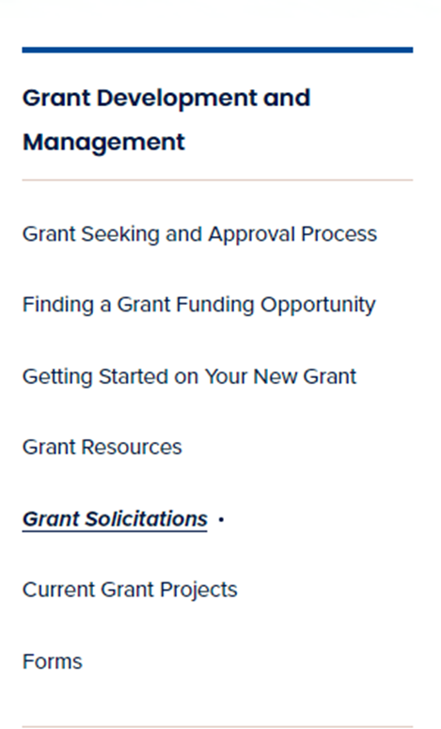
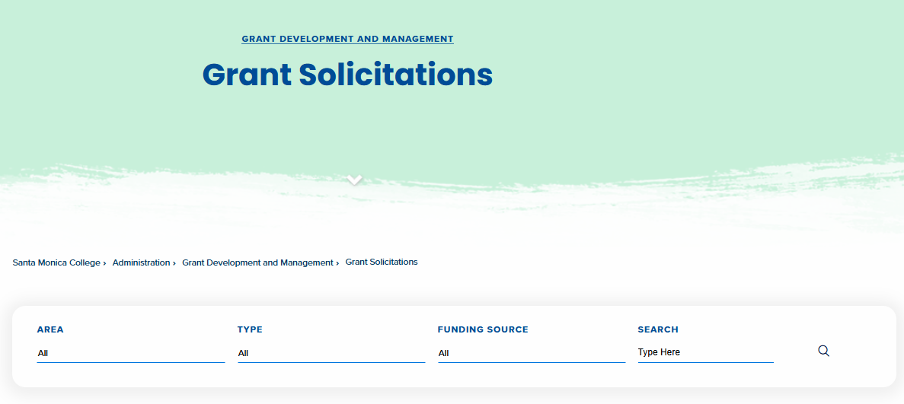
GRANT SOLICITATIONS
SMC FOUNDATION GRANTS TRAINING | 2025

Slide 18



You are now on your way...
SMC FOUNDATION GRANTS TRAINING | 2025

Slide 19
Participant Poll
SMC FOUNDATION GRANTS TRAINING | 2025

Slide 20

SMC FOUNDATION GRANTS TRAINING | 2025

Slide 21

RESOURCES
SMC Grants Office Website
GAP Form
Grant Solicitations
SMC FOUNDATION GRANTS TRAINING | 2025

Slide 22



THANK YOU!
Contact Tracy Beidleman
310.434.4180 (Direct)
beidleman_tracy@smc.edu
Contact Nane Zadouri
310.434.4247 (Direct)
zadouri_nane@smc.edu
Come Visit Us! 1516 Pico Boulevard

