Slide 1


Thursday, March 16, 2023
Kathryn E. Jeffery, Ph.D., Superintendent/President

Slide 2


Slide 3
William Augustine ~ Part-time Faculty, Music ~ 4/15/2022
Barbara Baird ~ Full-time Faculty, Communication ~ 8/1/2021
Donald Battle ~ Full-time Faculty, Photography & Fashion ~ 9/1/2022
Paul Dennis Bice ~ Warehouse & Mail Services Supervisor, Procurement, Contracts & Logistics ~ 7/17/2021
Michael Brandt ~ Full-time Faculty, Transportation Technology ~ 8/14/2022
Ernest Buchholz ~ Full-time Faculty, Social Sciences ~ 8/22/2021
Wayne Burrell Sr ~ CC Prkg Enforcement Officer, Campus Police ~ 1/19/2022
Nancy Cattell ~ Board Member, Board of Trustees ~ 12/30/2021
Carol Chamberlin ~ Full-time Faculty, Psychology ~ 5/7/2022
Elizabeth Chris ~ Cash Receipts Coordinator, Cashier's Office ~ 4/21/2022
Edward Cisneros ~ CC Parking Enforcement Officer, Campus Police ~ 4/22/2021
Clifton Clarridge ~ Full-time Faculty, Mathematics ~ 9/12/2022
Dontraneil Clayborne ~ Part-time Faculty, History ~ 9/14/2022
Clarence Cooper ~ Full-time Faculty, Communication ~ 6/18/2021
James Croxton ~ Full-time Faculty, Psychology ~ 11/18/2021

Slide 4
Barbara D’angelo ~ Cash Receipts Coordinator, Bursar's Office ~ 12/20/2020
Ronald Davis ~ Full-time Faculty, Art ~ 10/7/2020
Thomas Donner ~ President, Superintendent/President ~ 1/20/2021
Arnold Doty ~ Full-time Faculty, Construction Technology ~ 11/1/2020
John Duganne ~ Part-time Faculty, Design Technology ~ 4/12/2020
Dorothy Ehrhart-Morrison ~ Board Member, Board of Trustees ~ 6/18/2020
William Elliot ~ Part-time Faculty, Emeritus ~ 8/16/2020
Allison Fujii ~ Part-time Faculty, Counseling ~ 1/2/2021
Diane Gross ~ Full-time Faculty, CSIS ~ 12/2/2022
Loann Haegele ~ Full-time Faculty, Health Science ~ 9/28/2022
Peter Hansen ~ Facilities Services Administrator, Facilities ~ 4/7/2021
Edwin Harte ~ Dir. of Auxiliary Services, Auxiliary Services ~ 5/30/2020
Erma Hashaway ~ EOPS Program Specialist, EOPS ~ 3/15/2022
James Hawkins ~ Full-time Faculty, Social Sciences ~ 7/27/2021
Joan Healy ~ Full-time Faculty, Health Science ~ 4/3/2020

Slide 5
Philip Hendricks ~ Payroll Specialist, Fiscal Services ~ 1/19/2022
Edward Hernandez ~ Custodian, Operations ~ 12/6/2020
Harry Johnson ~ Part-time Faculty, Communication ~ 7/9/2021
Janie Jones ~ Full-time Faculty, Theatre Arts ~ 1/27/2021
Robert Juarez ~ Gardener-Equip Operator, Grounds ~ 4/19/2022
David Kaplan ~ Full-time Faculty, Social Sciences ~ 2/24/2022
Carmen Koebel ~ Reprographics Oper II, Media Center/Graphic Center ~ 12/27/2020
Donald Krehbiel ~ Administrator, MIS ~ 7/5/2021
Jasmine Lieb ~ Part-time Faculty, Emeritus ~ 1/29/2021
Alvin Lyles ~ Full-time Faculty, Music ~ 6/15/2020
Ann Maddox ~ Full-time Faculty, Disabled Students Center ~ 8/7/2022
Tommy Martinez ~ Rec, Stockroom & Delivery Worker, Bookstore ~ 2/7/2021
Janet McKay ~ Full-time Faculty, CSIS ~ 9/16/2021
Diane McLaughlin ~ Part-time Faculty, Life Science ~ 11/4/2020
Robert McMullen ~ Full-time Faculty, Athletics ~ 8/19/2022

Slide 6
Ian Mitchell ~ Stage Construction Technician, Theater Arts/Dance ~ 12/21/2022
David Muller ~ AVP Facilities, Facilities ~ 10/29/2020
Gordon Newman ~ Administrative Dean, Admissions & Records ~ 3/24/2022
Danny O'Fallon ~ Part-time Faculty, Kinesiology ~ 1/9/2020
Odis Oliver ~ Custodian, Operations ~ 1/3/2022
Jackelyne Portal-Purdy ~ Administrative Assistant II, Academic Affairs ~ 12/31/2020
Belinda Ramos ~ Administrative Assistant II, Facilities ~ 8/5/2121
Eleanor Reich ~ Part-time Faculty, Emeritus ~ 5/1/2120
Aurora Sealana ~ Lead Library Assistant-Circulation, Library ~ 11/17/2021
Clyde Smith ~ Part-time Faculty, Communication ~ 11/24/2020
Joseph Smith ~ Rec, Stockroom & Delivery Worker, Bookstore ~ 4/10/2021
Lyle Stevenson ~ Full-time Faculty, Transportation Technology ~ 3/16/2021
Edith Tesdahl ~ Administrative Assistant I, Business ~ 5/5/2020
Bruce Tomkinson ~ Full-time Faculty, Art ~ 4/1/2022
Wallace Umber ~ Part-time Faculty, Emeritus ~ 1/28/2021

Slide 7
Natividad Vazquez ~ Student Services Specialist, EOPS ~ 9/18/2020
Nani Vigil ~ Sign Language Interpreter III, Disabled Students Center ~ 10/30/2022
Richard Wohlgemuth ~ Full-time Faculty, Physical Science ~ 6/29/2021
Chris Young ~ Academic Records Evaluator, Admissions & Records ~ 11/16/2021
Bruce Young ~ Full-time Faculty, Earth Science ~ 12/19/2021
Donna Zelaya ~ Dept Secretary II, Operations ~ 4/26/2022
Information Courtesy of Lugina Rogers / Human Resources

Slide 8



Slide 9

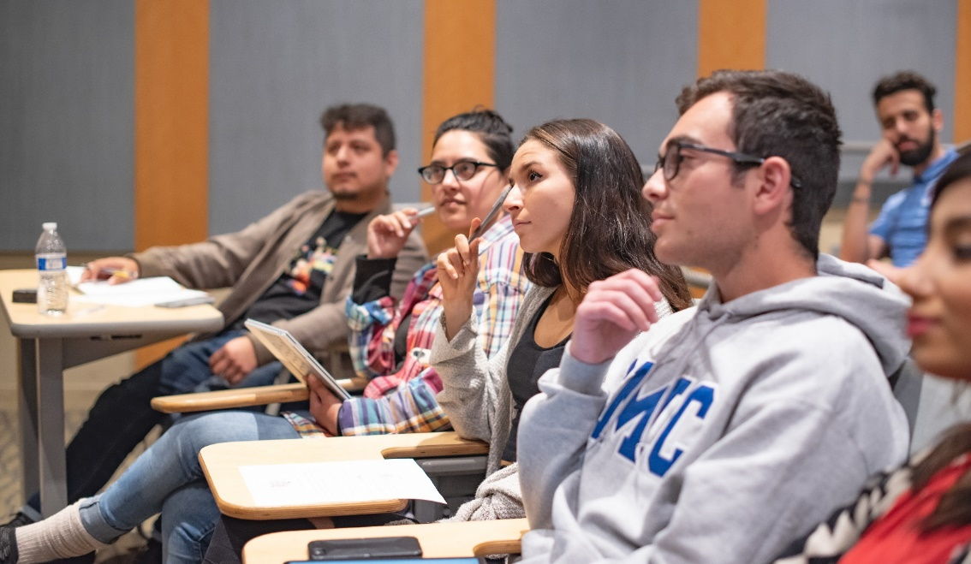

Slide 10


Slide 11
A FEW HIGHLIGHTS….
…Fall 2023-Present

Slide 12
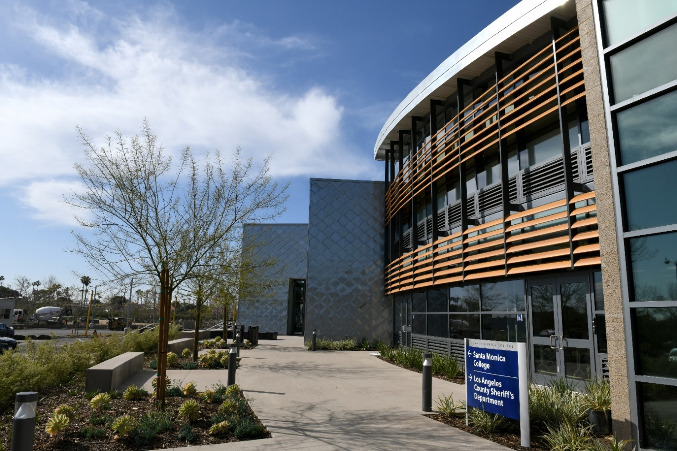
SMC Malibu is Open!

Slide 13
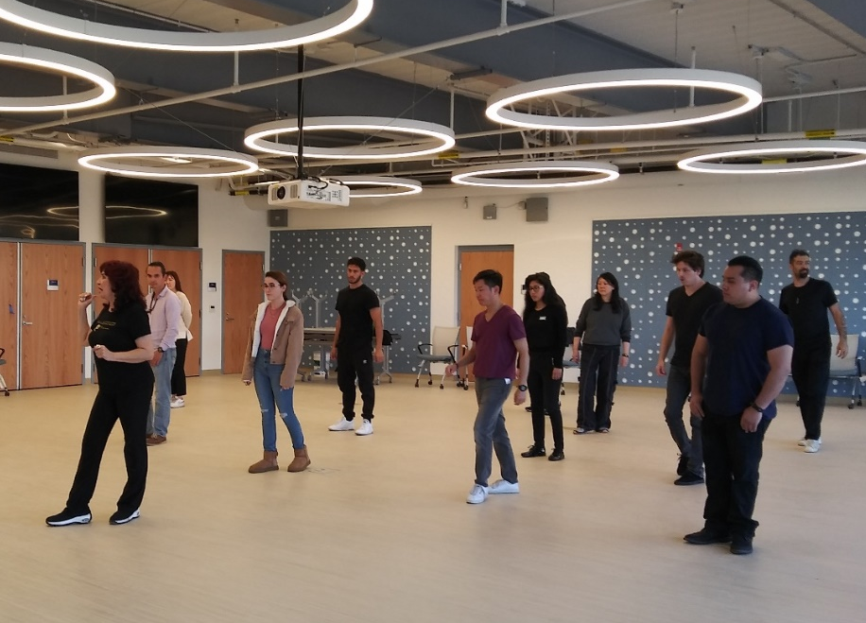
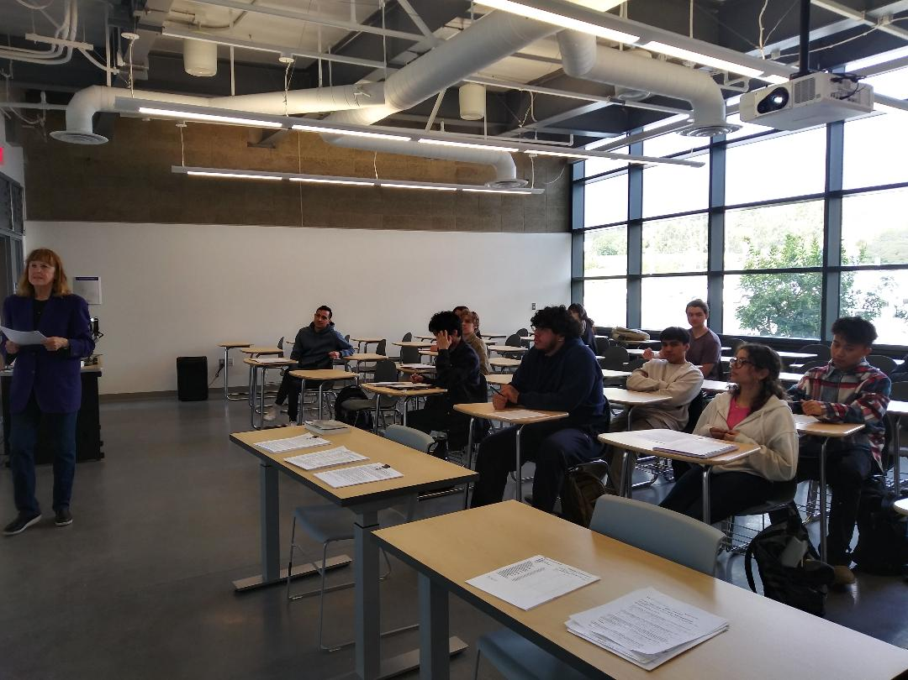
(L-R) A Salsa Class and an English Class at SMC Malibu
Photo Credit: Carla Brown, Media Resources Asst., SMC Malibu

Slide 14
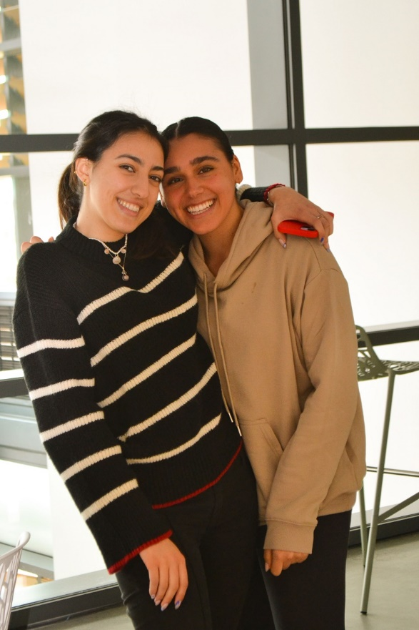
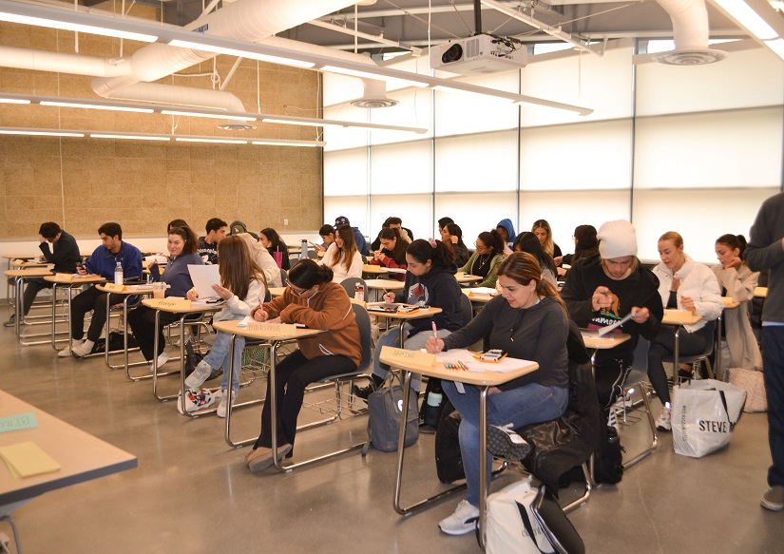
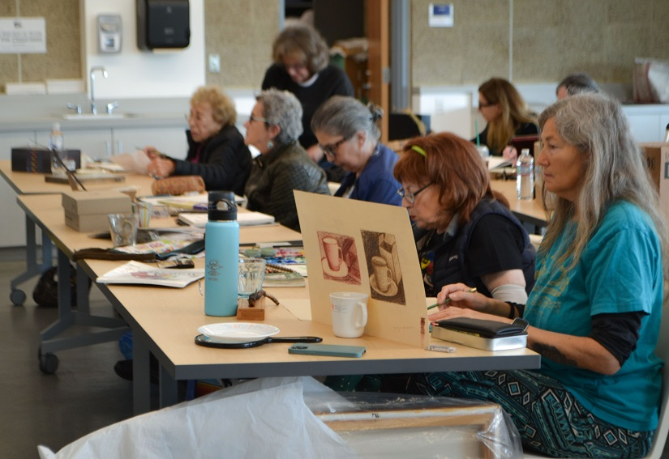
(L-R) A Math Class, students in the Lounge Area, and an Emeritus Drawing Class at SMC Malibu.
Photo Credit: Carla Brown, Media Resources Asst., SMC Malibu

Slide 15


Slide 16
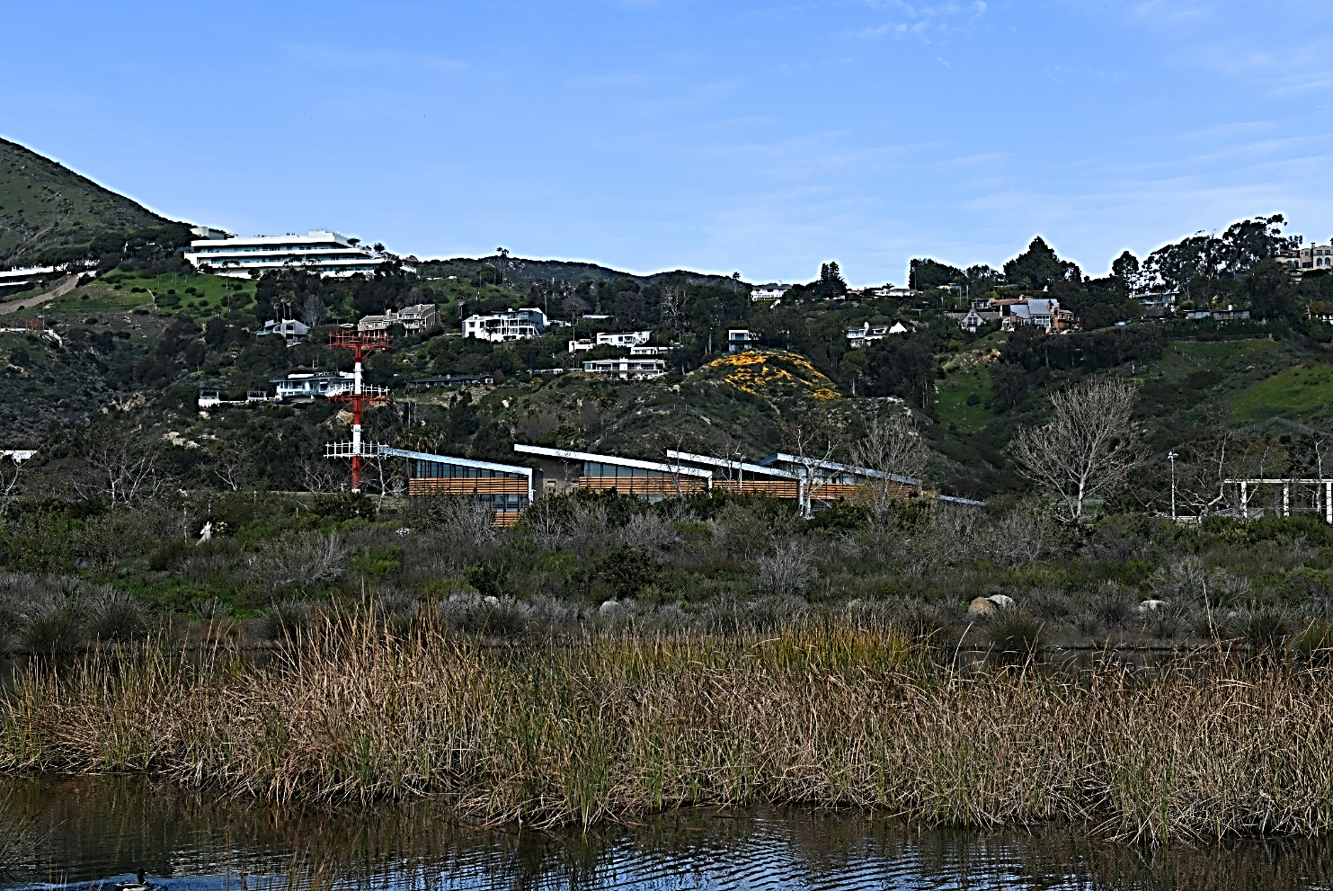

Slide 17
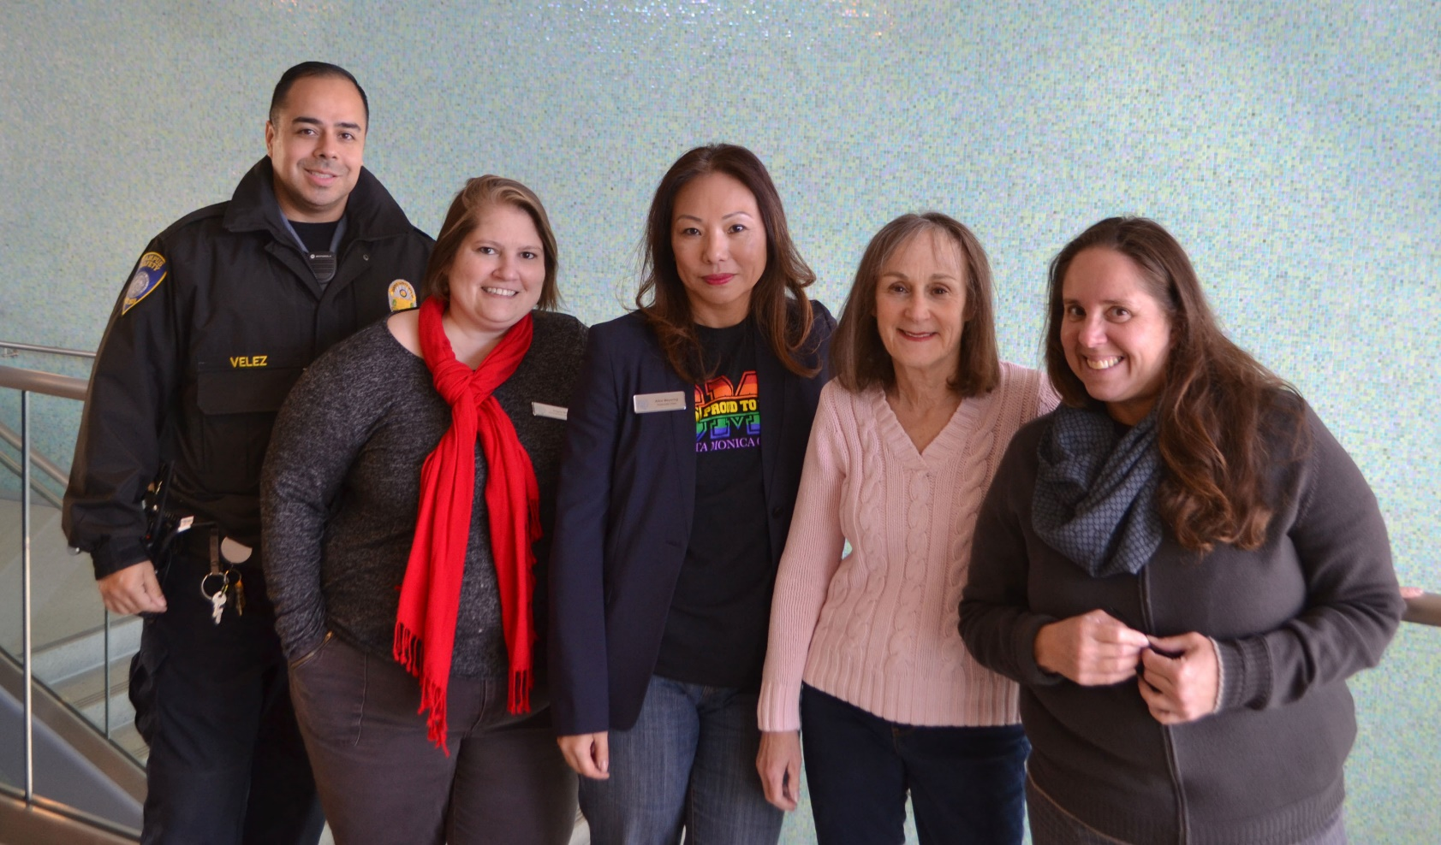
The SMC Malibu Team (L-R): Sergio Velez, Campus Security Officer;
Angela Bice, Administrative Assistant II; Alice Meyering, Associate Dean;
Janet Kleinman, Student Services Specialist; Carla Brown, Media Resource Assistant.

Slide 18



Slide 19




Slide 20
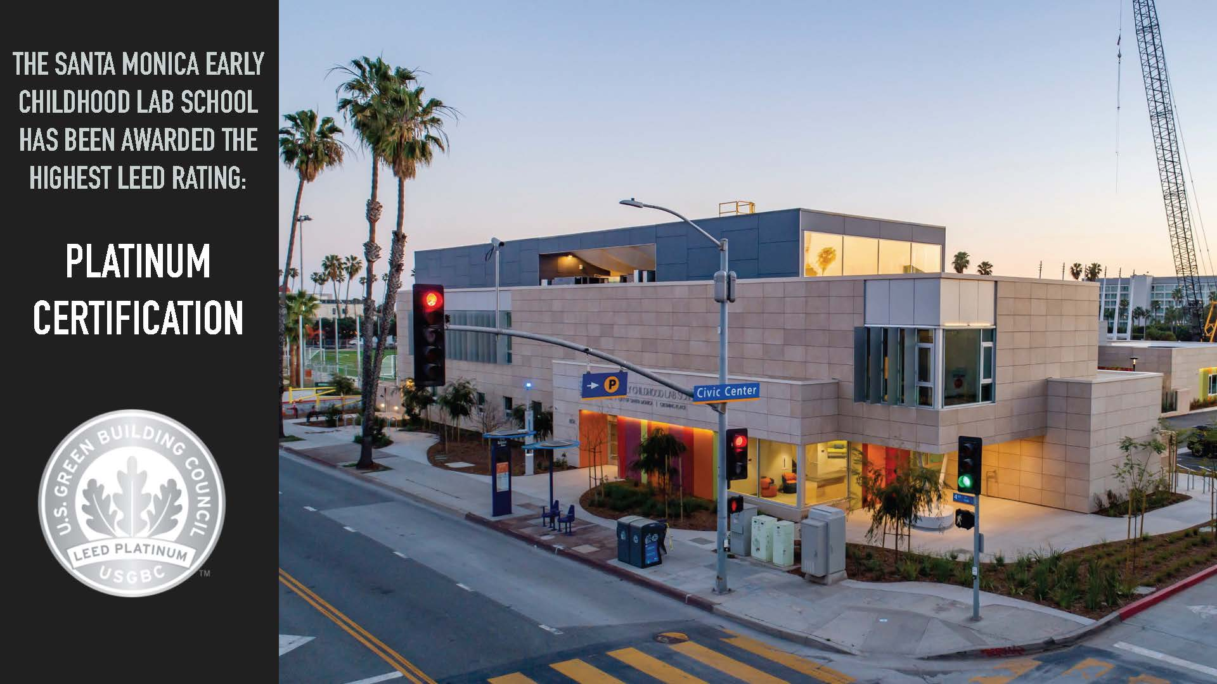

Slide 21
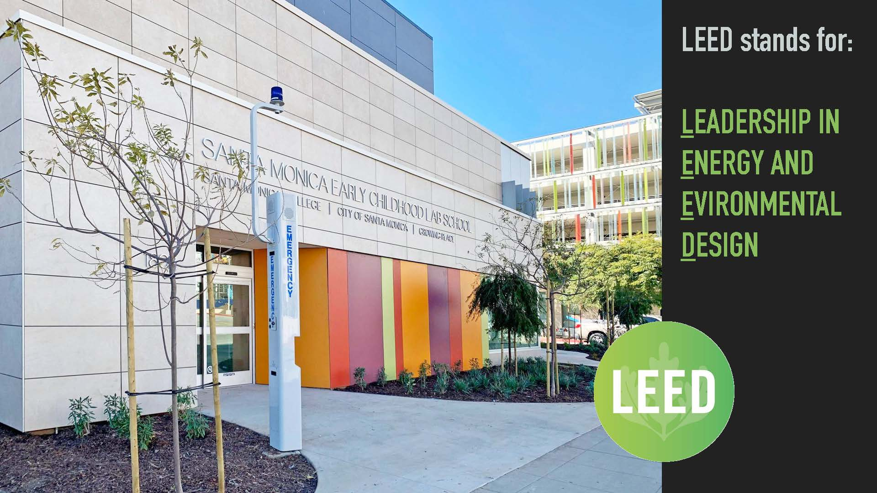

Slide 22


Slide 23


Slide 24

Save the Date!
College-wide ACCJC Open Forum (Online):
March 21 & March 28, 3pm – 4pm

Slide 25
Special thanks:
Accreditation Liaison Officer and Co-Chair Dr. Dione Carter;
Jamar London, Co-Chair;
and Co-editors George Davison and Mitch Heskel.
Also: Warren Cancilla (formatting expertise) & Dr. Hannah Lawler and
Elisa Meyer (leading Quality Focused Essay).

Slide 26
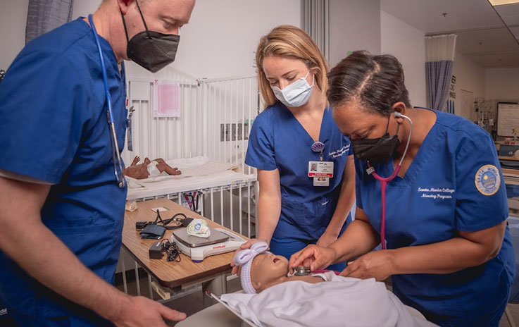
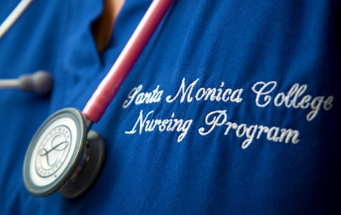
SMC Nursing Reaccredited Until 2030!
By the California State Board of Nursing & the Accreditation Commission for Education in Nursing.

Slide 27
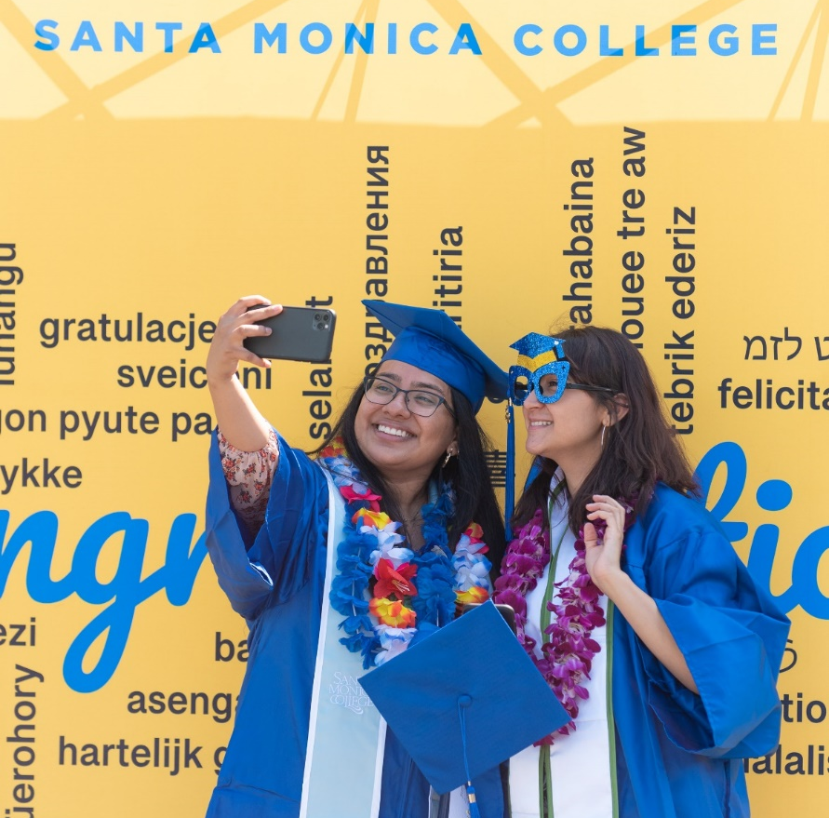
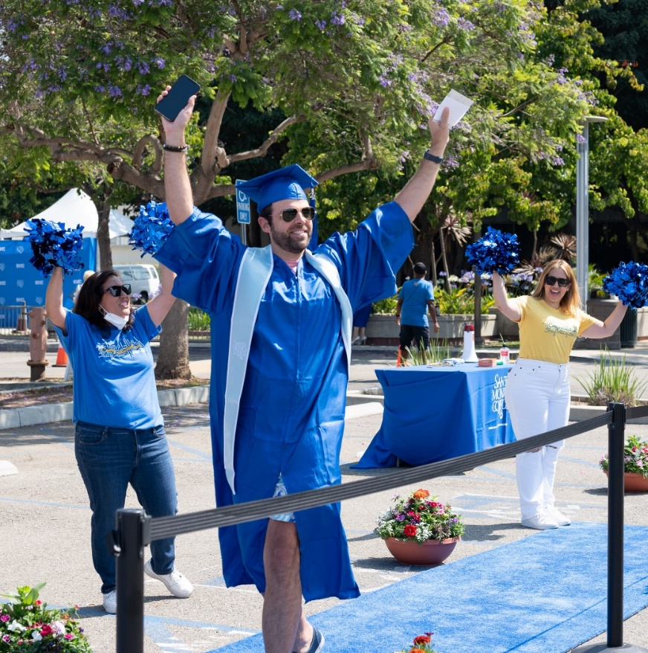

Slide 28
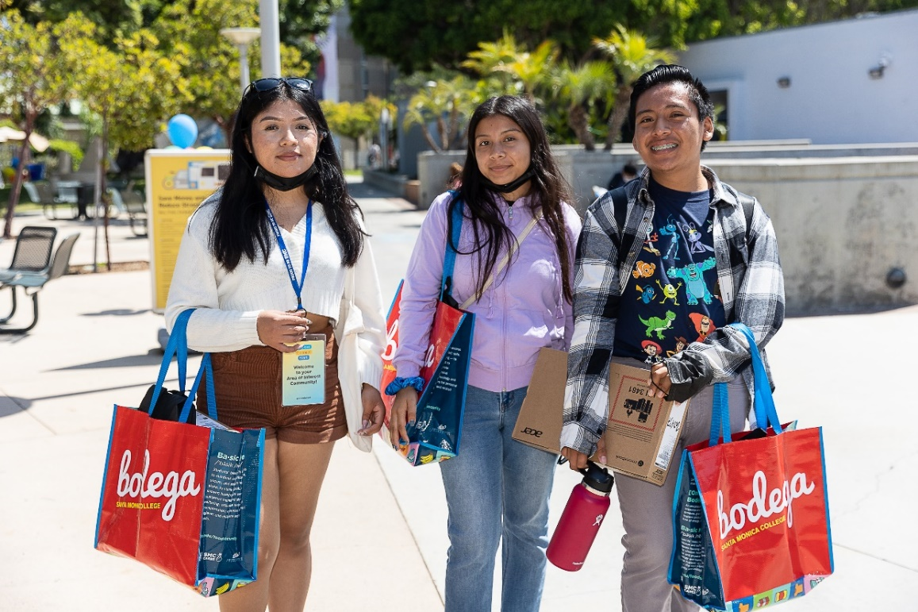
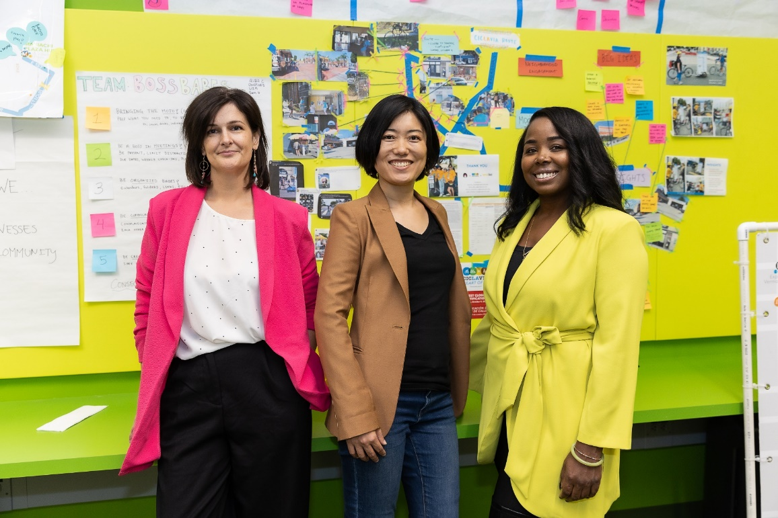

Slide 29
