Slide 1

Back to Basics &
an SMC Update
Fall 2022 Opening Day | August 25, 2022
Dr. Kathryn E. Jeffery, Superintendent/President

Slide 2


Slide 3


Slide 4
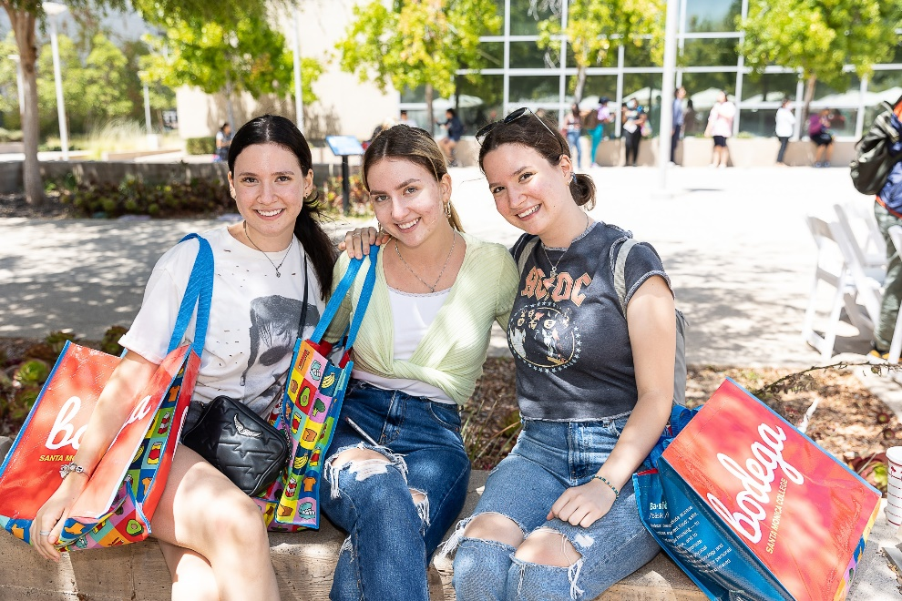
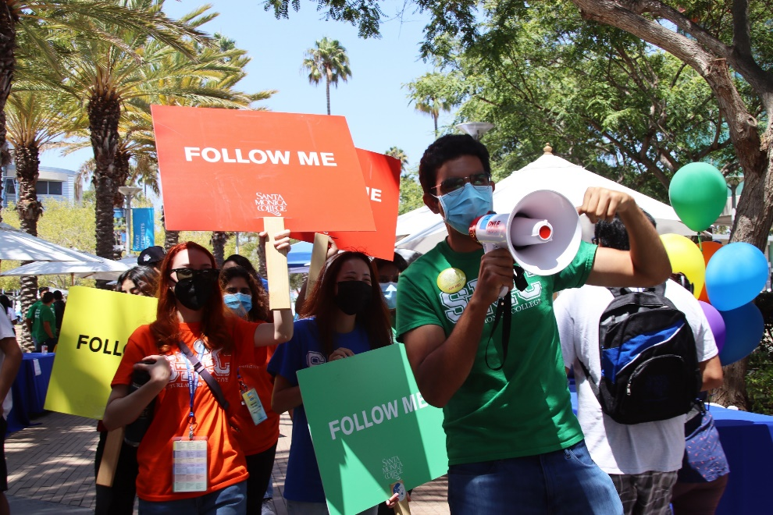
VIP Welcome Day 2022

Slide 5
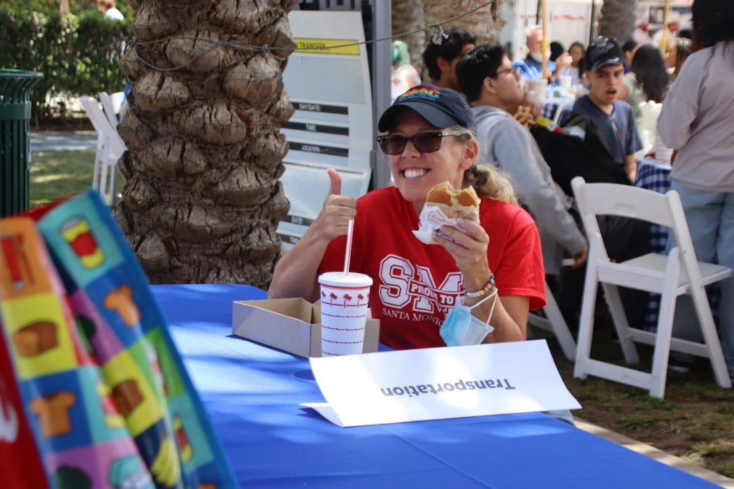
Thank you,
VIP Welcome Week Planning Team!
Kiersten Elliott
Maria Bonin
Aaron Delatorre
Christina Marcial
Estela Ruezga
Febe Soliman
J.R. Stevenson
Carolina Trejo
Mark Engfer, Brant Looney, Matt Wong and the team from IT
Alice Gheorghiu, Wendy Liu, Meredith Ouwersloot, and MIS
Elease Juarez and the SMC Bookstore team
Maintenance and Operations, Grounds and Facilities teams
Walter Meyer and the Art Department

Slide 6
Special additional thanks to the following:
Thomas Bui |  | Sharlyne Massillon
Tessa Cavenah |  | Pressian Nicolov
Aaron French |  | Stuart Ortiz
Denise Henninger |  | Thaddeus Phillips
Jose Hernandez |  | Vicki Rothman
Stacey Jones |  | Scott Silverman
Ferris Kawar |  | Deirdre Weaver
Maria Martinez |  | Matt Wong

Slide 7
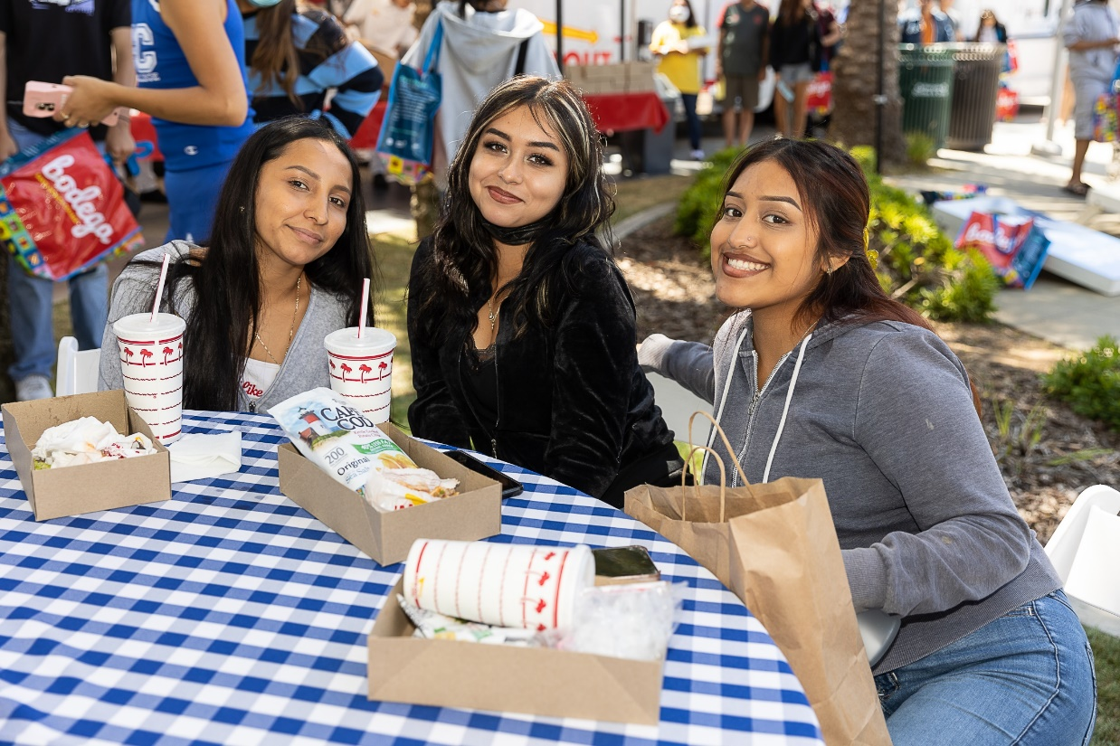
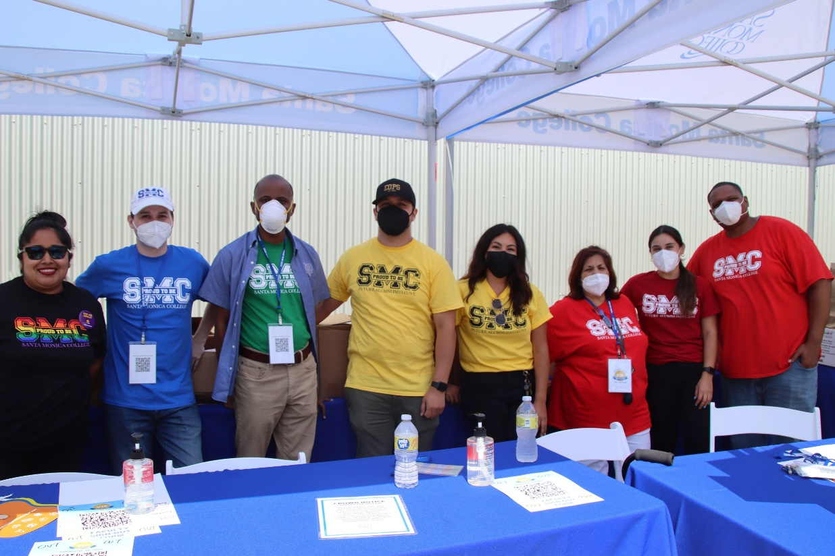

Slide 8
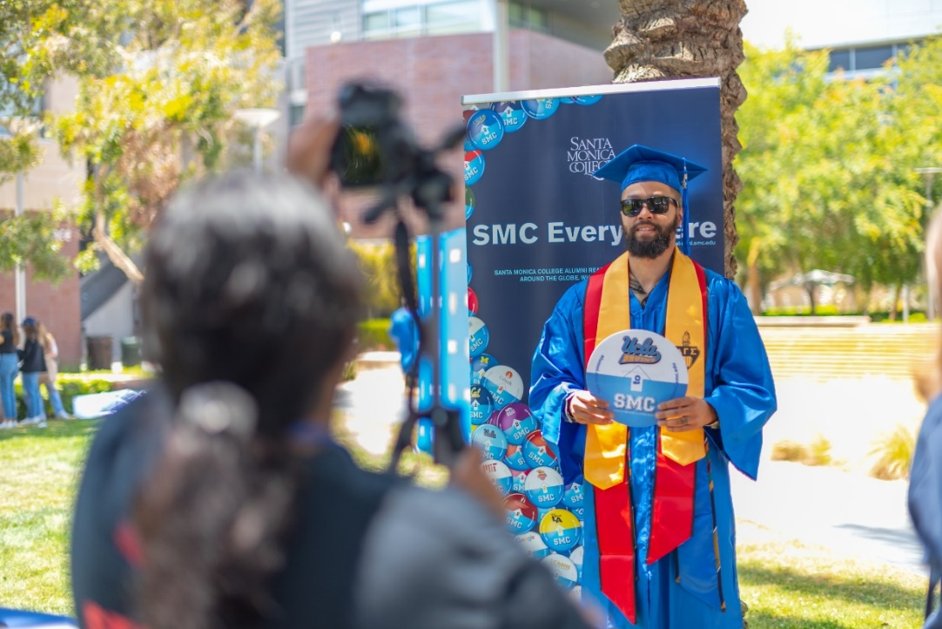
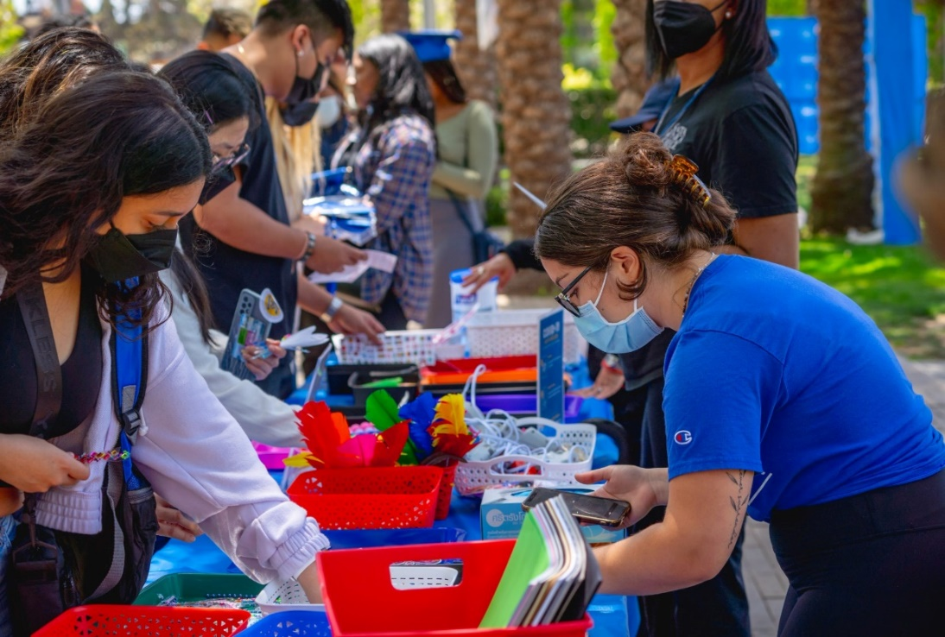
Grad Fest 2022

Slide 9
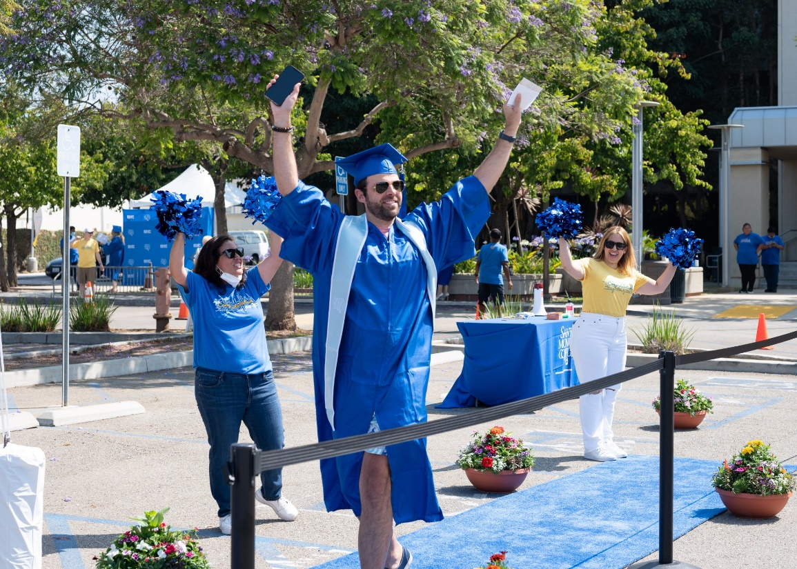
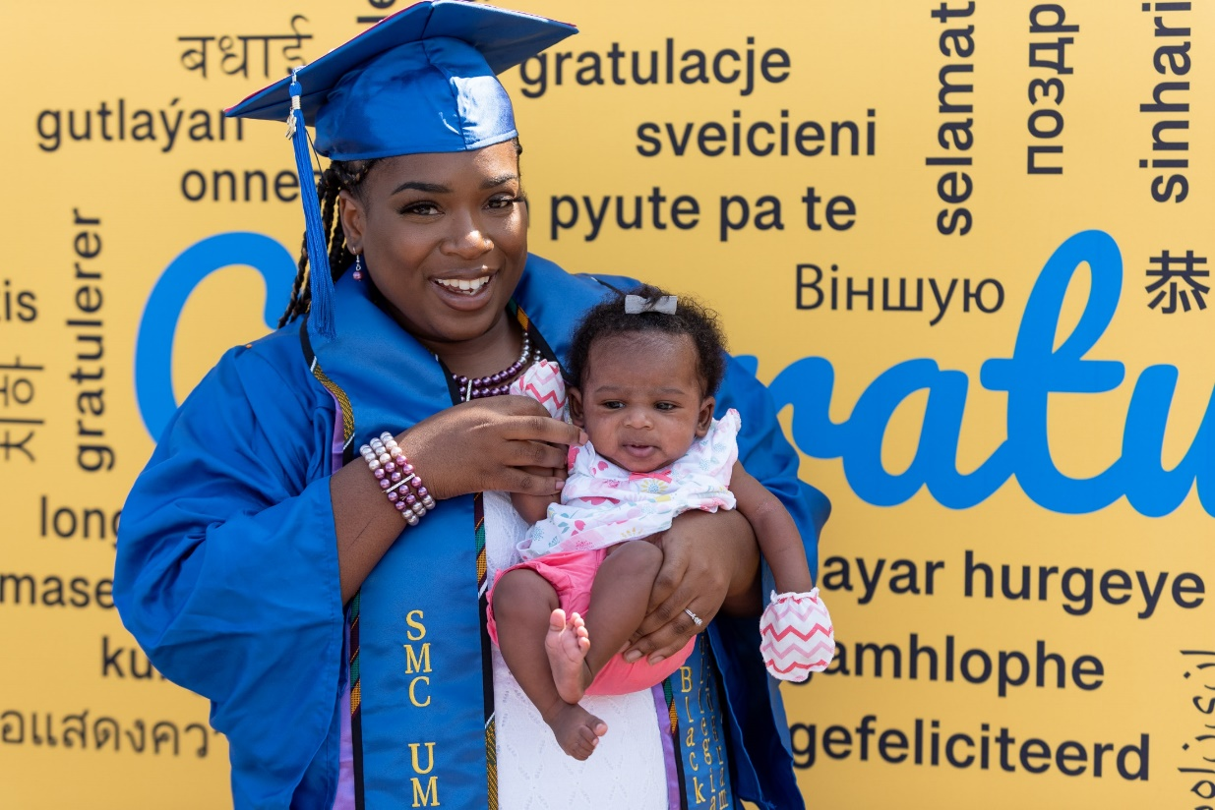
Grad Walk

Slide 10
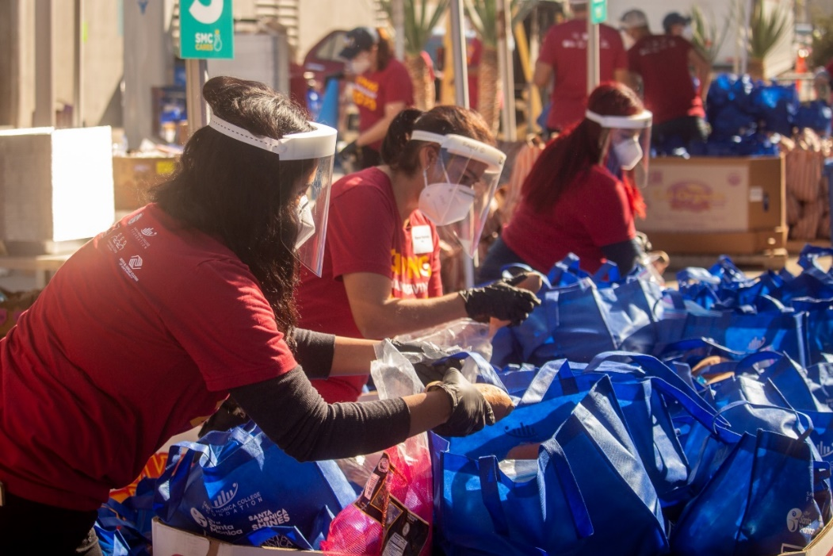
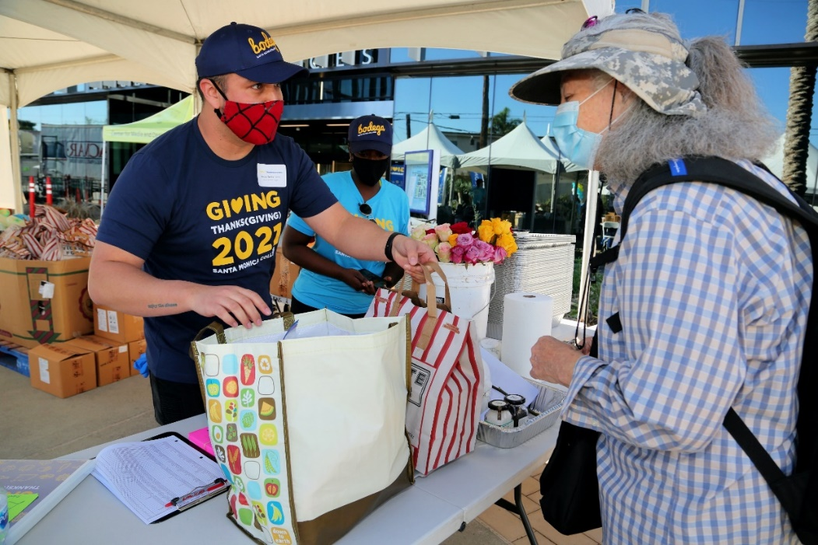
Giving (Thanks)giving 2021

Slide 11
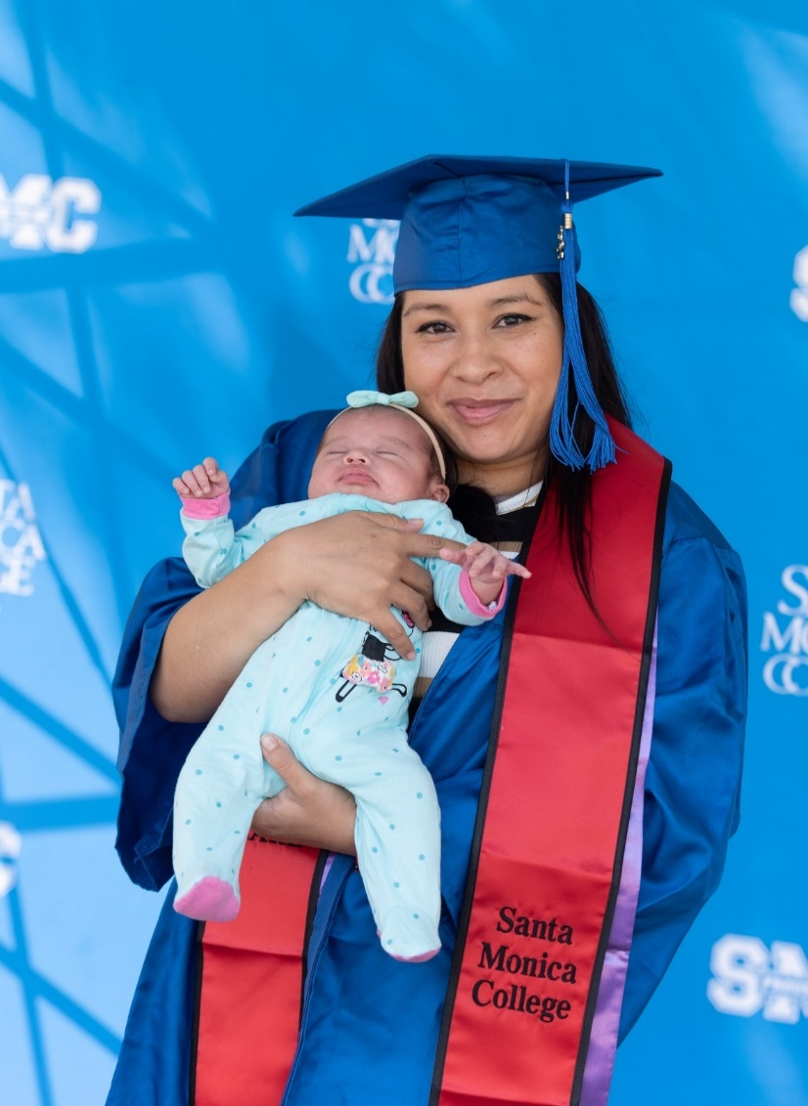
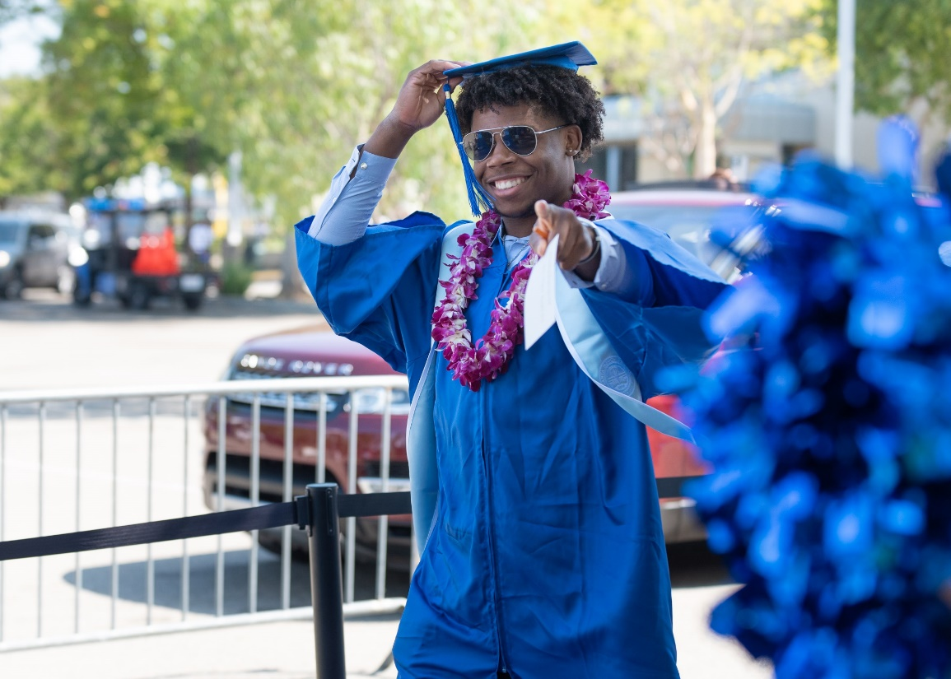

Slide 12

SMC Board Rescinds Mandatory COVID-19 Vaccination Program (Aug. 16, 2022)

Slide 13
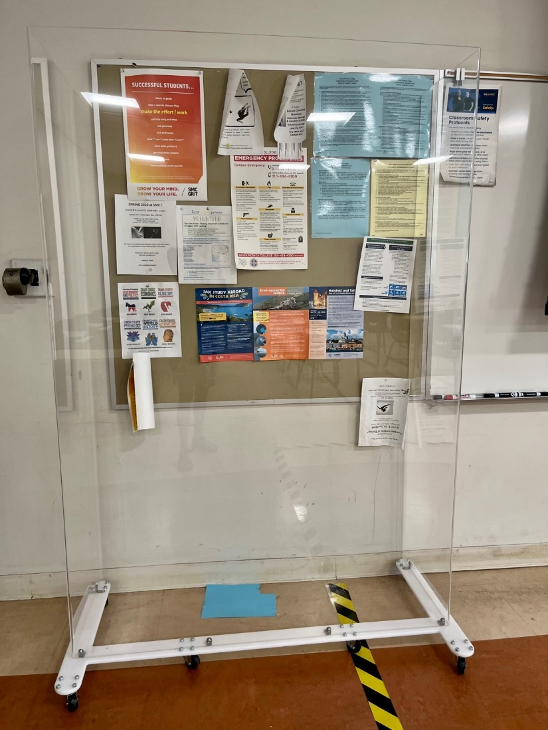
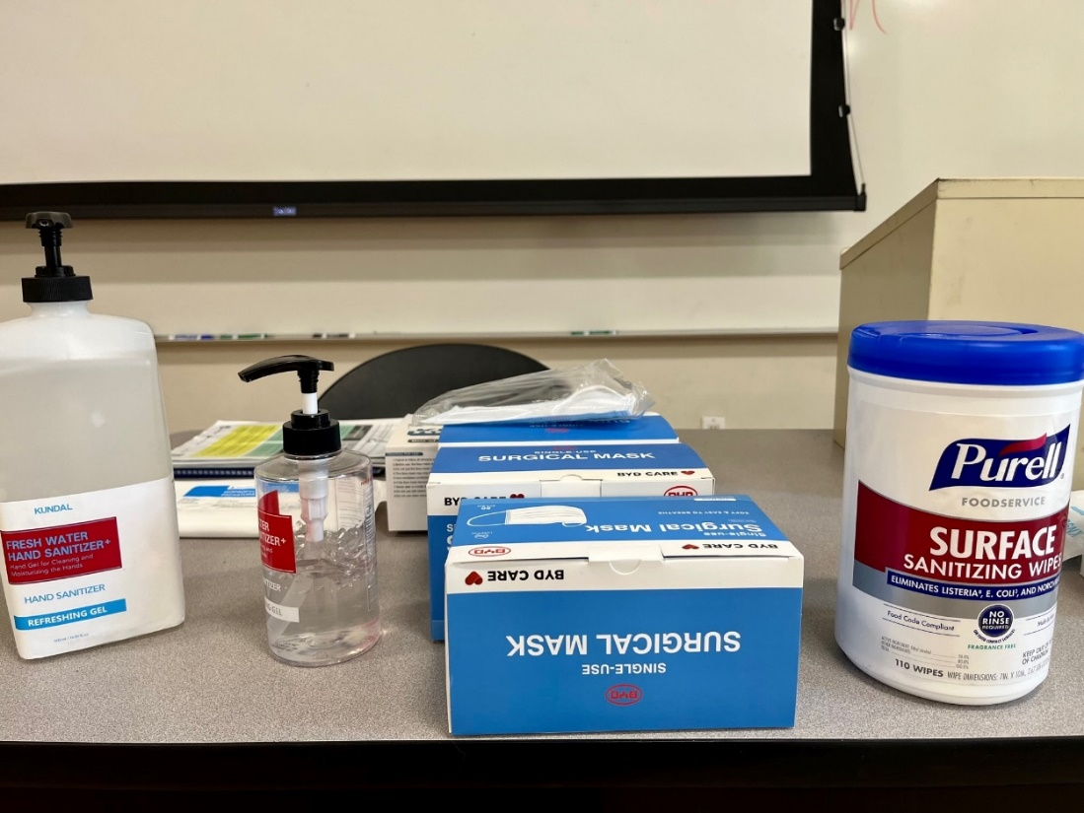

Slide 14
This fall semester:
49 percent of classes are on-ground, including hybrid classes,
and 51 percent are online.
14,000 unduplicated students*
*as of Aug. 23, 2022

Slide 15
Six HyFlex Classrooms!
HSS 151
HSS 251
HSS 263
BUS 144
CPC 216
SCI 159

Slide 16
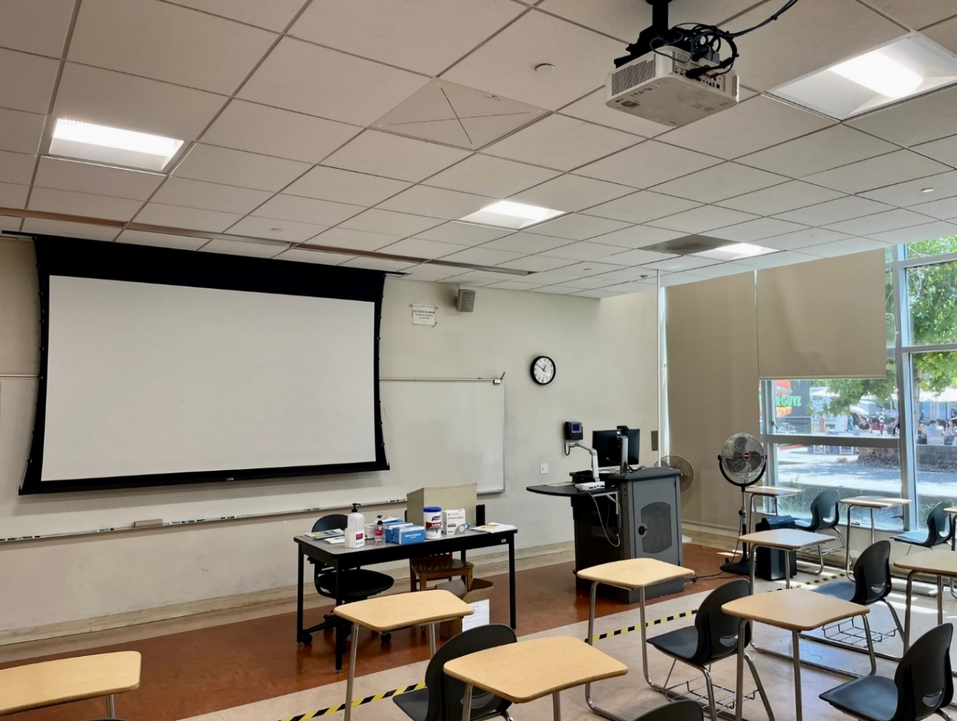
A HyFlex Classroom at SMC

Slide 17
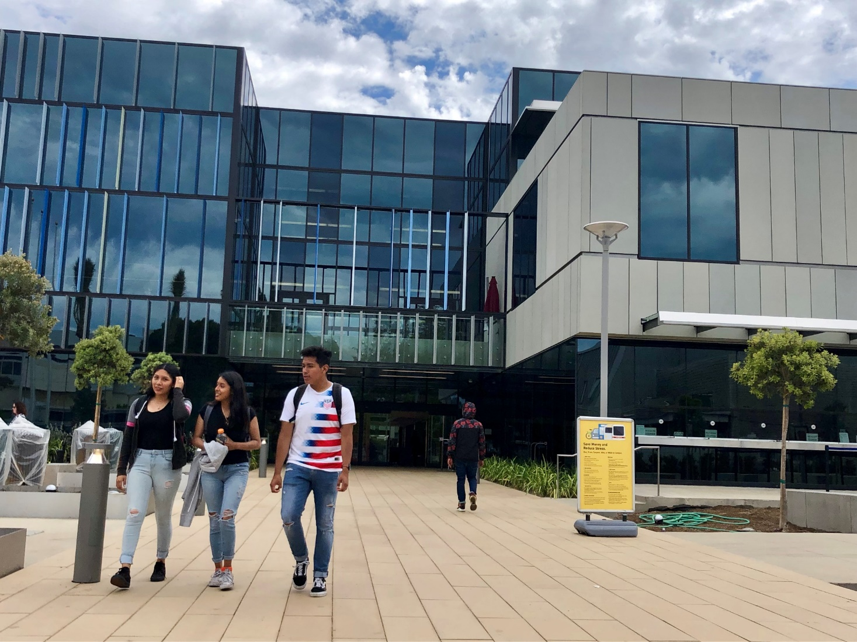

Slide 18
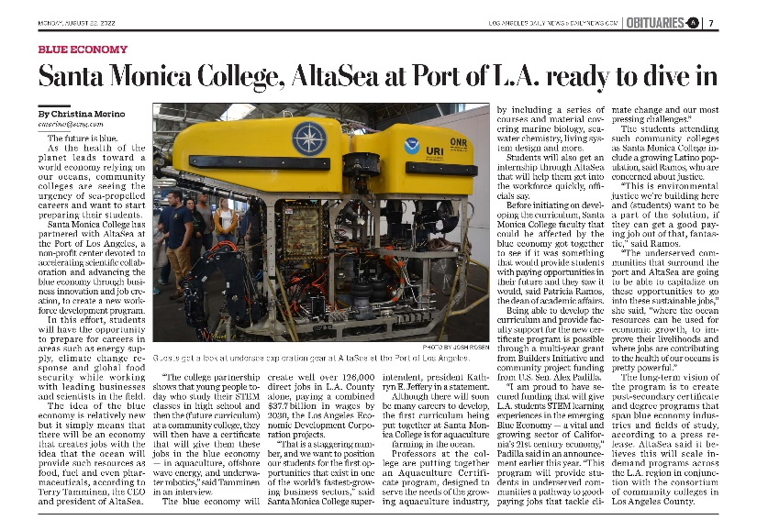

Slide 19
SMC Aquaculture Faculty!
Nathan Churches (faculty program lead)
Eric Minzenberg
Lisa Collins
Dana Nasser
Keith Everett
Katya Rodriguez
Alex Tower
Garen Bahgdasarian

Slide 20
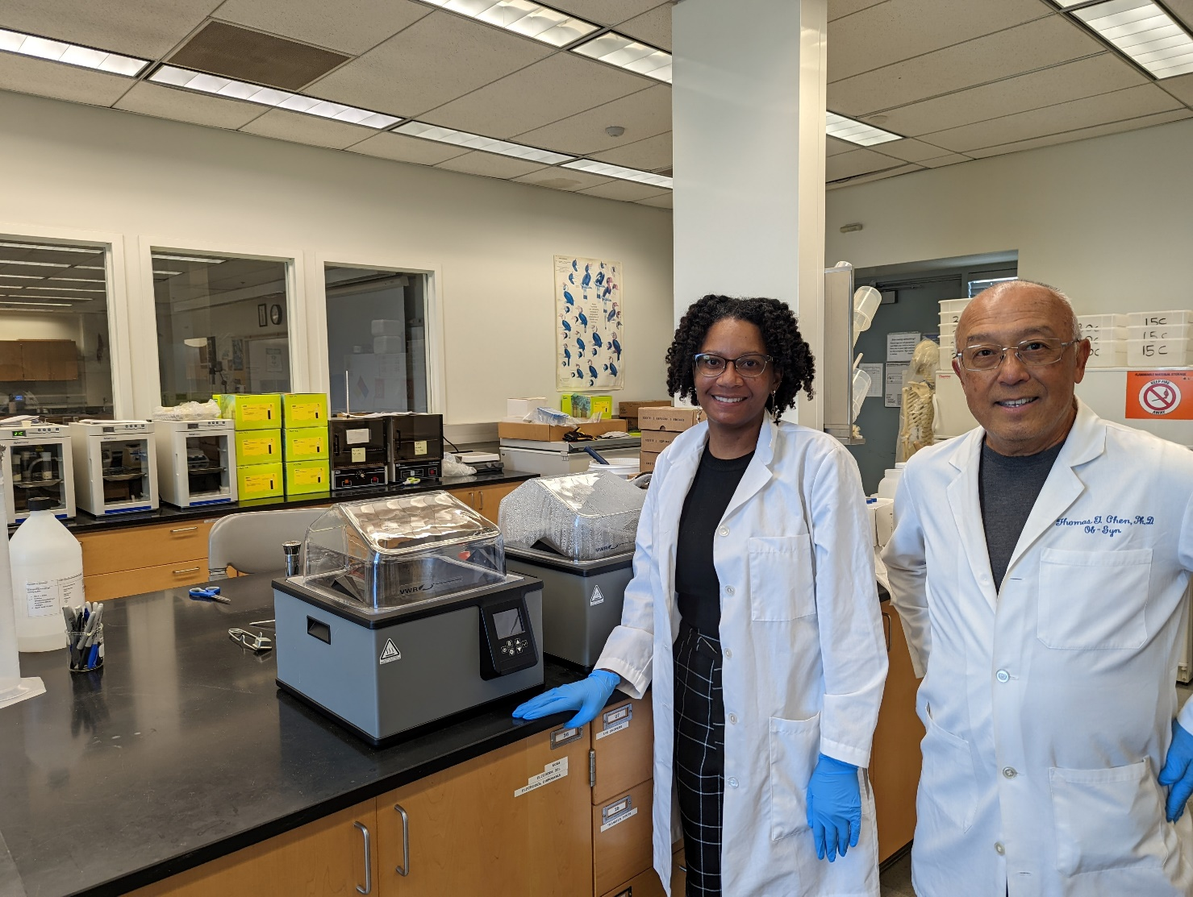
Drs. Andria Denmon & Tom Chen, Biotechnology

Slide 21





Slide 22



Slide 23
Enrollment & Budget

Slide 24
Compared to fall 2019, credit resident FTES or full-time in-state students against whom SMC can get apportionment from the state, is down 19 percent.*
Non-resident FTES enrollment is down 28 percent compared to fall 2019.
*Data as of August 24, 2022, Courtesy of Enrollment Development

Slide 25
Enrollment Development Engagement Strategies:
Outreach to students with unsubmitted admission applications
Call campaigns aimed at engaging with specific student populations such as Black and LatinX high school applicants, students who stopped out, prospective students, social media leads, and more
Webinars & Welcome Center Café for Students, Parents, and More
An Open House Plus Enrollment lab
Various digital/social media marketing campaigns
Special thanks: Enrollment Development, Welcome Center Outreach, Marketing, Community & Academic Relations

Slide 26
International Education Center
Recruitment & Enrollment Initiatives:
Increase incentives to IEC global partners to augment new student referrals
Participate in virtual recruitment fairs across largest established and emerging markets
In Collaboration with Marketing developed digital Advertising/Search Engine Maximization campaign that resulted in a 254% increase in IEC page views
Implement Admission Workshops, Pre-enrollment Seminars and Online New Student Webinar to increase applications to admission yields and admission to enrollment yields.
Work with IEC Counseling Team to increase counselor availability following new student webinars to facilitate new student enrollment

Slide 27
Retention Initiatives:
Address Financial Challenges by connecting students to timely information about on-campus employment options, SEVIS eligibility regulations on Economic Hardship based employment, paid internships and Optional Practical Training opportunities
Connect students to campus support services (Bodega, Center for Wellness and Wellbeing, Career Services, Tutoring and counseling services) & expand resources guide to affordable housing
Work with the Center for Wellness and Wellbeing to bring onboard a dedicated international student Mental Health Specialist

Slide 28
$375 Million Bond | Measure SMC
Supporting Equitable Outcomes &
Preparing for Today’s Jobs

Slide 29
Measure SMC Would:
  help fund much-needed updates to existing SMC career training facilities,
  create new housing for eligible low-income students, and
  provide technology upgrades to meet emergent needs in the post-pandemic world.

Slide 30
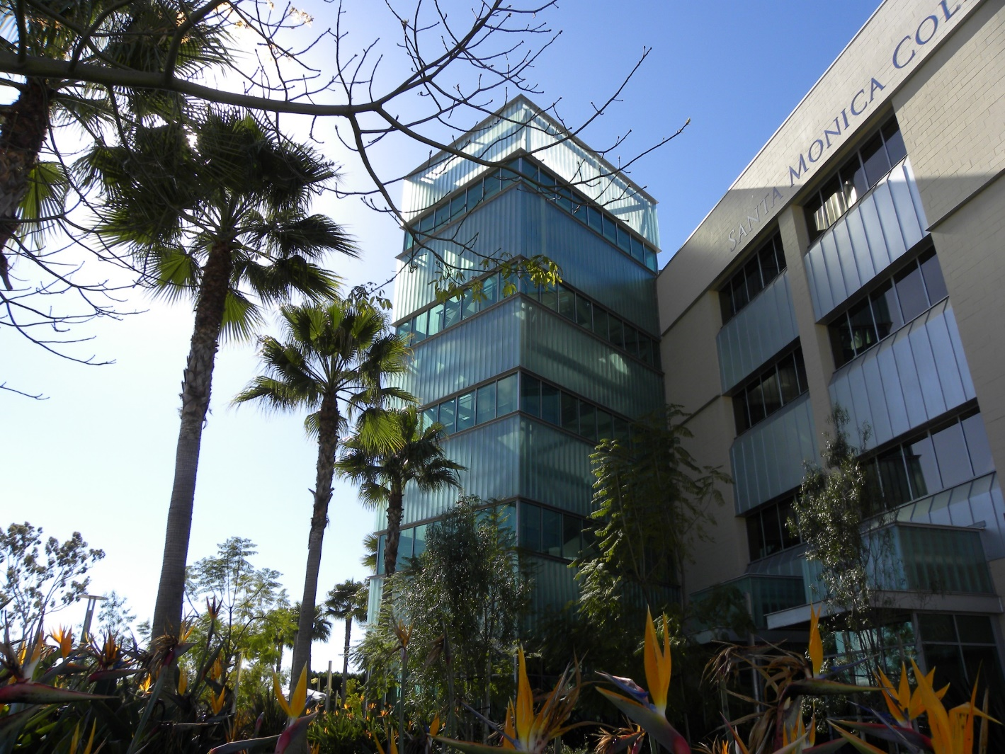

Slide 31
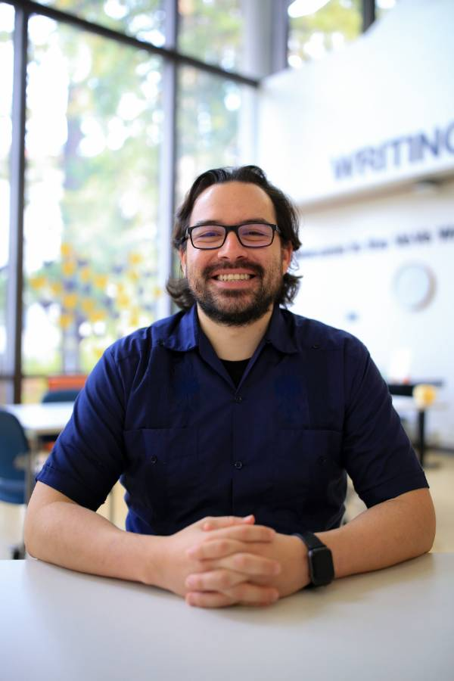
Back to Basics
Welcome, Ruben Canedo!

Slide 32
Thank you to the Basic Needs Team!
Sharlyne Massillon, MSW Basic Needs Project Manager
Thaddeus Phillips, MSW Basic Needs Counselor
Alyssa Heskin, MSW Basic Needs Counselor
Sally Calderon, MSW Basic Needs Counselor
Andrew Smith, MSW Basic Needs Counselor

Slide 33
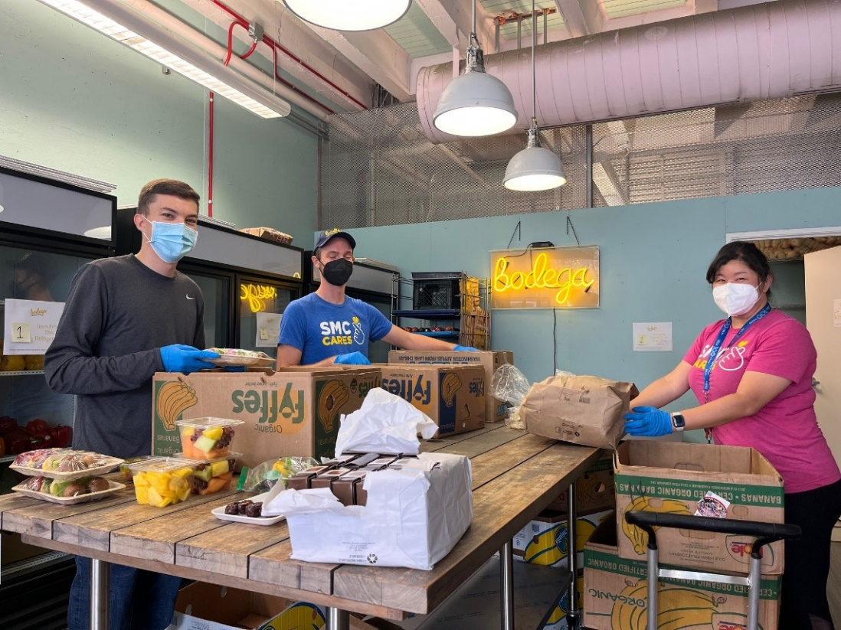
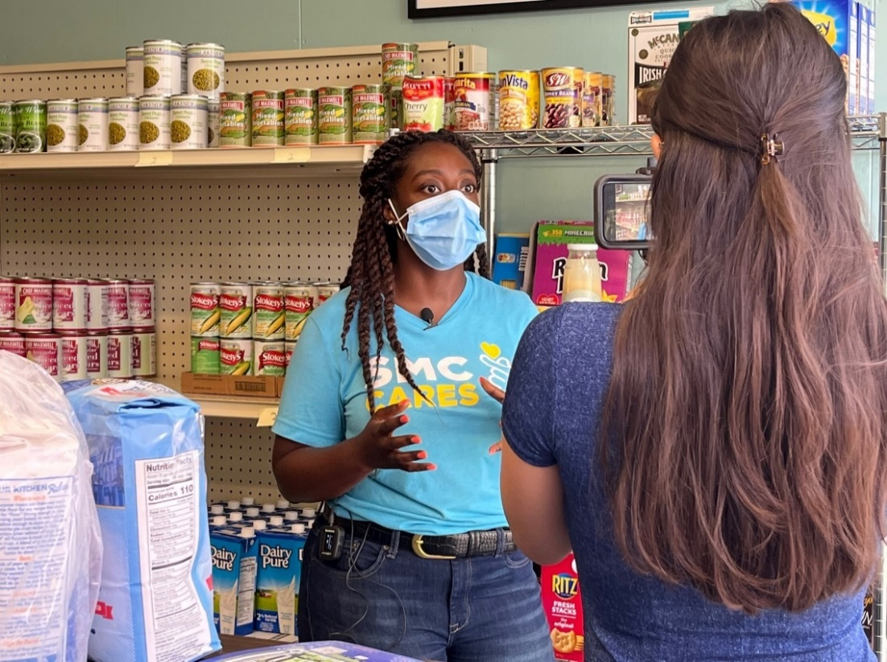

Slide 34
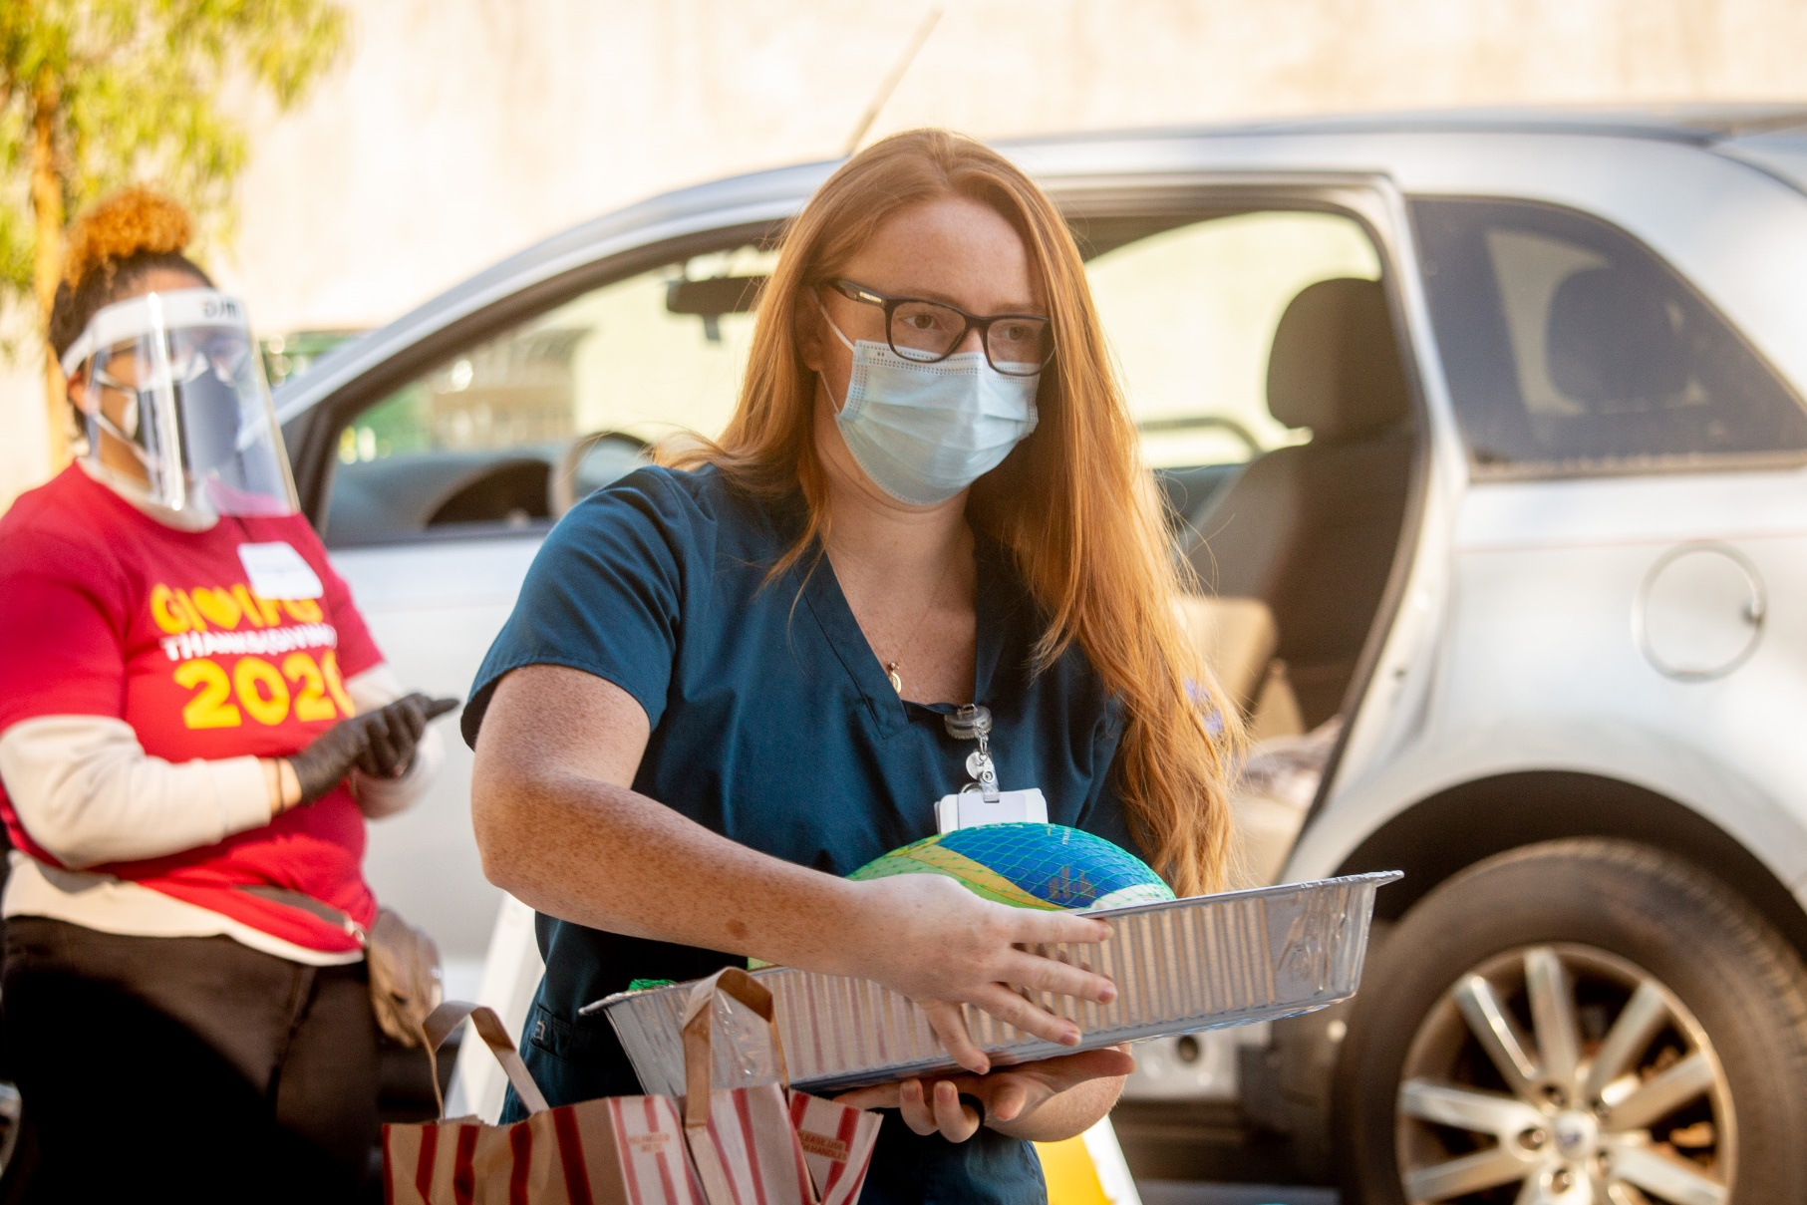

Slide 35
“Basic Needs Support for Community College
Students is Urgent and Actionable”
—Diverse Issues in Higher Education, Dec. 3, 2021

Slide 36


Slide 37
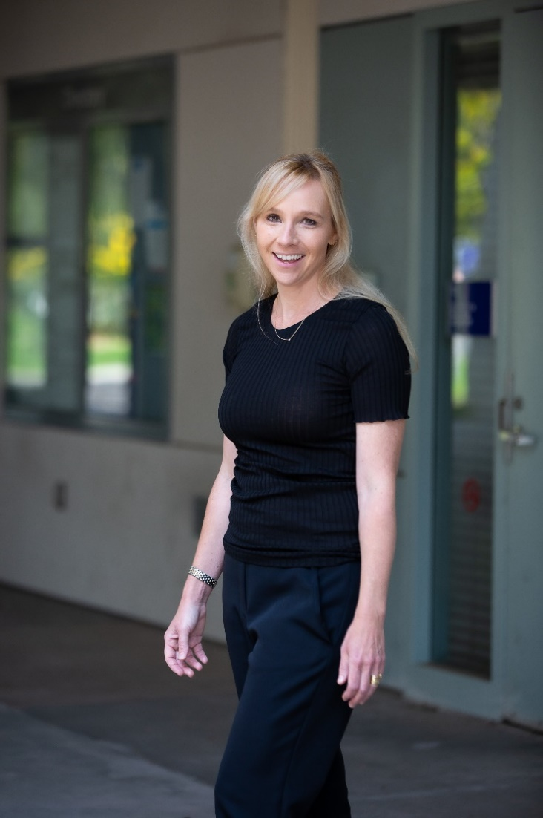
Dr. Susan Fila

Slide 38
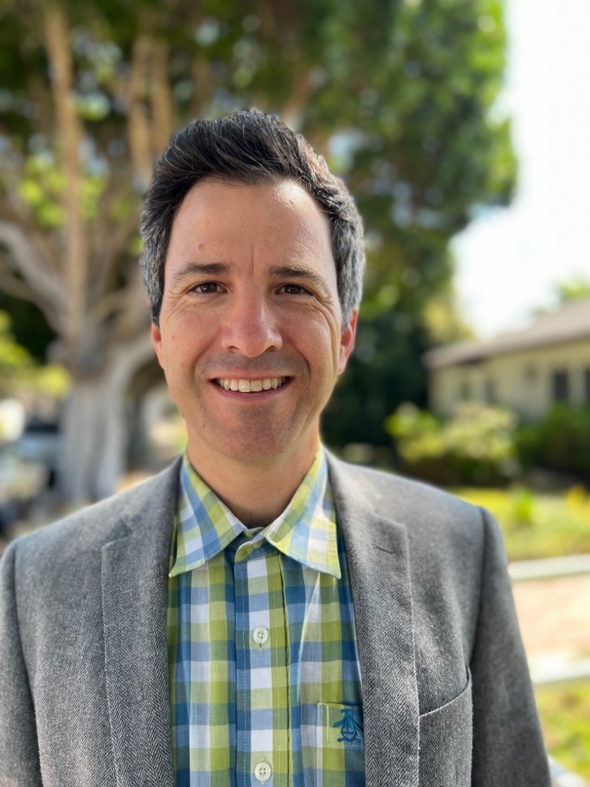
Jason Beardsley

Slide 39
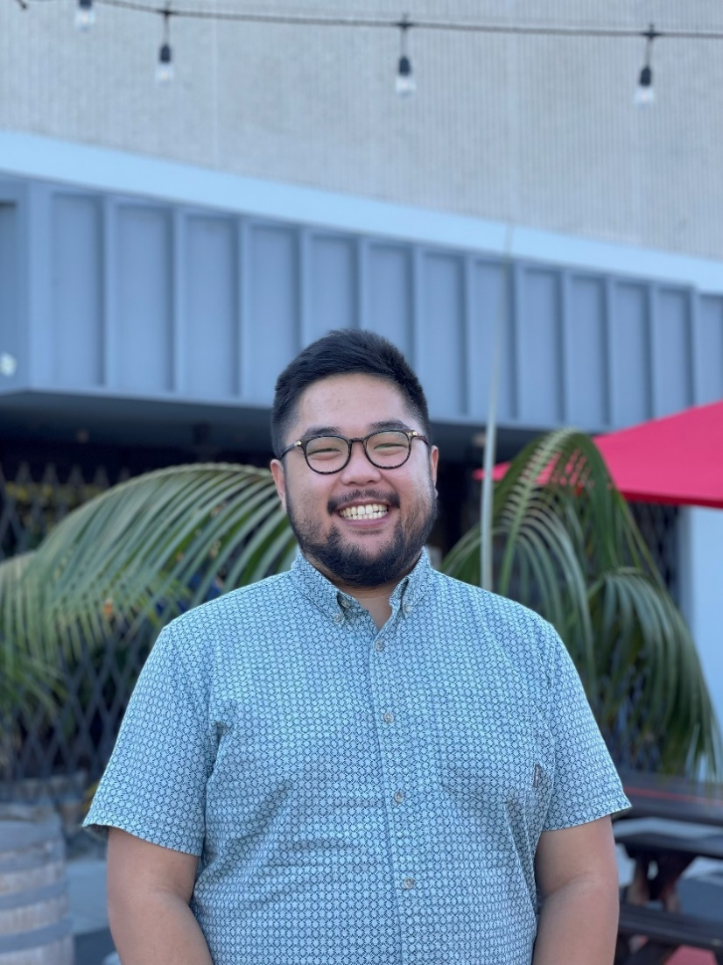
Thomas Bui

Slide 40
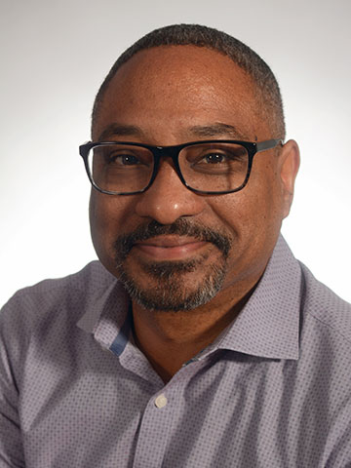
Dr. Devin Starnes

Slide 41
“Nothing is permanent except change.”
--Heraclitus

Slide 42


