Slide 1


  Professional Development Committee: Marisol Moreno, Chair | Edna Chavarry, Vice Chair | Julie Chekroun | Eric Oifer | Brian Rodas | Nick Fox | Lea Hald | Dione Carter |
  Kiersten Elliott
  Classified Professional Development Committee: Fariba Dinaali | Estela Ruezga |
  Carla Alvarado | Aaron De La Torre | Jose Fernandez |Cyrus Fernandez
  Partners: Paige Glaves | Nate Donahue | Peter Morse | Sherri Lee-Lewis | Mike Tuitasi | Denise Henninger | Lugina Rogers

Slide 2
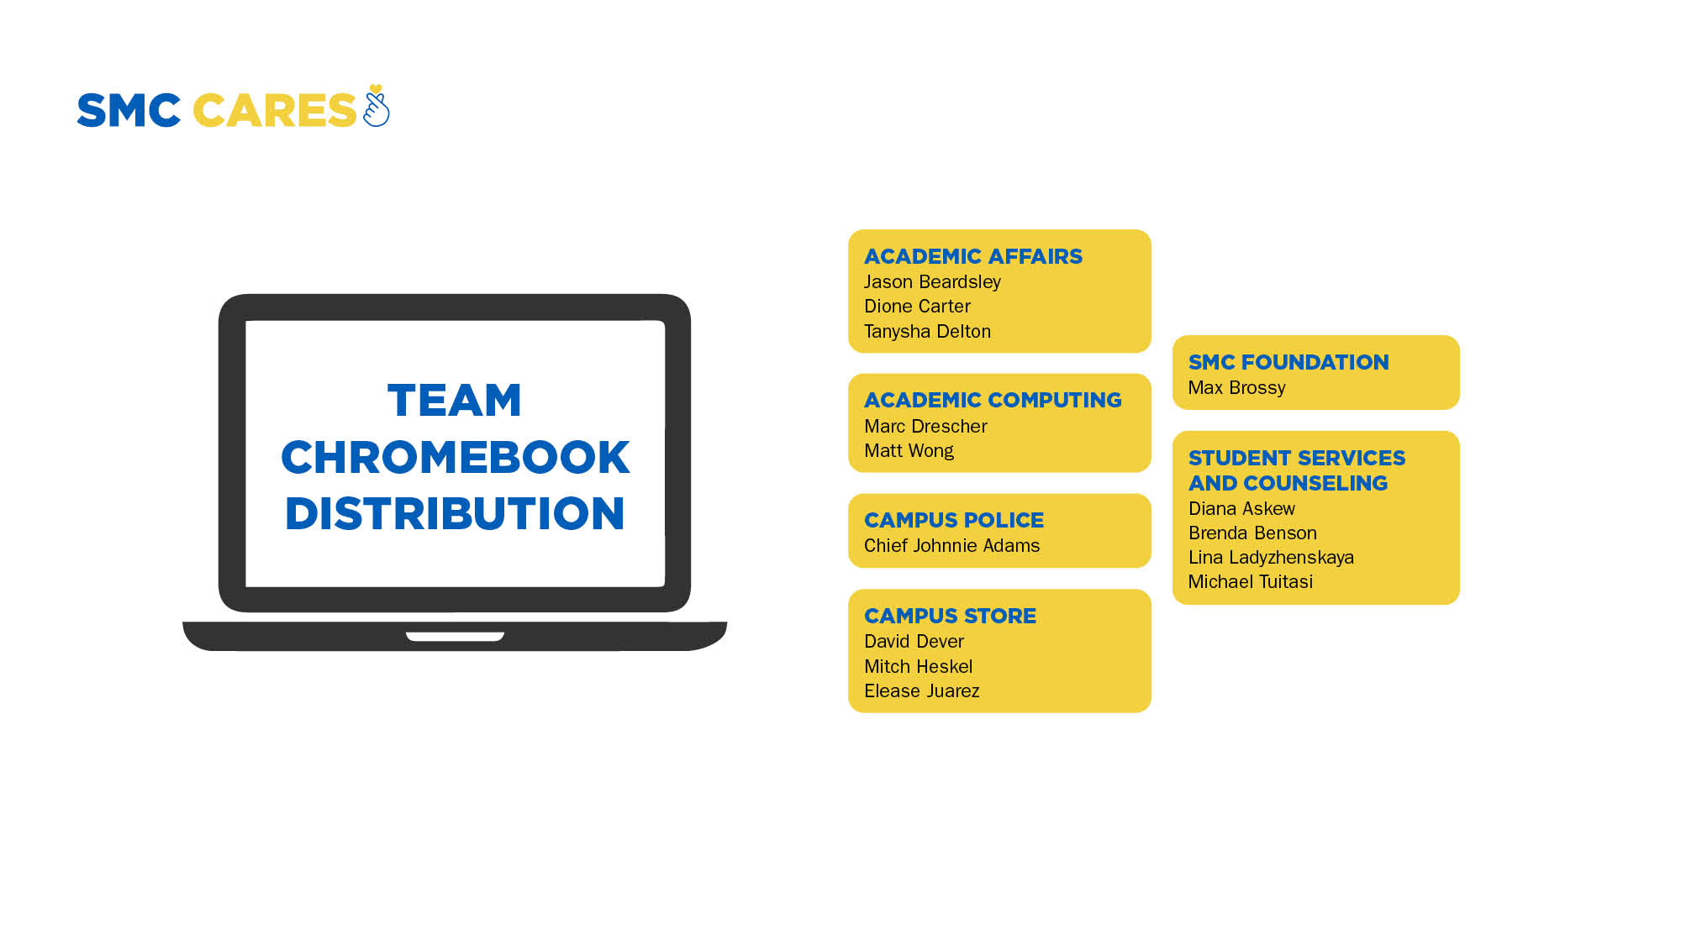

Slide 3
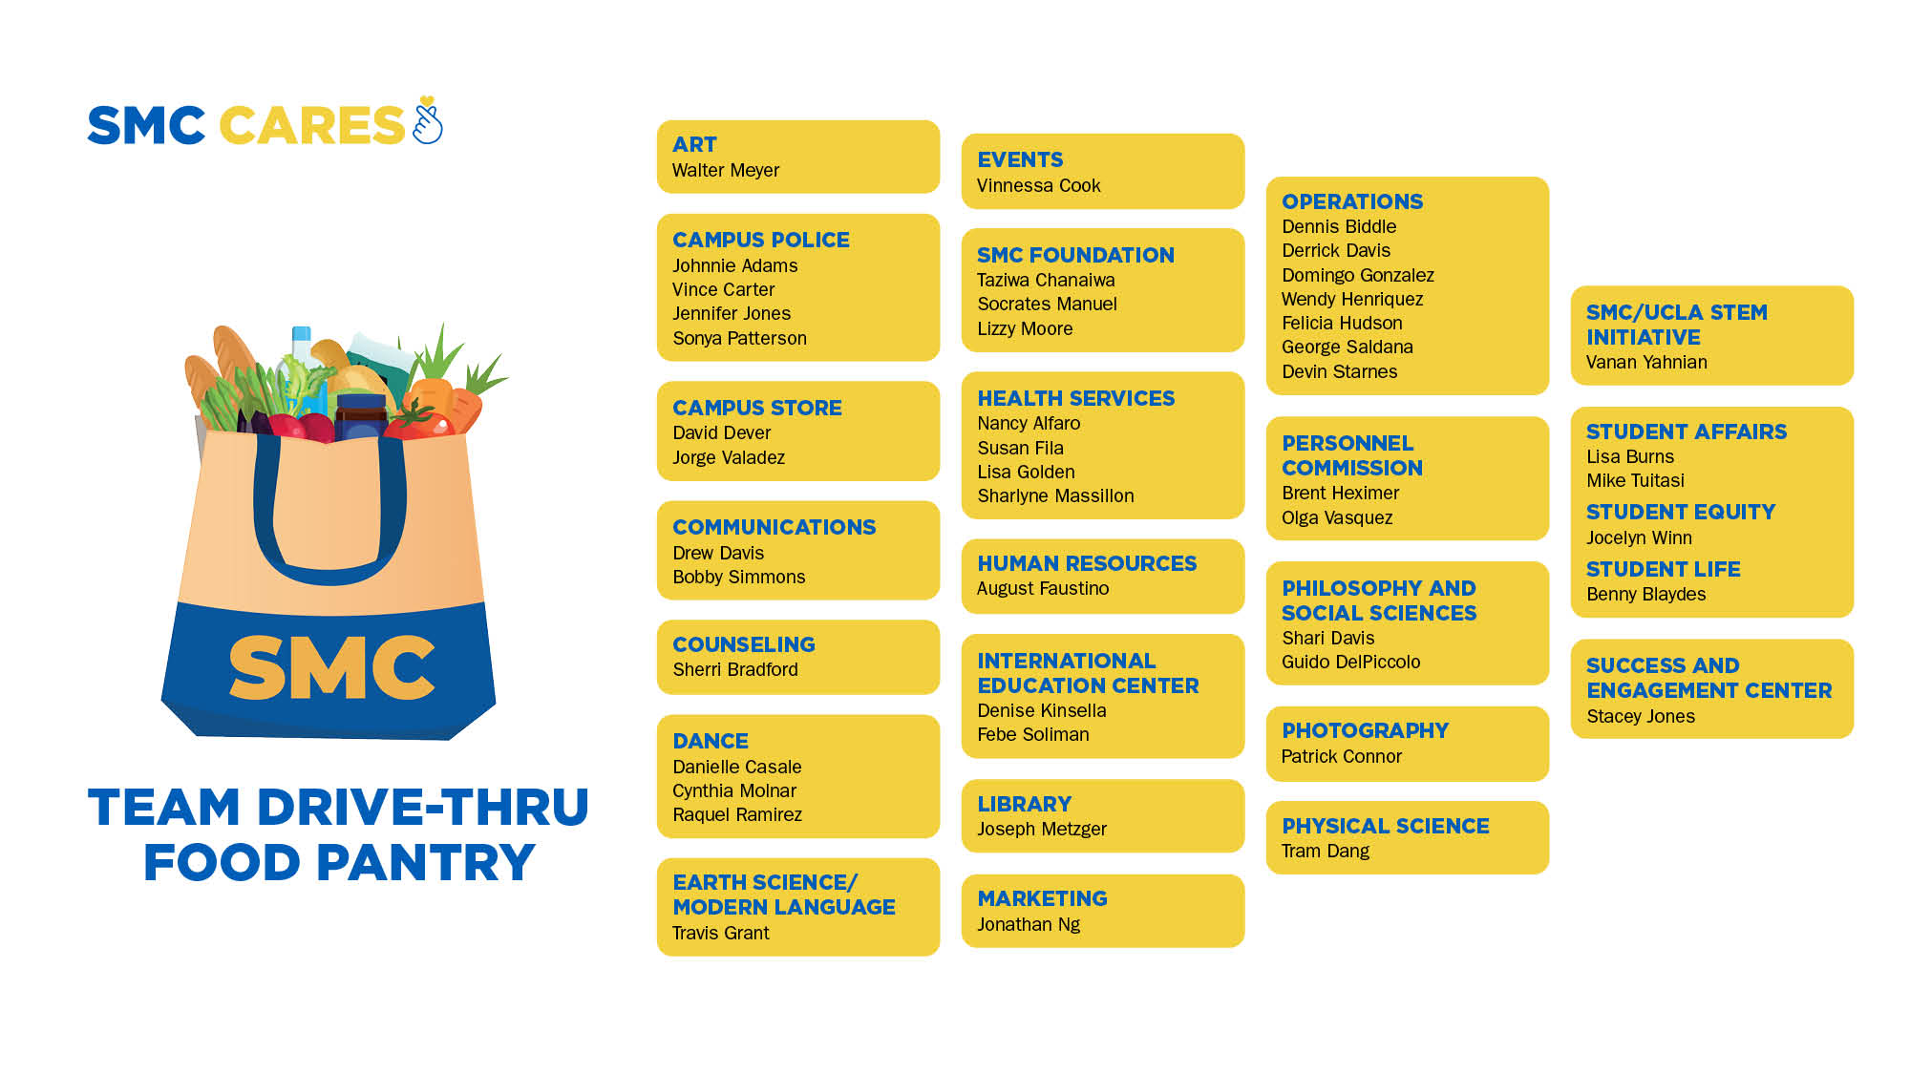

Slide 4
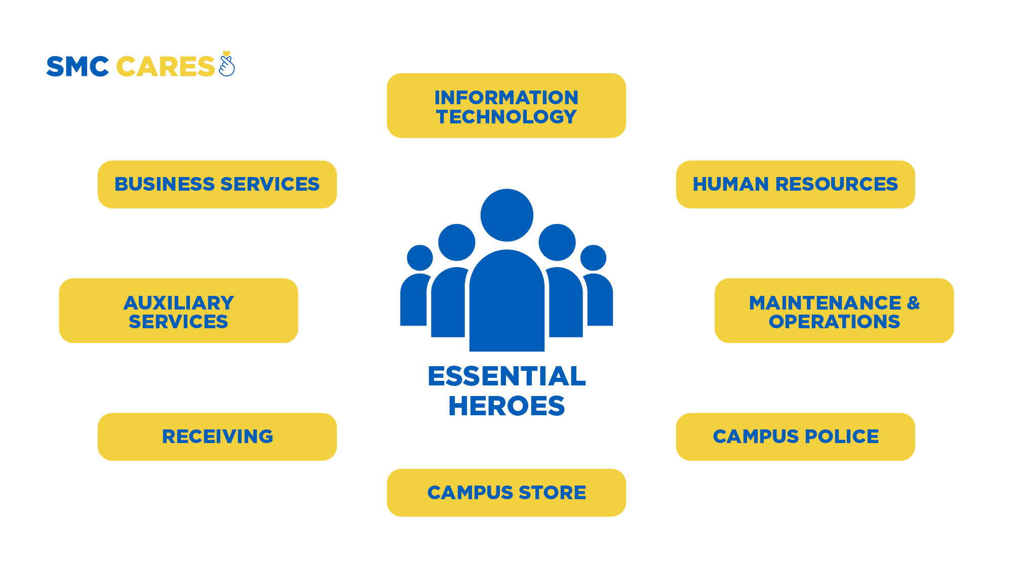

Slide 5

I love SMC so much and the help that is being offered to us during this difficult time is astounding and refreshing.
--SMC Student/CARES Recipient

Slide 6

It will be a very sad moment to graduate and leave Santa Monica. . . . After the U.S government has granted me political asylum, becoming a student at SMC was the best decision in my life.
--SMC Student/CARES Recipient

Slide 7

I thank you so much for all the support. . . in this difficult time, from Food Pantry to this Cares Act Relief. I am holding tight with my shelter in place in LA while maintaining 5 classes online and I will try my best to finish them strong.
--SMC Student/CARES Recipient

Slide 8

Congratulations on 25 Years!
Sal Veas | Patricia Del Valle | Teresa Garcia
Eileen Rabach | Yolanda Fierro | Deborah Adams
Dwayne Iles | Alma Nevarez | Poonam Pant
Wai Wong | Jere Romano

Slide 9
Congratulations & Welcome, New Hires!
(Faculty, Classified, Managers, Administrators)
Lydia Ayala | Ernesto Castro | Monica Jeong | Ricardo Perez | Wayne Gainey | Brittany Wilson
Linda Subias | Sherri Himelstein | Laura Navarro | Isaac Rodriguez Lupercio | Hector Gutierrez | Jamina Russell
Giulio Copeta | Amber Wade | Sang Hee Cho | Salomon Morales Martinez | Patrick McCarthy | Marisa Sandoval
Juliana Carranza | Amanda De La Torre | Wilmer De Los Santos | Armando Olivera Santos | Nancy Esparza | Russell Hulst
Rita Esparza Torres | Jerry Foster | Rico Gutierrez | Maisha Reid | Jose Prieto | Vidal Turner
Alvaro Bravo | Josemar Diaz | Nehhe'h Feagin | Royce Lewis | Melissa Montes | Michelle Villalobos
Tanysha Delton | Cyrus Fernandez | Ashley Eutsey | Tracie Hunter | Erik Torregano | Javier Cambron
Leonardo Luna | Carlos Jauregui | Donatas Bukauskas | Travis Grant | Diana Pennington | Duc Pham
Martha Hall | Fernanda Guido | Getahun Deresse | Mauricio Rosales | Ngan "Kim" Tran | Sue In Lee
Carlos Lucio | Clarenda Stephens | Joseph Kolbly | David Hall | Raymond Adams | Kaelyn Rodriguez
Barry Okonoboh | John Greenlee | Keyang Li | Terry Kamibayashi | Janice Tovar | Amanda Garcia
Zhan Que | Ranon Ruff | Matthew Kiaman | Marco Zetina | Michael McCann | Nicola Vruwink
 |  |  | Raul Armando Avila | Hibatullah (Hiba) Lachgar

