Slide 1

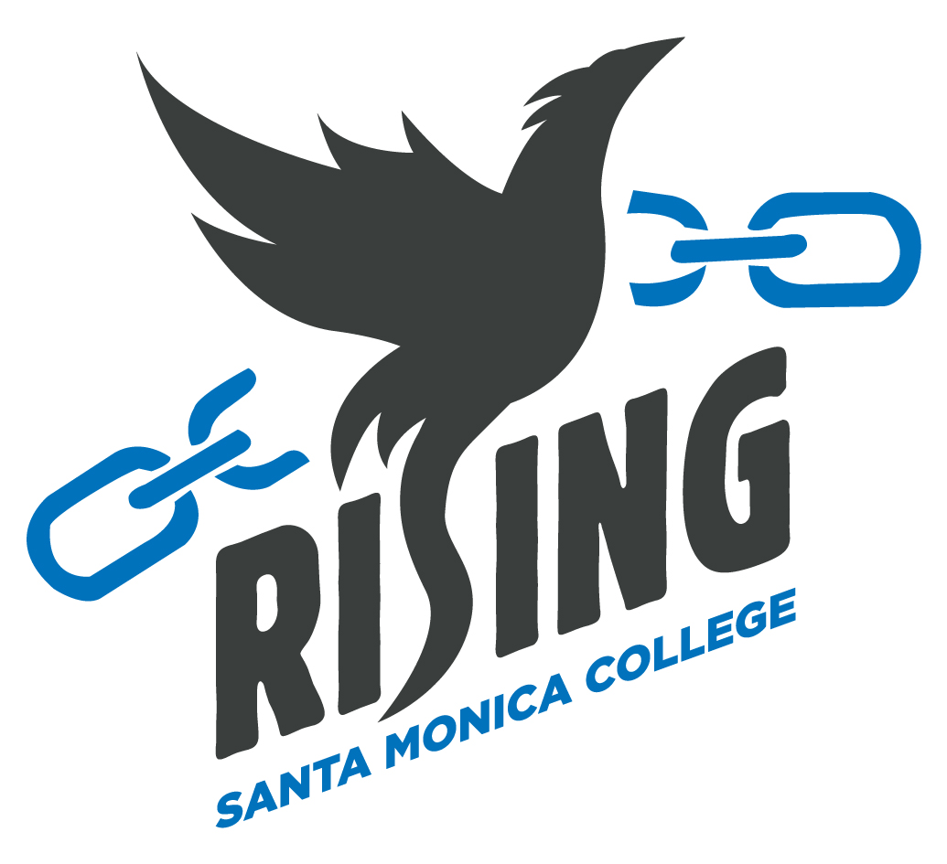

Slide 2
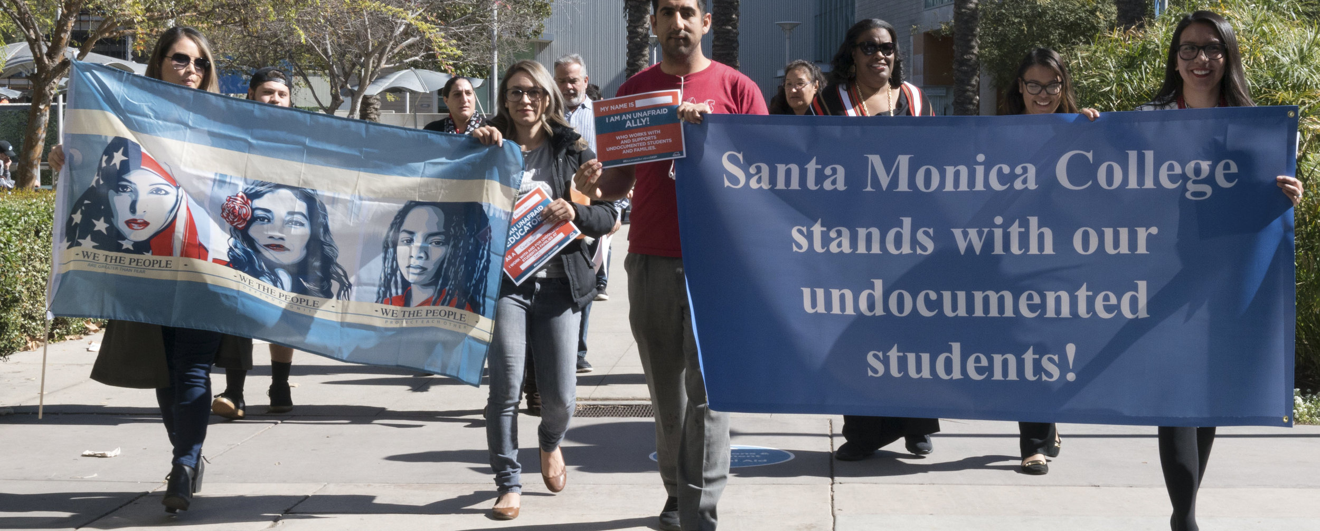
DREAM Program

Slide 3
DREAM Program History
Fall 2016
Social Justice Workgroup
Spring 2017
UndocuAlly Program established
Fall 2018
DREAM Program established through SMC Student Equity funding
Spring 2020
DREAM Program joins Immigration Services Legal Project with CARECEN
Fall 2020
SMC receives on-going funding through the DREAM Resource Liaison Support Allocation
Spring 2023
DREAM Program expands with Dream Resource Center within the Student Equity Center

Slide 4

DREAM Program Services
Comprehensive academic, transfer, financial aid and career counseling
Student success workshops
Outreach services
UndocuOrientation
Free immigration legal services
DACA application clinics
College field trips
Undocumented Student Week of Action
Financial Aid/Emergency Aid Assistance
IDEAS student club advising
UndocuAlly Training
Mental Health Support

Slide 5
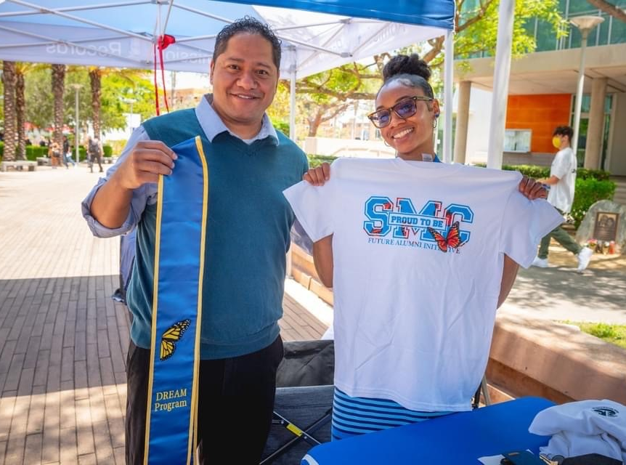
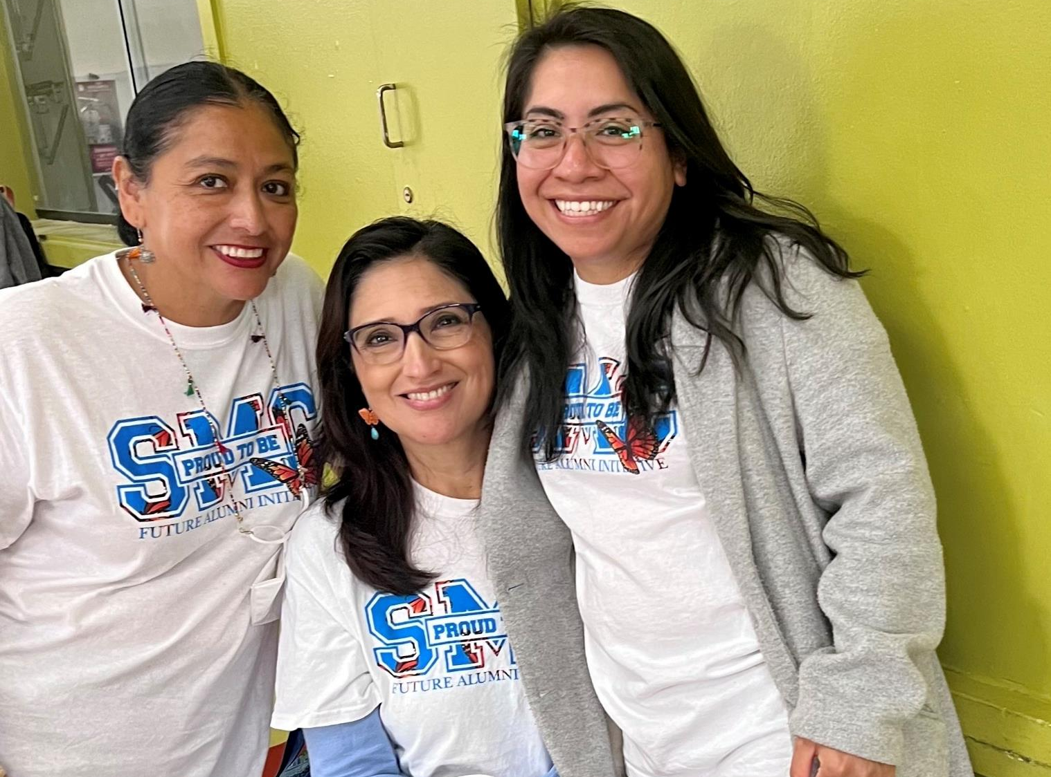
DREAM Team
Sergio Belloso – Counselor
Victoria Santiago – Counselor
Fabio Prieto – Program Specialist
Julyssa Guevarra – Therapist
Nick Mata – Dean of Special Programs
CARECEN Legal Partners – Martha Gonzalez and Ann Park
Sergio Belloso & Christina Fuller
Sara Nieves-Lucas, Marisol Moreno & Victoria Santiago

Slide 6
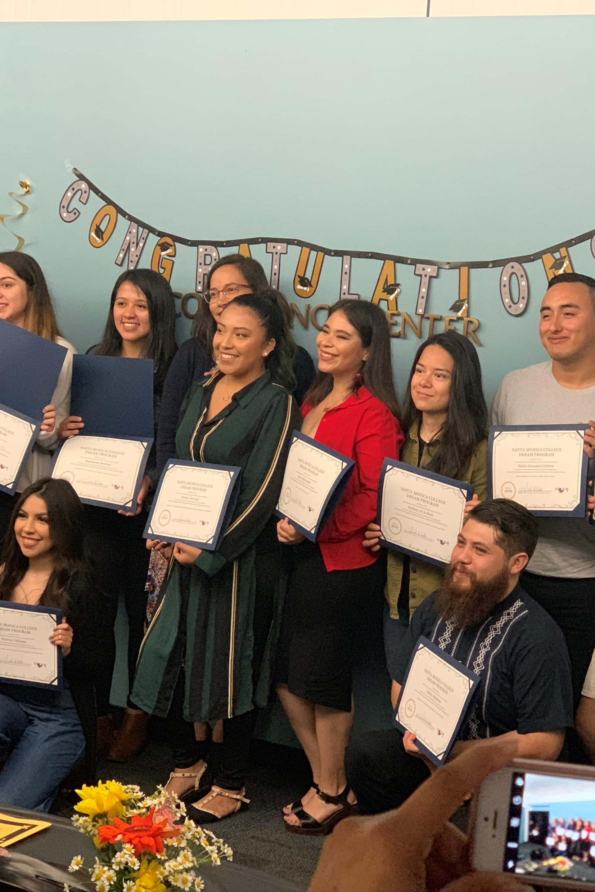
2022-23 Participants: 168
Race/Ethnicity
Latine/x – 88%
Asian/Pacific Islander – 5%
White – 4%
Black – 2%
Unknown – 1%
Gender Identity
Female – 69%
Male – 31%
Average enrolled units: 9
Average cumulative GPA: 2.76
Since the start of the program DREAM participants have earned 91 associate degrees, 80 certificates and most of them also transferred.

Slide 7
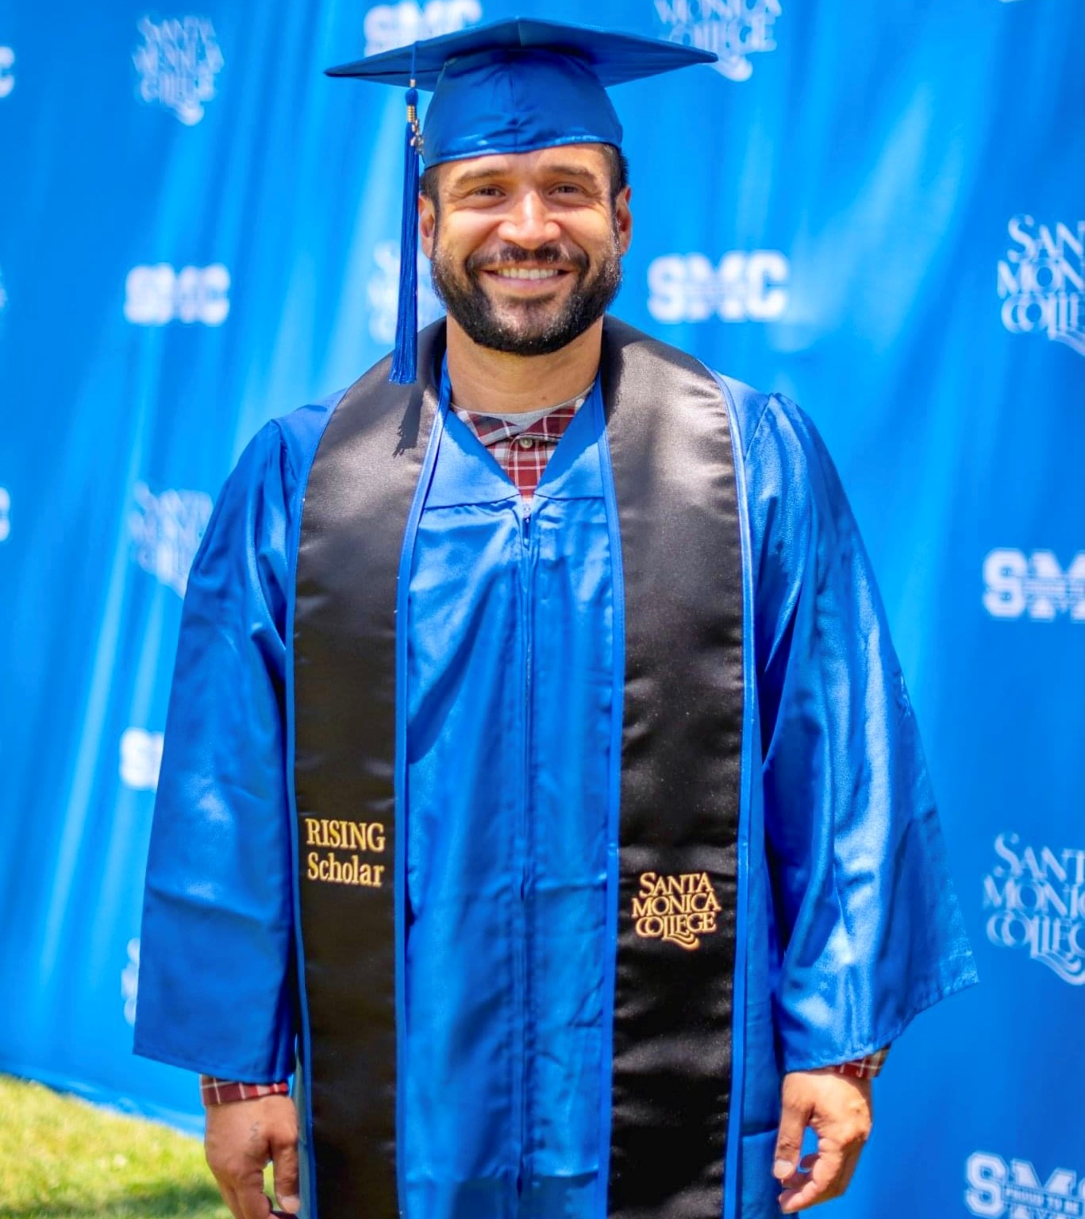
RISING Program
Jose, RISING Graduate
(Re-entering Incarcerated and System Impacted Navigating Greatness)

Slide 8
RISING Program History
2009
Homeboy and Homegirl student club established
2019
Formerly Incarcerated and System Impacted Work Group
Fall 2021
RISING Program established through funding from Student Equity and Achievement
Fall 2021
Workgroup becomes the RISING Program Advisory Committee
Winter 2023
SMC awarded a RISING Scholars Network grant for 2023-2025
Spring 2022
SMC begins asking on CCCApply about incarceration and system impact status

Slide 9
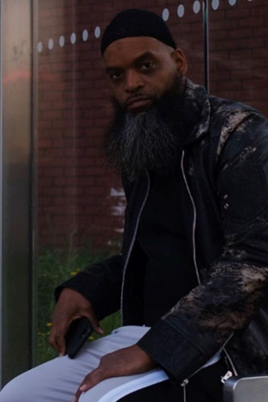
RISING Program Services
Comprehensive academic, transfer, financial aid and career counseling
Transition and student success workshops
Outreach services
Referrals to community organizations
Mental health support
Liberating Scholars Educational Training
Coming in 2023-24:
Peer mentor program
Financial aid grants
Student club
Collaboration with Camp Kilpatrick in Malibu
King, RISING Student

Slide 10
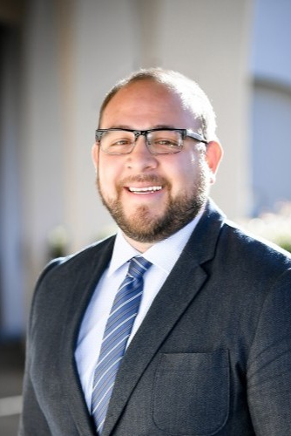
RISING Team
Nick Bravo – Counselor
Grace Santiago – Counselor
Giovanni Ochoa – Counselor
Julyssa Guevarra – Therapist
Rebecca Romo – RISING Advisory Committee Chairperson
Nick Mata – Dean of Special Programs
Nick Bravo, Counselor

Slide 11
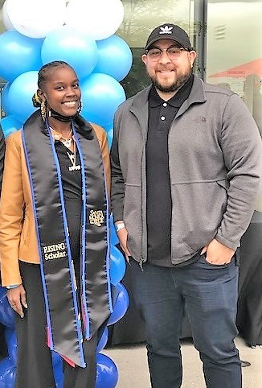
RISING Grad Vershaun and Counselor Nick
2022-23 Participants: 26
(50 total participants since Fall 2021)
Race/Ethnicity
Latine/x – 40%
Black – 25%
White – 25%
Asian/Pacific Islander – 5%
Unknown – 5%
Gender Identity
Male – 68%
Female – 32%
Average enrolled units: 10
Average cumulative GPA: 2.39
Since April 2022, 447 applicants to SMC have identified as formerly incarcerated or system impacted.

Slide 12
Student Voice

Slide 13
DREAM and RISING Champions!
Luis Andrade
Carla Alvarado
Tracy Beidelman
Benny Blaydes
Melanie Bocanegra
Jason Bostick
Sherri Bradford
Thomas Bui
Silvana Carrion
Edna Chavarry
Aaron De La Torre
Patti Del Valle
Dennis Funes
Christina Fuller
Jose Hernandez
Maral Hyeler
Luis Jauregui
Denise Kinsella
Hannah Lawler
Debra Joseph Locke
Sara Nieves Lucas
Esmeralda Martinez
Maria Martinez
Marisol Moreno
Lizzy Moore
Maria Munoz
Stacy Neal
Rebecca Romo
Esau Tovar
Janet Tercero
Michael Tuitasi
Belen Vaccaro
Vanan Yahnian

