Slide 1
Student Care Teams (SCTs)- Fall 2018
Dr. Luis Andrade & Laurie Guglielmo
“Redesigning student supports in an integrated, collaborative, and holistic way that enables students to progress along their educational and career pathways.” – Achieving the Dream

Slide 2
Agenda
Purpose, Research, and Definition of Student Care Teams (SCTs)
Examples of SCTs
Consistent Findings of STCs
Preliminary Recommendations for SMC (Counseling)
Q&A

Slide 3
Purpose, Research, and Definition of SCTs

Slide 4
SCTs (Integrated support; Advisement)
4 Essential Components:
Education, career, and financial planning
Counseling, advising, coaching
Targeting risk and intervention
Transfer practices and labor market alignment
Equity focused!
Source: Achieving the Dream, https://www.achievingthedream.org/resource/17257/integrated-student-support-redesign-toolkit

Slide 5
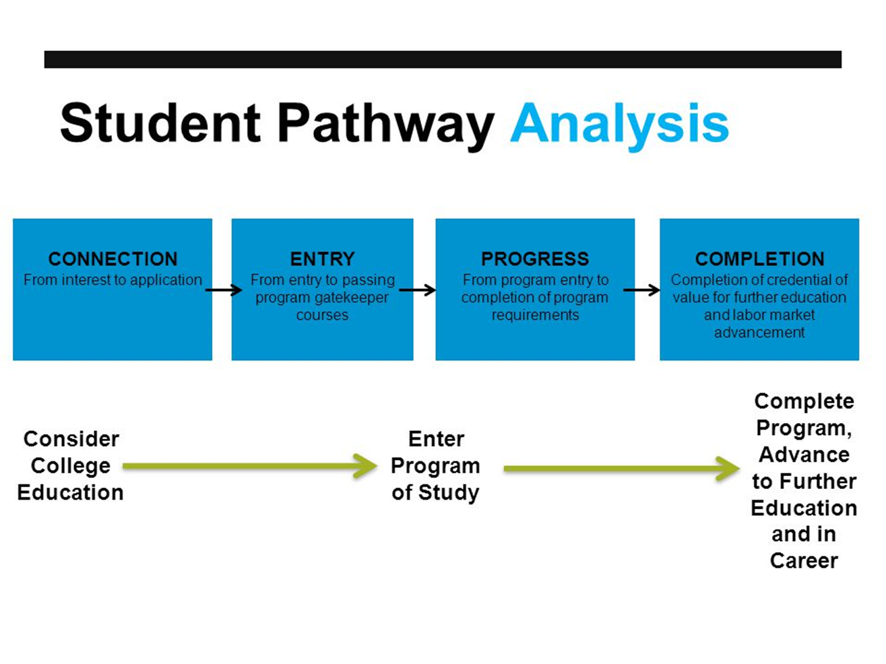
Source: Redesigning Community Colleges

Slide 6
2018 National Report
With survey findings collected from over 130,000 community college students across more than 200 institutions, Show Me the Way: The Power of Advising in Community Colleges confirms that students who receive more advising—more time with advisors and more in-depth discussions in their sessions—are more engaged.
Source: Center for Community College Student Engagement, http://www.ccsse.org/nr2018/vignettes.cfm

Slide 7
Examples of
SCTs

Slide 8
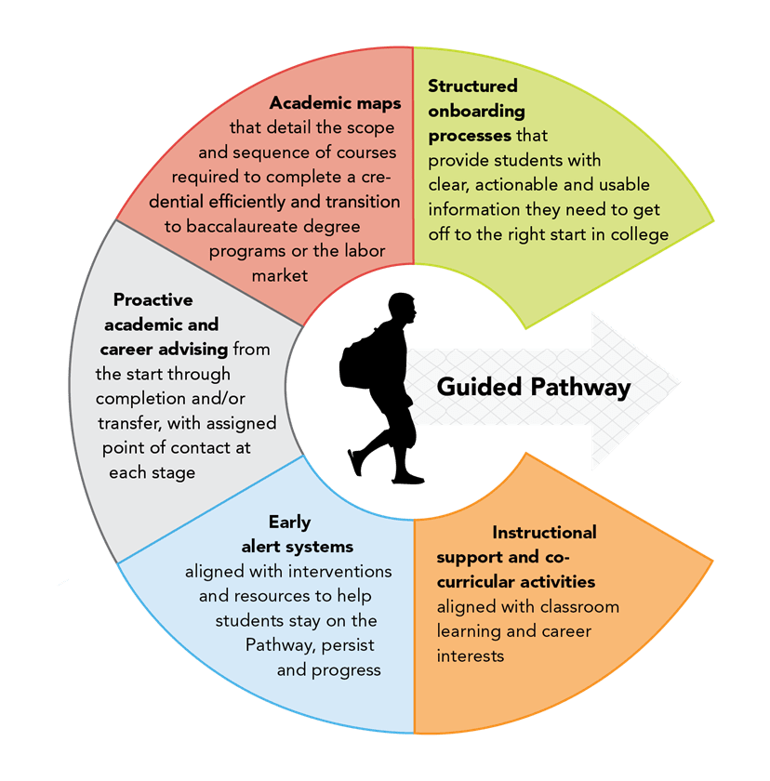


Virginia Community Colleges System
Source: Virginia Community Colleges System

Slide 9
Bakersfield Community College
Completion Coaching Team generally includes:
    Financial Aid Technician
    Job Development Specialist
    An Educational advisor (classified position)
    A “Learning & Career Community” Counselor (or counselors)
Utilizes Starfish, including flags for high-touch opportunities at regular intervals
Early Alert system is part of Starfish to assist students when they are at risk
Number of counselors assigned per is determined by amount of students enrolled in each “Learning & Career Community”

Slide 10
Chaffey College Community College
SCT is called “GPS”- Guiding Panthers to Success
GPS Teams consist of:
Full-Time Counselor
Part-Time Counselor(s)
Graduate School Apprentices called “Success Guides”
GPS is for all students and the advising is all conducted on a walk-in basis. Services do not appear to be very intentional

Slide 11
Consistent findings of SCTs

Slide 12
Consistent findings of SCTs
Most models have
  counselors assigned to Meta-Majors or academic pathways
  instructional faculty involvement/advisement
  experts (career and/or financial) that help students with needs beyond course and meta-major needs.
Utilize comprehensive technology

Slide 13
Consistent findings of SCTs
They reach out to students immediately after enrollment/registration
They assist students with selecting a Meta-Major at the start of the student’s college career
They initially assign students to a Meta-Major or Pathway community
They connect the student to financial aid information and resources at the start
They “front-load” career counseling
They provide counseling, continuous guided pathways advisement and mentorship throughout the student’s journey
They have coaches to provide ”high-touch” services at regular and necessary intervals
They provide extracurricular activities

Slide 14
Preliminary Recommendations for SMC

Slide 15
Input from SMC Counselors
Pathways Survey Results
90 SMC counselors, approximately 60 adjunct and 30 contract counselors, responded to the Counselor Survey for Pathways Redesign.
20% of the SMC counselors work at other colleges that are implementing counseling services around GPs
The top ways that other LACC’s are implementing counseling services include:
  Counselors are assigned to specific Meta-Majors but still see students for general counseling issues: 38.9%
  General Counseling is available for all students, regardless of Meta-Major and/or pathway: 33.3%

Slide 16
Remaining Questions for SMC
How will SMC counselors be assigned to different Meta-Majors?
  Will TCC and WC counselors share the responsibility of both first-year and continuing students?
How will SMC Counselors be provided with specific Meta-Major training and resources upon assignment?
What role will instructional faculty have in student care teams? How can they be compensated for this involvement?
What role will SMC Special Program counselors play in Meta-Major based counseling?
How can we bring student coaches on board at SMC?
(position, selection, training, supervision, location)

Slide 17
Top recommendations from SMC Counselors for implementing counseling services around GP at SMC
Assign a Meta-Major coordinator for each Meta-Major, including special program counselors, to serve as an expert resource for other counselors: 49.4%
Provide counselors for each Meta-Major in all Counseling programs and locations: 48.3%
Special Program counselors should be able to provide guidance for any SMC Meta-Major pathway to their assigned population: 62.%
Special Program counselors can serve as a Meta-Major liaison, receiving training in the Meta-Major and keeping other counselor colleagues informed: 55.1%

Slide 18
Preliminary Plans for Implementation
Fall 2019
Student Success Coaching Team – to provide high touch contact at regular intervals
Begin to look at STEM "Meta-Major" as a pilot with wrap-around support in Spring 2019 that can expand to other "Meta-Majors" in Fall 2019
Assignment of Counselors to "Meta-Major Clusters"
Training provided by discipline faculty

Slide 19
Q&A

Slide 20
References
http://www.ccsse.org/nr2018/vignettes.cfm
Guided Pathways Executive Summit, http://trcenter.vccs.edu/guided-pathways-2/

