Slide 1
Support Programs

Slide 2
Embedded Tutoring Program Overview
Student tutors work in the classroom under faculty guidance to assist students in course concepts and enhance student engagement
Student tutors spend hours in Math lab to further assist students
Past Embedded Tutoring Data from Math
Class Type | Fall 2017 | Winter 2018 | Spring 2018 | Summer 2018 | Fall 2018 | Winter 2019 | Spring 2019
Math 1, 1B, 1C | none | none | none | none | 1 | 1 | 5
Math 18 | none | none | 2 | 1 | 5 | 2 | 4
Math 20 | 3 | 5 | 3 | 3 | 7 | 4 | 9
Math 31 | 1 | 1 | 4 | 1 | 7 | 2 | 5
Math 50 | none | 1 | 4 | 1 | 9 | 3 | 6
Math 54C | none | none | none | none | none | none | 2
Math 81 | 2 | 2 | 2 | none | none | 1 | 3
Math 84 | 2 | 2 | 2 | none | 1 | none | 1
Math 85 | 2 | 4 | 3 | none | 1 | 1 | 7
Total | 10 | 15 | 20 | 6 | 21 | 14 | 42

Slide 3
Embedded Tutoring 2019-2020 Academic Year Proposal
Math
Provide an Embedded Tutor for all co-requisite courses, Math 1 and Math 50.
Semester | Number of Sections
Summer 2019 | 18
Fall 2019 | 84
Winter 2020 | 18
Spring 2020 | 84
Total

Slide 4
Embedded Tutoring 2019-2020 Academic Year Proposal
English
Provide an Embedded tutor for all English 1/28 courses.
Semester | Number of Sections
Summer 2019 | 7
Fall 2019 | 57
Winter 2020 | 5
Spring 2020 | 40
Total

Slide 5
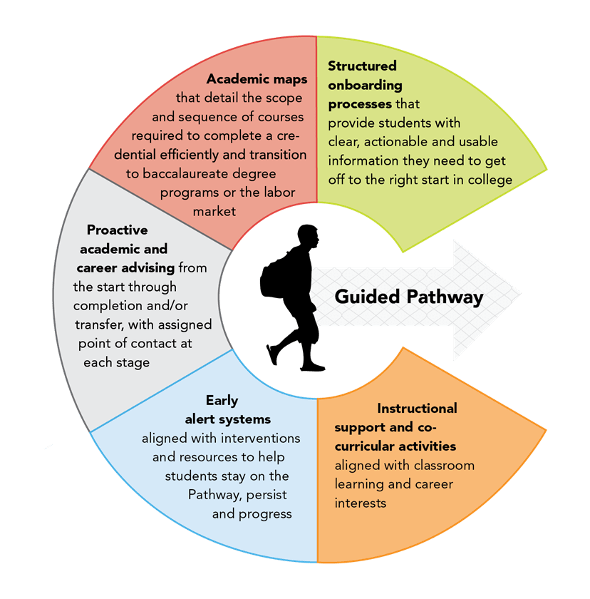
Embedded Counseling Program Overview
Counselors were assigned to visit specific math classes. They were tasked with the following:
Meet with math faculty to determine best approach
Provide guidance on career/major goals and support social and emotional well-being. During weeks 2-7.
Ensure all students have a Student Ed Plan (SEP), completed FAFSA and enrolled in the correct math course.
 | Course | Number of sections
Fall 2018 | Math 1 | 4
 | Math 20 | 4
 | Total | 8
Winter 2019 | Math 1 | 2
 | Math 50 | 4
 | Total | 6
Spring 2019 | Math 1 | 8
 | Math 50 | 19
 | Math 54C | 3
 | Total | 30
Source: Virginia Community Colleges System

Slide 6
Embedded Counseling 2019-2020 Academic Year Proposal
Math Support
Continue with Embedded Counselor Pilot for math
Use data from fall enrollment to determine the co-requisite courses that will benefit from this intervention
Try to pair up at least 40 sections
Request:
One part-time counselor
Program Coordinator to ensure consistency and improve program
Part-time Counselor

Slide 7
Embedded Counseling 2019-2020 Academic Year Proposal
English Support
Offer multiple presentations or activities to English 1+28 sections (57 sections). Each counselor will be assigned a class and asked to work with the English faculty to determine presentation schedules.
Work with a team of counselors and English faculty to determine the content and format for the presentations.
Request:
One part-time Counselor to oversee the program and provide counselor training
English faculty support (if needed)

Slide 8
Next Steps
Conduct student, faculty, counselor and tutor questionnaires to assess the embedded tutoring and counseling program.
Evaluate student success and retention for courses that had the embedded counselor and tutor support.
Use data from research above to further enhance the two programs for the 2019-2020 academic year.

Slide 9
Faculty Leads Support courses, Math 1, Math 50
Support faculty assigned to teaching the courses above during the 2019-2020 academic year
Revise and improve the course materials based on feedbacks from faculty and students
Encourage and train faculty to utilize active learning and affective domain activities
Train any new faculty assigned to teach the above courses after the spring 2019 trainings

Slide 10
Sections for Fall 2019 (Tentative)
Math 1 10 sections
Math 50 20 sections
Math 2C 8 sections
Math 3C 4 sections
Math 4C 4 sections
Math 21C 5 sections
Math 26C 3 sections
Math 54C 29 sections
Total Fall 2018 sections- 83

