Slide 1
Step by Step Instructions on How To Set Up Proxies

Slide 2
Click on Manage Delegates (Proxies)

Slide 3
Click on “Create” to add a Delegate (Proxy)

Slide 4
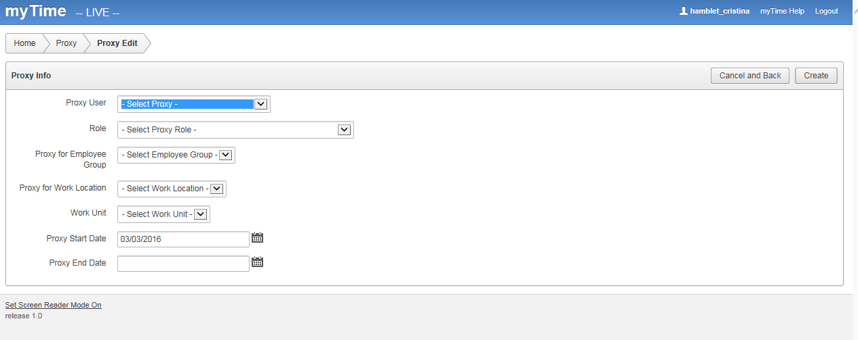
After you click “Create”, this screen will open. This is where you will choose the security settings for your proxy.

Slide 5
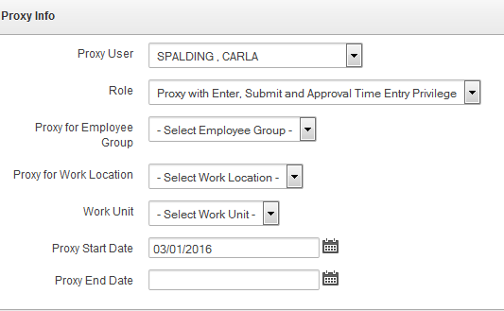
Here are the choices you will need to work through when setting up your proxy.
Click on the arrow and select the name of the person you would like to make a proxy.
Options include;
Proxy with Enter Time Entry Privilege
Proxy with Enter and Submit Time Entry Privilege
Proxy with Enter, Submit and Approval Time Entry Privilege
Options include; Student Worker, Temp Bi-Monthly, or Temp Monthly
Options include; All Work Locations, or you may select individual Work Locations
Options include; All Work Units, or you may select individual Work Units
You may select dates to include a specific period of time, or leave the end date blank if you wish for the proxy
rights to extend indefinitely.

Slide 6
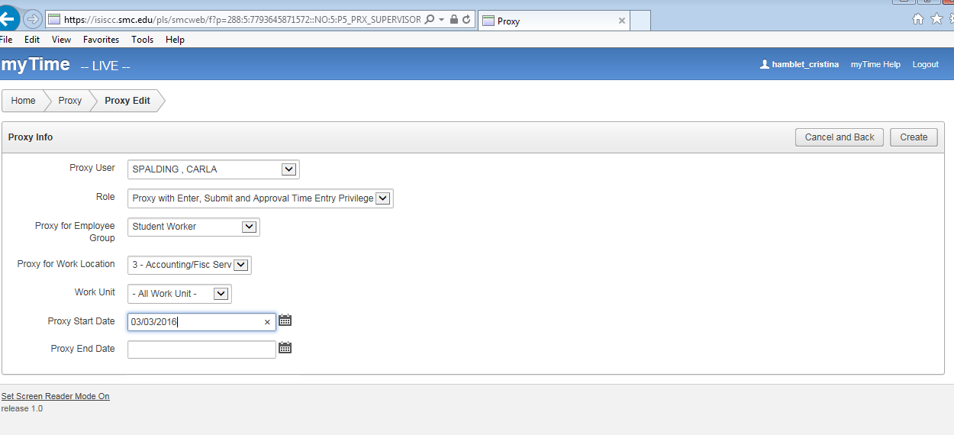
This is an example of what a completed screen might look like. The next step would be to click “Create”.

Slide 7
After you click “Create”, this screen will appear. You can now see the person you set up and you have the option to make
edits from here if necessary by clicking the “pencil”.

Slide 8
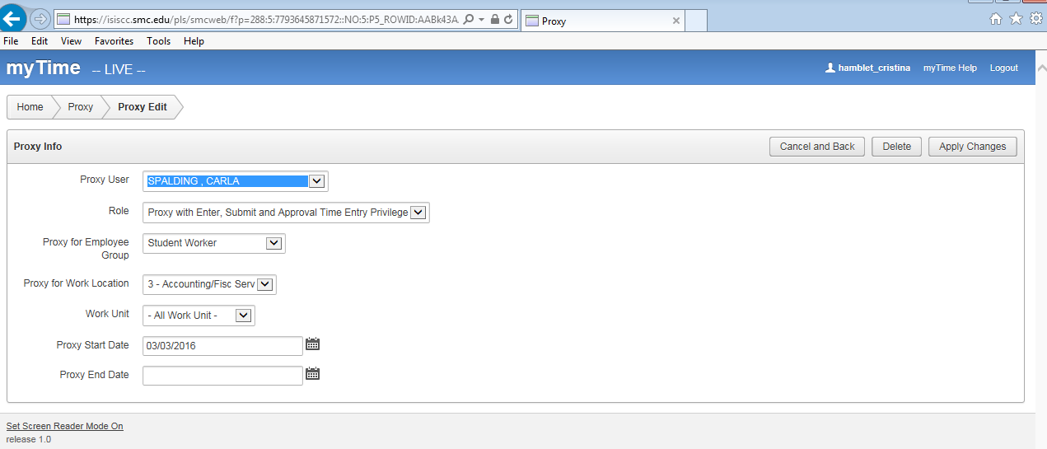
Here you can make any necessary adjustments to the original set up and click on “Apply Changes”
Or if necessary, you can also delete this proxy by clicking on the “Delete” button.

