Slide 1
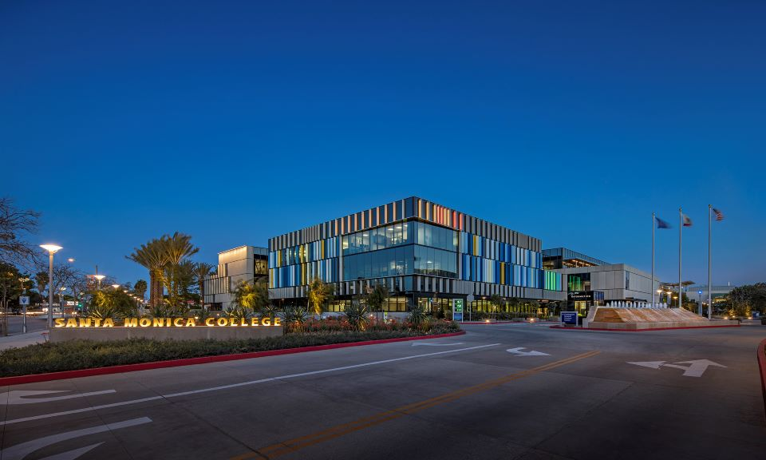
Santa Monica College
Board of Trustees
Tentative Budget
June 9, 2026

Slide 2

How can I keep up-to-date?
DPAC: Both in-person and online meetings: https://admin.smc.edu/administration/governance/district-planning-policies/meetings.php
Budget Committee: Both in-person and online meetings: https://admin.smc.edu/administration/governance/district-planning-policies/budget-planning-subcommittee.php
SMC Budget Office: Reports, presentations and guides to budget items. https://admin.smc.edu/administration/business-services/budget/
Board of Trustee Meetings: Both in-person and online meetings. https://admin.smc.edu/administration/governance/board-of-trustees/meetings.php

Slide 3

Where to Begin……
Lots of information!
  Santa Monica College Budget Office
  https://www.smc.edu/administration/business-services/budget/
Things will change….
  Legislature and Governor negotiations – Final State Budget
  Year End Closing
  District Adopted Budget in September

Slide 4
Overview
May Revise
2025-2026 Tentative Budget

Slide 5
May Revise

Slide 6
2026-2027 May Revision
State finances have improved since January
  Governor (DOF) projects $16.5 billion more revenue over the three-year budget window that was projected in January
    LAO projecting revenue is up to $25 billion higher than January
    January projection was $42.3 billion more than the State Adopted Budget
  Main cause of increased revenue related to stock-market performance
    Capital gains and strong IPO’s
    LAO and DOF warn increased revenue is likely unsustainable

Slide 7
2026-2027 May Revision
Governor projects multi-year deficit
    HR1 – Medi-Cal and CalFresh
  Proposes the following revenue solutions to generate $3.6 billion in 2026-27 and $5.1 billion in 2027-28
    Limiting line-of-credit usage to $5 million for businesses
    Imposing taxes on digital software and software-as-a-service platforms
    Extending taxes on Managed Healthcare Organizations
  Proposes the following expenditure reductions totaling $411 million in savings in 2026-27, growing to $711.9 million in savings by 2029-30
    Applying an asset test for Medi-Cal eligibility
    Increasing monthly Medi-Cal premiums for adults with unsatisfactory immigration status (the Administrations terminology) to $50 per month

Slide 8
2026-2027 May Revision
Rebuilding Reserves: Combined reserves of $29.9 billion
  $15.1 billion - Budget Stabilization Account (Rainy Day Fund)
  $10.3 billion – Public School System Stabilization Account (PSSSA –Education Rainy Day Fund)
  $4.5 billion – Special Fund for Economic Uncertainties (SFEU)
  For Comparison - 2025-2026 State Budget
  $11.2 billion - Budget Stabilization Account (Rainy Day Fund)
  $0 billion – Public School System Stabilization Account (PSSSA –Education Rainy Day Fund)
  $4.5 billion – Special Fund for Economic Uncertainties (SFEU)

Slide 9
Prop 98 – Funding for K-14
  May Revise projections: (State Adopted to May Revise)
    2024–25: increased from $119.9 billion to $124.9 billion
    2025–26: increased from $114.6 billion to $125.1 billion
    2026–27: increased from $125.5 billion to $127.1 billion
  Additionally, a $10.2 billion one-time Prop 98 payment will be made to repay previous underpayments in 2024-25 and 2025-26
    2024-25 “maintenance factor” and 2025-26 “settle-up” obligation
  Approximately $28 billion more over the three-year budget window (Community Colleges traditional portion is 10.87% or $3.04 billion)
  May Revise proposes underfunding the Prop 98 guarantee by $3.96 billion, creating a “settle-up” funding that would be paid in future years if the minimum guarantee ultimately exceeds the amount funded.

Slide 10
Community Colleges
Total Increase of ~$249 million or ~39.2% from January proposal
Major Ongoing changes include:
  Increased Statutory COLA for SCFF from 2.41% to 2.87%
  Addition of a Discretionary COLA of 1.44%
    Total COLA of 4.31% - Super COLA!
    Paid Pregnancy Leave – Up to 14 weeks of paid leave
      Pregnancy, miscarriage, childbirth, termination of pregnancy, and recovery from those conditions
  COLA works different under SCFF
    Old method = Prior Year Apportionment times COLA = $7.2m
    SCFF method = Prior year payment per metric increased by COLA = $3.76 million (includes projected growth funding)

Slide 11
Community Colleges - Ongoing
No Change in 2026-27 enrollment growth - 0.5% with retroactive 1.0% growth to 2025-26
  If 1% growth is achieved and available for funding = $551,414
  Growth works differently than prior years
    Old method = Prior year FTES time Enrollment Growth
    New method = Multifaceted calculation. Guaranteed is 0.13% growth for SMC. Unfunded FTES will be funded if other Districts don’t use their allocation

Slide 12
Community Colleges - Ongoing
  Increase of COLA for Adult Education, EOPS, DSPS, CalWORKs, Mandates, Apprenticeship and CARE from 2.41% to 2.87%
  No Change to the proposal to establish a new California Healthy School Pathway Program - $14.3 million systemwide
  No Change to the proposal to reallocate $8 million of funding from the Classified Employee Summer Assistance Program to Basic Needs Centers to allow classified staff access to food pantry services
  No Change in Common Cloud Data Platform - $5 million systemwide
  No Change in Credit for Prior Learning - $2 million systemwide

Slide 13
Community Colleges – One-time
Major One-time changes include:
  No Change of $120.7m for Deferred Maintenance
  Increased Student Support Block Grant from $100m to $100.6m
    Change in language makes it unrestricted
  No Change Common Cloud Data Platform - $36 million
  No Change Credit for Prior Learning - $35 million
  New Adult Learner Demonstration Project - $9.7 million
Funding Deferrals
  $408.4m deferred from 2025-26 to 2026-27 to be repaid in 26-27

Slide 14
2026-2027
Tentative Budget

Slide 15
Tentative Budget
Tentative Budget is preliminary
  State Budget will not be adopted until mid June
  Trailer bills will continue through summer
  Allows for operations between July 1 and Adopted
Not all May Revise proposals included in the Tentative
  Cannot project due to lack of information
    Guidelines
    Application
    Reporting
    Allocation
  CCCCO August Budget Workshop

Slide 16
Major Assumptions
Apportionment $172,505,073 - $3.76 million increase from 25-26
  Strong May Revise proposed COLA
  Increased metrics (as of P1 25-26)
    Supplemental metrics/Financial Aid increased 9.1%
    Student Success metrics-All students increased 3.4%
    Student Success metrics-Promise students increased 7.2%
    Student Success metrics-Pell students increased 10.0%
  Projected resident FTES growth of 1% in 2026-27
Assuming enrollment meets projections, State fully funds 1% District growth and no major changes from May Revise, it is projected the District will emerge from Hold Harmless

Slide 17
Projected Credit Resident Enrollment Increase of 1.0% or 167.76 FTES
  Resident enrollment drives 80+% of revenue
    Apportionment, Lottery, Fees
  2018-2019 Final: 19,501
  2019-2020 Final Actual: 17,551
  2020-2021 Final: 19,101
  2021-2022 Final: 17,013
  2022-2023 Final: 16,074
  2023-2024 Final: 16,640
  2024-2025 Final: 16,932
  2025-2026 Projected : 16,776
  2026-2027 Projected : 16,944

Slide 18
~<2,557> or <13.11%>
Decrease in
Credit Resident FTES
~168 or 1.0%
Projected Increase in
Credit Resident FTES

Slide 19
Proj. Non-resident Enrollment Decrease of <4.00%> or <108.92> FTES
  Second largest source of revenue – 12.2% of UGF Revenue
2018-2019 Final: 4,259
2019-2020 Final: 3,702
2020-2021 Final: 3,088
2021-2022 Final: 2,763
2022-2023 Final: 2,844
2023-2024 Final: 3,157
2024-2025 Final: 3,011
2025-2026 Projected: 2,723
2026-2027 Projected: 2,614

Slide 20
~<1,645> or <38.6%>
Decrease in
Non-resident FTES
~<109> or <4.0%>
Decrease in
Non-resident FTES

Slide 21
Continuation of Fee Based Instruction: Approximately $2 million
Non-resident Tuition reflects fee increase of 4.5% and FTES decline of <4.0%>
Non-repetition of one-time items from 2025-26 totaling a revenue reduction of <$6.7> million
  KCRW reimb., SMCF donation for sections, Wildfire Assistance, Auxiliary Transfer

Slide 22
Salaries and Benefits reflect:
  Reduction in force for management/administration and CSEA
  Implementation of furloughs for management/administration (2 days of furlough a month) and CSEA (1 day furlough a month)
  Implementation of salary freezes for management/administration, SMCPOA and CSEA
  Hourly instruction expenditure deferral from intersession banking of ~$1.09 million
  Increase of step, column and longevity for Faculty
  Increase in District funded instructional hours of 2.4% - Credit Efficiency of 89.0%
    2022-23: 78.6%; 2023-24 = 83.6%; 2024-25: = 87.4%: 2025-26 Proj.: 90.3%
Health and Welfare
  Current Employees: 10.66% increase
  Retirees: 6.34% increase plus 25-26 retirees

Slide 23
Supplies: Continue prior year reductions adj. for PBAR
Contracts: Continue prior year reductions adj. for PBAR
Insurance increased by 15% and $400,000 for AB 218
Utilities increased by 10%

Slide 24

Projected Changes in Revenue 2025-2026 Projection to 2026-2027 Tentative Budget
2025-2026 Projected | $230,181,499
Apportionment | 3,764,747
Lottery | 188,208
Interest – Lower Fund Balance | -302,700
Non-repetition of One-time Items | -6,694,116
Other | -113,425
2026-2027 Tentative Budget Revenue Projection | $227,024,213
`
Decrease in revenue of <$3,157,286> or <1.37%>

Slide 25
Projected Changes in Expenditures 2025-2026 Projection to 2026-2027 Tentative Budget
2025-2026 Projection | $237,301,699
Health and Welfare – Current and Retirees | 3,043,866
Insurance and Utilities (Incl. $400,000 for AB 218) | 1,347,196
Step and Longevity (Faculty only – No Step and Longevity for Management, Administration or CSEA)) | 1,240,815
Increase in Hourly Instruction and Non-Instruction (Net of intersession banking deferral) | 904,677
Vacancy List | 852,762
Supplies and Contracts | -488,045
Employment and Retirement Benefits | -835,788
Non-repetition on One-time Items ($1m SMCF Donation and $1.67m Vacation Payout) | -2,674,801
Full Year Effect of Hiring, Termination and Retirements Incl. Benefits | -2,689,897
Furlough of Management/Admin. (2 days a month) and CSEA (1 day a month) Incl. Benefits | -3,622,063
Reduction in Force of Management/Admin, and CSEA Incl. Benefits | -5,376,099
Other | 7,926
2026-2027 Tentative Budget Expenditure Projection | $229,012,248
Reduction in expenditure of $8,289,451 or 3.49%

Slide 26
<$8,721,323> or <6.1%>

Slide 27
<$427,279> or <0.6%>

Slide 28
<$37,736> or <4.6%>

Slide 29
<$448,097> or <4.0%>

Slide 30
$639,531 or 10.0%

Slide 31
$707,665 or 34.5%
Type | 2025-26 Projected | 2026-27 Tentative | Increase
Property | 568,360 | 653,614 | 85,254
Liability | 1,231,415 | 1,416,127 | 184,712
Liability AB 218 |  | 400,000 | 400,000
Other Minor | 875 | 1,006 | 131
Other Major | 250,000 | 287,500 | 37,500
Film Production | 450 | 518 | 68
Totals | 2,051,100 | 2,758,765 | 707,665

Slide 32
Fund Balance
 | Projected 2025-2026 | Tentative 2026-2027
Beg. Fund Balance: | 23,529,795 | 16,409,595
Revenue - Ongoing | 222,681,753 | 226,218,579
Expenditures - Ongoing | 233,901,894 | 233,830,419
Structural Surplus/Deficit | <11,220,141> | <7,611,840>
One-time Revenue and Exp. (Net) | 4,099,941 | 5,623,803
Overall Surplus/Deficit | <7,120,200> | <1,988,037>
Ending Fund Balance: | 16,409,595 | 14,421,558
FB to Total Expenditure and Trfr: | 6.92% | 6.30%
*Chancellor’s Office recommended minimum fund balance is 16.67%

Slide 33
 | Tentative 2026-2027 | Projected 2027-2028 | 2027-2028 Reduction Needed
Beg. Fund Balance: | 16,409,595 | 14,421,558 | 14,421,558
Ongoing Revenue: | 226,218,579 | 230,754,423 | 230,754,423
Ongoing Expenditure: | 233,830,419 | 239,610,018 | 239,610,018
Structural Surplus/Deficit: | <7,611,840> | <8,855,595> | <8,855,595>
Net One-time Items: | 5,623,803 | - | -
Surplus/Deficit w/OT Items: | <1,988,037> | <8,855,595> | <8,855,595>
Deficit Reduction to Balance: | - | - | 8,855,595
Ending Fund Balance: | 14,421,558 | 5,565,965 | 14,421,558
FB to Total Expenditure and Trf: *Note: 2026-27 includes Board approved furlough and freeze of longevity, step and column for management | 6.30% | 2.32% | 6.02%

Slide 34
Reduction in Fund Balance
of
<$29,493,048> or <67.2%>
Equivalent to
<$491,551> a month

Slide 35
Key Take Aways
    May Revise is better than expected but does not provide enough new funding to solve our fiscal situation
    Tentative budget includes non-permanent savings actions
        Furloughs and freeze of step, column and longevity for Management/Admin. and CSEA
    Adopted budget is in September and numbers will change
        Final State budget
        District Year End Closing
    The District is near 5% fund balance. State recommends fund balance of 2 months or 16.67%
    Further budget actions are still required

Slide 36
    Special Thank You To…
    Veronica Diaz and the Budget Team
    John Greenlee, Yu-Ngok Lo
    and the Facilities Planning Team
    Kim Tran, Irma Haro and the Accounting Team
    The Budget Committee

Slide 37
Questions

