Slide 1
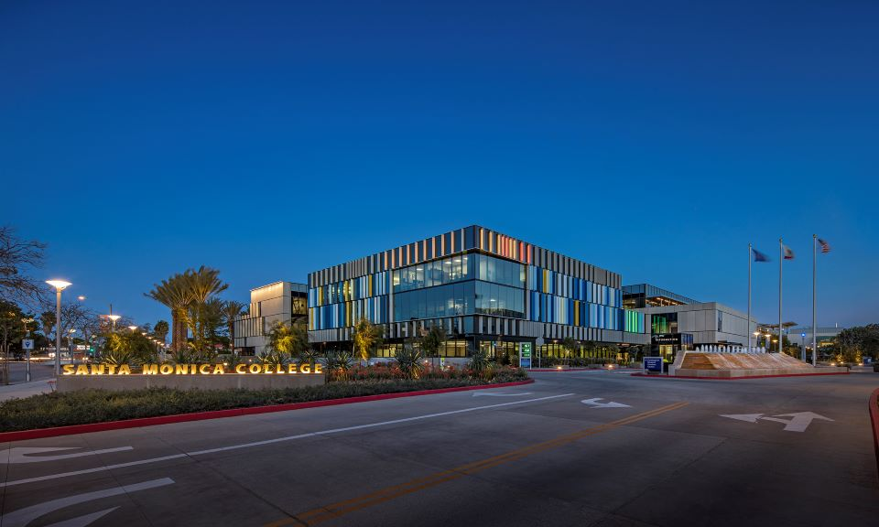
Santa Monica College
Board of Trustees
2026-2027 State Adopted Budget
July 7, 2026

Slide 2

How can I keep up-to-date?
DPAC: Both in-person and online meetings: https://admin.smc.edu/administration/governance/district-planning-policies/meetings.php
Budget Committee: Both in-person and online meetings: https://admin.smc.edu/administration/governance/district-planning-policies/budget-planning-subcommittee.php
SMC Budget Office: Reports, presentations and guides to budget items. https://admin.smc.edu/administration/business-services/budget/
Board of Trustee Meetings: Both in-person and online meetings. https://admin.smc.edu/administration/governance/board-of-trustees/meetings.php

Slide 3
Things Are Still Developing
State Budget is systemwide and general
  Trailer Bills through Summer will give more clarity on specific requirements related to funding
  CCCCO Budget Workshop in August will provide District specific allocations

Slide 4
2026-2027 State Adopted Budget

Slide 5
Prop 98
May Revise | Legislature | Final
24-25: $124.9b 25-26: $125.1b 26-27: $127.1b Total: $377.1b | 24-25: $124.9b 25-26: $127.0b 26-27: $127.9b Total: $379.8b | 24-25: $124.9b 25-26: $125.5b 26-27: $128.0b Total: $378.4b
Creation of a “Settle Up”
  Prop 98 is underfunded by $3.9 billion
  Funding will be provided at a future date if current projections are correct
Community College share of Prop 98 is 11.1%
  Traditionally Community College share is 10.87%
Change in SCFF
  FTES is now 3 Year Average or Current Year; Whichever is higher

Slide 6
2025-2026 Deferrals
May Revise | Legislature | Final
Fully repay | Fully repay | Fully repay
In 2025-2026 the State deferred paying Districts for Apportionment in May/June as a budget savings action
SMC deferral was ~$9 million

Slide 7
COLA/Inflationary Adjustment
May Revise | Legislature | Final
Statutory: 2.87% Discretionary: 1.44% Total 4.37% | Statutory: 2.87% Discretionary: 1.44% Total 4.37% | Statutory: 2.87% Discretionary: 1.44% Total 4.37%
Paid Pregnancy Leave – Up to 14 weeks of paid leave
    Pregnancy, miscarriage, childbirth, termination of pregnancy, and recovery from those conditions
COLA works different under SCFF
  Old method = Prior Year Apportionment times COLA = $7.2m
  SCFF method = Prior year payment per metric increased by COLA = $3.76 million (includes projected growth funding)

Slide 8
COLA/Inflationary Adjustment - Categoricals
May Revise | Legislature | Final
2.87% | 2.87% | 2.87%
Adult Education, EOPS, DSPS, CalWORKs, Mandates, Apprenticeship and CARE

Slide 9
COLA/Inflationary Adjustment - SEAP
May Revise | Legislature | Final
0.00% | 5.74% | 5.74%
First COLA since the program inception in 2018

Slide 10
Enrollment Growth
May Revise | Legislature | Final
1.5% over two years | 3.5% over two years | 2.5% over two years
Growth works differently than prior years
  Old method = Prior year FTES time Enrollment Growth
  New method = Multifaceted calculation. Guaranteed is 0.13% growth for SMC. Unfunded FTES will be funded if other Districts don’t use their allocation

Slide 11
CalBright College
May Revise | Legislature | Final
$38 million ongoing | $38 million ongoing | $38 million ongoing
Online classes can be offered by Districts at a fraction of the cost

Slide 12
Deferred Maintenance – Instructional Equipment
May Revise | Legislature | Final
$120.7m one-time | $120.7m one-time | $120.7m one-time
Provides funds for deferred maintenance projects and instructional equipment
  Last funded in 2022-23 State Budget Act
  SMC: $2,062,272

Slide 13
Credit for Prior Learning
May Revise | Legislature | Final
$35m one-time $2m ongoing | $35m one-time $2m ongoing | $35m one-time $2m ongoing
Continued investment aimed at providing opportuny to veterans, working adults and apprentices with a jumpstart of one year on completing degrees based on experience

Slide 14
Common Cloud
May Revise | Legislature | Final
$35m one-time $2m ongoing | $35m one-time $2m ongoing | $36m one-time $5m ongoing
Implementation of common technology for all Districts including:
  E-Transcripts
  Mapping Articulation Pathways platform
  Program Pathways Mapper

Slide 15
California Early College Demo Initiative
May Revise | Legislature | Final
$0 | $0 | $10m one-time
Expand opportunities for high school students to earn significant college credit

Slide 16
Cal-Bridge
May Revise | Legislature | Final
$0 | $1.2m one-time | $1.2m one-time
Cal-Bridge is a statewide partnership among the California Community Colleges, the California State University system, and the University of California that helps talented students—especially those from groups historically underrepresented in STEM—transition successfully into graduate education.

Slide 17
Student Support Block Grant
May Revise | Legislature | Final
$100.6m one-time | $275.0m one-time | $147.2m one-time
Waiting for trailer language to clarify usage
CCCCO has not released allocation (Preliminary District projection $2.0m)

Slide 18
LGBTQ+ Centers
May Revise | Legislature | Final
$0 | $30m one-time | $30m one-time
Support for College LGBTQ+ Centers

Slide 19
Dreamer Resource Liaisons
May Revise | Legislature | Final
$0 | $101.6m one-time $15m ongoing | $70m one-time
Continued support for undocumented and AB 540 students including providing specialized advising and case management; Connect students with financial aid resources, including the California Dream Act Application (CADAA); Assist students in accessing legal services and immigration-related resources; and Coordinate referrals for basic needs, mental health, and other student support services.

Slide 20
Related and Supplemental Instruction
May Revise | Legislature | Final
$16m one-time | $16m one-time | $16m one-time
Related and Supplemental Instruction (RSI) is the required classroom instruction that complements paid on-the-job training in registered apprenticeship programs. Community college districts and K–12 local educational agencies are reimbursed for providing this instruction. The program supports apprentices in acquiring the technical knowledge needed to complete their apprenticeship and earn industry-recognized credentials.

Slide 21
Adult Learner Demo Project
May Revise | Legislature | Final
$9.7m one-time over three years | $9.7m one-time over three years | $9.7m one-time over three years
Demonstration project that provides comprehensive support to help low-income adult learners and workers gain skills, complete education and training, and transition into stable, higher-paying jobs

Slide 22
Future of Creative Industries Pilot
May Revise | Legislature | Final
$0 | $15m one-time | $15m one-time
Preparing students for careers in fields such as Digital Media, Film and Television, Animation, Gaming, Music and Audio Production, Design, and Emerging AI-enabled Creative Technologies

Slide 23
Healthy Schools Food Pathway
May Revise | Legislature | Final
$14m ongoing | $14m ongoing | $14m ongoing
To support workforce training for school nutrition professionals

Slide 24
English Language Learners Pathway
May Revise | Legislature | Final
$0 | $20.1m one-time | $20.1m one-time
Educational and workforce pathways for English language learners, helping them improve English proficiency while earning college credentials and preparing for employment in high-demand careers.

Slide 25
Questions

