Slide 1
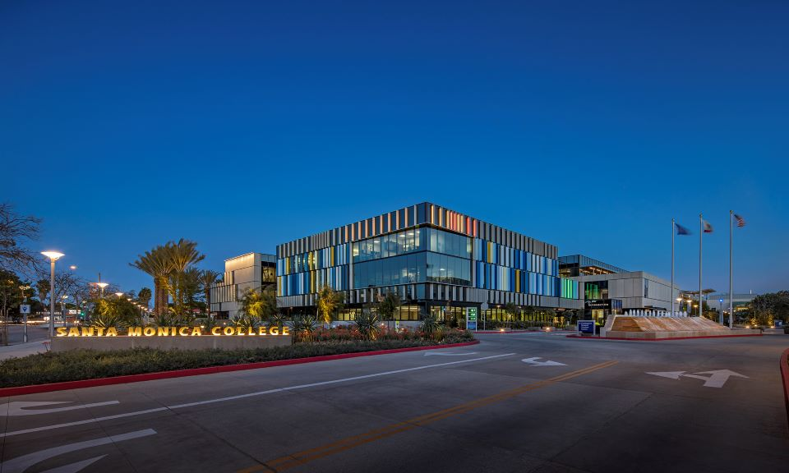
Santa Monica College
Board of Trustees
Adopted Budget
September 8, 2026

Slide 2

How can I keep up-to-date?
DPAC: Both in-person and online meetings: https://admin.smc.edu/administration/governance/district-planning-policies/meetings.php
Budget Committee: Both in-person and online meetings: https://admin.smc.edu/administration/governance/district-planning-policies/budget-planning-subcommittee.php
SMC Budget Office: Reports, presentations and guides to budget items. https://admin.smc.edu/administration/business-services/budget/
Board of Trustee Meetings: Both in-person and online meetings. https://admin.smc.edu/administration/governance/board-of-trustees/meetings.php

Slide 3

2025-2026
Summary of Changes
Adopted to Final

Slide 4
 | 2025-2026 Adopted | 2025-2026 Unaudited Final | Major Change | Change Amount
Beginning FB | $ 23,529,795 | $ 23,529,795 | No Change | $ -
Apportionment | $ 168,740,327 | $ 168,740,327 | No Change | $ -
Non-Apportionment | $ 21,441,560 | $ 26,913,541 | One-time: Aux = $2.7m; Wildfire = $2.0m; SMCF = $1.0m | $ 5,471,981
STRS On-behalf Payment | $ 6,805,191 | $ 7,259,802 | Accounting entry only – No budget effect | $ 454,611
Non-Resident Tuition | $ 27,981,784 | $ 27,234,888 | AB: <7.03%>; Fl: <9.46%> | $ (746,896)
Total Revenue | $ 224,968,862 | $ 230,148,558 | 2.3% Difference | $ 5,179,696
Salary and Benefits | $ 207,221,618 | $ 207,919,363 | Net of $2.2m vacation payouts; $1.0m SMCF sections; attrition, ASCIP | $ 697,745
STRS On-behalf Payment | $ 6,805,191 | $ 7,259,802 | Accounting entry only – No budget effect | $ 454,611
Supplies/Other Operating/Transfers | $ 21,028,042 | $ 19,679,880 | AB218 Savings; Utility rebates & lower rates | $ (1,348,162)
Total Expenditure | $ 235,054,851 | $ 234,859,045 | (0.08%) Difference | $ (195,806)
Surplus/Deficit | $ (10,085,989) | $ (4,710,487) |  | $ 5,375,502
Ending Fund Balance | $ 13,443,806 | $ 18,819,308 |  | $ 5,375,502
 | 5.72% | 8.01% |  | 2.29%

Slide 5
Reduction in Fund Balance
of
<$25,095,300> or <57.1%>
Equivalent to
<$522,819> a month

Slide 6
ACCJC Enhanced Fiscal Monitoring

Slide 7
ACCJC Enhanced Fiscal Monitoring
Letter received July 24, 2026, District placed on Enhanced Fiscal Monitoring
Factors identified for “at-risk” designation:
  Unresolved structural deficit and negative trend in Fund Balance
  Significant underfunding of Other Post-Employment Benefits (OPEB) liability
  34% decline in cash balance over reporting years of 2022-23 through 2024-25
  Multiple open collective bargaining agreements
District prepared a response to ACCJC and shared that response with the campus community
ACCJC has accepted the District response and will continue monitoring

Slide 8
CCCCO
Fiscal Health Resiliency Monitoring

Slide 9
Fiscal Health Resiliency Monitoring
Letter received August 3, 2026, CCCCO will perform a fiscal and audit review
Purpose is to:
  Support proactive engagement
  Identify fiscal and enrollment trends
  Provide technical assistance that promotes long-term fiscal stability
Information may be used to update:
  Consultation Council
  Board of Governors
  FCMAT
District is working with CCCCO to schedule

Slide 10
Fiscal Health Resiliency Monitoring
Consultation Council Agenda August 20, 2026
  Fiscal indicators are reviewed collectively to evaluate trends and conditions that may affect long-term fiscal sustainability. These indicators include:
    Reserve levels and unrestricted fund balances
    Enrollment trends and related revenue impacts
    Cash flow and liquidity
    Surplus or deficit spending trends
    Salaries and benefits as a percentage of expenditures
    Executive leadership turnover
    Timeliness of required financial reporting
    Audit findings and compliance issues

Slide 11
Fiscal Health Resiliency Monitoring
“Based on the 2024-25 Fiscal Health and Resiliency Monitoring review, the Chancellor's Office identified the following districts for additional monitoring. As part of this process, the Chancellor's Office will schedule a Fiscal Forward session with each district to review financial data, evaluate key indicators, discuss fiscal trends, and identify opportunities for support and technical assistance.”
  Chabot-Las Positas Community College District
  Mt. San Antonio Community College District
  Santa Monica Community College District
  West Kern Community College District

Slide 12
2026-2027
Proposed Adopted Budget

Slide 13
Linking Planning to Budgeting
District Planning and Advisory Council (DPAC)
Two new Annual Action Plan Recommendations
Cost: $20,000

Slide 14
AAP #1: Strategic Data-Informed Scheduling
Budget: $20,000
Purpose/Goal of Action Plan:
Advance Santa Monica College towards a more strategic, coordinated, and data-informed approach to course scheduling and enrollment management.
AAP #2: Educate the campus on the Student-Centered Funding Formula (SCFF)
Budget: $0
Purpose/Goal of Action Plan:
Educate the campus on the SCFF and its implications for funding and student success ensuring college practices translate into recognized success under the SCFF. (Institutional Effectiveness Committee recommendation)

Slide 15
Major Assumptions
Apportionment $174,310,122 - $5.57 million increase from 25-26
  District is no longer in Hold Harmless
  District is now in Stabilization – (PY SCFF increased by COLA)
    2025-26 SCFF: $167,107,777
    2025-26 Hold Harmless: $168,740,327
    2026-27 SCFF Proj: $173,638,816
    2026-27 Stabilization: $174,310,122
Assuming enrollment meets projections and State fully funds 0.3462% District growth
Block Grant is not included as the State has yet to finalize allocations

Slide 16
Projected Credit Resident Enrollment Increase of 2.53% or 426.41 FTES
    State will only guarantee funding 0.3462% growth or 62.45 FTES
    In February 2028 State will reallocate unused statewide growth and some unfunded growth may be funded
  2018-2019 Final: 19,501
  2019-2020 Final Actual: 17,551
  2020-2021 Final: 19,101
  2021-2022 Final: 17,013
  2022-2023 Final: 16,074
  2023-2024 Final: 16,640
  2024-2025 Final: 16,932
  2025-2026 Projected : 16,839
  2026-2027 Projected : 17,265

Slide 17
~<2,236> or <11.47%>
Decrease in
Credit Resident FTES
~426 or 2.5%
Projected Increase in
Credit Resident FTES

Slide 18
Proj. Non-resident Enrollment Decrease of <8.96%> or <244.38> FTES
  Second largest source of revenue – 11.4% of UGF Revenue
2018-2019 Final: 4,259
2019-2020 Final: 3,702
2020-2021 Final: 3,088
2021-2022 Final: 2,763
2022-2023 Final: 2,844
2023-2024 Final: 3,157
2024-2025 Final: 3,011
2025-2026 Projected: 2,726
2026-2027 Projected: 2,482

Slide 19
~<244> or <8.96%>
Decrease in
Non-resident FTES
~<1,777> or <41.7%>
Decrease in
Non-resident FTES

Slide 20
Continuation of Fee Based Instruction: Approximately $2.2 million
Non-resident Tuition reflects fee increase of 4.52% and FTES decline of <8.96%>
Non-repetition of one-time items from 2025-26 totaling a revenue reduction of <$6.9> million
  KCRW prior year reimbursement, SMCF donation for additional sections, Wildfire Assistance, Auxiliary Transfer

Slide 21
Salaries and Benefits reflect:
  Reduction in force for management/administration and CSEA
  Implementation of furloughs for management/administration (2 days of furlough a month) and CSEA (1 day furlough a month)
  Implementation of salary freezes for management/administration, SMCPOA and CSEA
  Increase of step, column and longevity for Faculty
  Increase in District funded instructional hours of ~2.8%
    Backfill of SMCF WTH plus 1.57% for growth
    Credit Efficiency of 89.5%
    2022-23: 78.6%; 2023-24: 83.6%; 2024-25: 85.8%: 2025-26 Proj.: 88.7%
Health and Welfare
  Current Employees: 6.5% increase
  Retirees: 6.34% increase plus 25-26 retirees

Slide 22
Supplies: Continue prior year reductions adj. for PBAR
Contracts: Continue prior year reductions adj. for PBAR
Insurance increased by ~18% and $302,572 for AB 218
Utilities increased by 7% less savings from UUT

Slide 23

Projected Changes in Revenue 2025-2026 Unaudited to 2026-2027 Proposed Budget
2025-2026 Projected | $230,148,558
Apportionment | 5,569,795
Interest – Lower Fund Balance | -227,719
CalSTRS On behalf | -239,584
Non-Resident Tuition/ESL | -1,325,420
Non-repetition of One-time Items | -6,896,527
Other | 102,183
2026-2027 Proposed Budget Revenue Projection | $227,131,286
Decrease in revenue of <$3,017,272> or <1.31%>

Slide 24
Projected Changes in Expenditures 2025-2026 Unaudited to 2026-2027 Proposed Budget
2025-2026 Projection | $234,859,045
Health and Welfare – Current and Retirees | 2,801,396
Increase in Hourly Instruction and Non-Instruction (Net of intersession banking deferral) | 2,607,979
Step and Longevity (Faculty only – No Step and Longevity for Management, Administration or CSEA)) | 1,259,751
Insurance and Utilities | 834,813
Vacancy List | 678,984
CalSTRS On behalf | -239,584
Non-repetition of One-time SMCF Funded Sections | -1,000,000
Net Vacation Payout w/ Benefits (25-26: $2,319,049; 26-27: $1,192,821) | -1,126,228
Furlough of Management/Admin. (2 days a month) and CSEA (1 day a month) Incl. Benefits | -3,561,708
Full Year Effect of Hiring, Termination and Retirements | -3,955,358
Reduction in Force of Management/Admin, and CSEA Incl. Benefits | -5,664,110
Other | -62,192
2026-2027 Proposed Budget Expenditure Projection | $227,432,788
Reduction in expenditure of <$7,426,257> or <3.16%>

Slide 25
<$7,925,092> or <5.6%>

Slide 26
<$455,454> or <0.6%>

Slide 27
$156,344 or 25%

Slide 28
<$73,008> or <0.7%>

Slide 29
$155,778 or 2.7%

Slide 30
$679,035 or 32.5%

Slide 31
Fund Balance
 | Unaudited 2025-2026 | Proposed 2026-2027
Beg. Fund Balance: | 23,529,795 | 18,819,308
Revenue - Ongoing | 222,446,401 | 226,325,654
Expenditures - Ongoing | 231,729,731 | 231,149,961
Structural Surplus/Deficit | <9,283,330> | <4,824,307>
One-time Revenue and Exp. (Net) | 4,572,843 | 4,522,805
Overall Surplus/Deficit | <4,710,487> | <301,502>
Ending Fund Balance: | 18,819,308 | 18,517,806
FB to Total Expenditure and Trfr: | 8.01% | 8.14%
*Chancellor’s Office recommended minimum fund balance is 16.67% or $37,913,046

Slide 32
 | 2026-2027 | Projected 2027-2028 | Projected 2028-2029
Beg. Fund Balance: | 18,819,308 | 18,517,806 | 13,351,066
Revenue: | 227,131,286 | 230,732,219 | 237,676,812
Expenditure: | 227,432,788 | 235,898,959 | 241,409,798
Surplus/Deficit: | <301,502> | <5,166,740> | <3,732,985>
Ending Fund Balance: | 18,517,806 | 13,351,066 | 9,618,081
FB to Total Expenditure and Trf: *Note: 2026-27 includes Board approved furlough and freeze of longevity, step and column for management and CSEA | 8.14% | 5.66% | 3.98%
Budget Actions Needed: | - | 5,166,740 | -
Revised Surplus/Deficit: | - | 0 | 1,433,755
Revised Ending Fund Bal: | - | 18,517,806 | 19,951,561
Revised FB to Tot. Exp and Trf: | - | 7.85% | 8.26%

Slide 33
 | 2026-2027 | Projected 2027-2028 | Projected 2028-2029
Beg. Fund Balance: | 18,819,308 | 18,517,806 | 13,351,066
Revenue: | 227,131,286 | 230,732,219 | 237,676,812
Expenditure: | 227,432,788 | 235,898,959 | 241,409,798
Surplus/Deficit: | <301,502> | <5,166,740> | <3,732,985>
Ending Fund Balance: | 18,517,806 | 13,351,066 | 9,618,081
FB to Total Expenditure and Trf: *Note: 2026-27 includes Board approved furlough and freeze of longevity, step and column for management and CSEA | 8.14% | 5.66% | 3.98%
Budget Actions Needed: | - | 5,166,740 | 5,000,000
Revised Surplus/Deficit: | - | 0 | 6,433,755
Revised Ending Fund Bal: | - | 18,517,806 | 24,951,561
Revised FB to Tot. Exp and Trf: | - | 7.85% | 10.34%

Slide 34
Key Take Aways
    Fall Budget Forum (Nov 2025) Deficit was projected to be <$16,730,361>. Action to date has improved fiscal stability but a structural deficit of approx. $5 million remains
    Projected fund balance is 8.14% or $18,517,806. State recommends a fund balance of 16.67% or $37,913,046
    2026-27 includes furloughs and freezes of step, column, and longevity for managers and classified staff. These actions help with current-year fiscal stability but are not a long-term solution
    Further budget actions are still required

Slide 35
    Special Thank You To…
    Veronica Diaz and the Budget Team
    John Greenlee, Yu-Ngok Lo
    and the Facilities Planning Team
    Kim Tran, Irma Haro and the Accounting Team
    The Budget Committee

Slide 36
Questions

