Slide 1
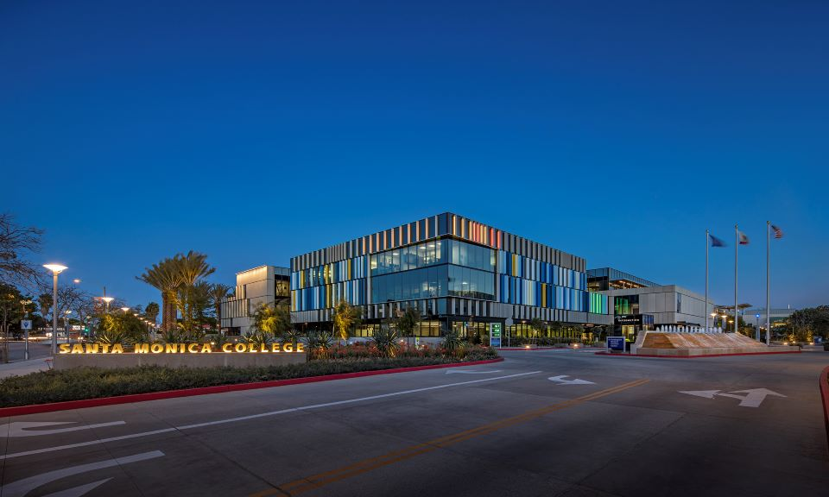
Student Success and the SCFF:
Connecting What We Do To How We’re Funded
Professional Development Day
August 27, 2026

Slide 2

How can I keep up-to-date?
DPAC: Both in-person and online meetings: https://admin.smc.edu/administration/governance/district-planning-policies/meetings.php
Budget Committee: Both in-person and online meetings: https://admin.smc.edu/administration/governance/district-planning-policies/budget-planning-subcommittee.php
SMC Budget Office: Reports, presentations and guides to budget items. https://admin.smc.edu/administration/business-services/budget/
Board of Trustee Meetings: Both in-person and online meetings. https://admin.smc.edu/administration/governance/board-of-trustees/meetings.php

Slide 3
Cannot Cover It All In An Hour!
How the SCFF works and how to maximize funding.
Goal is for all of us to have a better understanding of the formula and how we can maximize revenue through helping students!
I have to move fast but the presentation will be posted on Budget Office website and follow up trainings will be held this year

Slide 4
How Does SCFF Work?

Slide 5
Looking For More Details?
  Established in the 2017-18 through AB 1809, the Higher Education Trailer Bill
  https://www.leginfo.legislature.ca.gov/faces/billTextClient.xhtml?bill_id=201720180AB1809&utm_source
  Education Code 84750.4
  https://leginfo.legislature.ca.gov/faces/codes_displaySection.xhtml?lawCode=EDC&sectionNum=84750.4&utm_source

Slide 6
Student Centered Funding Formula
  Implemented in 2018
  Idea was to change to a performance-based funding model incentivize Districts to focus on student outcomes and equity to maximize funding
  Revenue is driven by Three Major Allocation Categories each containing numerous metrics that are funded at various amounts
  The District is projecting to be out of Hold Harmless in 2026-27 and fully under the SCFF. Two major changes related to this change include:
    COLA
    Growth

Slide 7
COLA
COLA works different under SCFF
  Old method = Prior Year Apportionment times COLA = $7.2m
  SCFF method = Prior year payment per metric increased by COLA = $3.76 million (includes projected growth funding)
While Statutory COLA is 4.31%, effective COLA is 2.23%

Slide 8
Enrollment Growth
Growth is allocated at different amounts for each District by the CCCCO
  Multifaceted calculation to determine growth need includes:
    Adults without College Degrees within district boundaries
    Unemployed Adults within district boundaries
    Households below poverty line within district boundaries
    Pell awards
    Pell student headcount
  Guaranteed is 0.3462% growth for SMC. Unfunded FTES will be funded if other Districts don’t use their allocation

Slide 11
Student Centered Funding Formula
  SCFF is a “Performance-Based Funding Model”
    “A model of funding colleges that allocates a portion of public funds based on whether colleges achieve specific performance goals or outcomes”
  Three Major Allocation Categories each containing numerous metrics
Base Allocation
“Access”
Metrics include FTES, size of college, and size of center
Represents 70% of Funding
Supplemental Allocation
“Equity”
Metrics include number students receiving Pell, Promise or are AB540
Represents 20% of Funding
Student Success Allocation
“Outcomes”
Metrics include awards conferred, transfers, and obtaining a living wage
Represents 10% of Funding

Slide 12
Base Allocation
  Focuses on “Access”
  Sub-Allocations and Metrics include:

Slide 13
Base Allocation
Basic Allocation
  Number and size of colleges in District
  Number and size of Centers in District

Slide 14
Base Allocation – Basic Allocation Funding Rates
2025-26 and projected rounded 2026-27 rates
Category | 2025-26 | 2026-27
> 20,000 Resident FTES | $11,096,910 | $11,575,187
> 10,000 < 20,000 Res. FTES | $8,877,529 | $9,260,150
<10,000 Resident FTES | $6,658,143 | $6,945,109
Grandparented Center >1,000 Res. FTES | $2,219,382 | $2,315,037

Slide 15
Base Allocation
  FTES Allocation (Only Resident Counts)
    Credit FTES
    Career Development and College Preparation FTES
      E.g. ESL, Basic Skills, Non-credit Workforce Preparation
    Dual Enrollment/Special Admits
    Incarcerated FTES
    Non-credit FTES
      E.g Emeritus
  As of 2026-27 Credit FTES counted in the formula are the higher of either the average FTES of the last three years or the current year FTES. All other FTES are current year reported FTES
  Year over year FTES funded growth is capped at the Districts growth rate

Slide 16
Base Allocation - FTES Funding Rates
2025-26 and projected rounded 2026-27 rates
FTES Category
2025-26
2026-27
Credit Resident
$5,488
$5,725
CDCP - (E.g. ESL, Basic Skills)
$7,595
$7,922
Dual Enrollment/Special Admits
$7,724
$8,057
Incarcerated
$7,724
$8,057
Noncredit
$4,567
$4,764
Different FTES are Funded at Different Rates!

Slide 17
Supplemental Allocation
  Focuses on “Equity”
  Metrics include unduplicated headcount of:
    Pell Grant recipients
    California Promise Grant recipients
    AB 540 students
  A student who qualifies under more than one category is funded under every category they qualify under

Slide 18
Supplemental Allocation Funding Rates
Category | 2025-26 | 2026-27
Pell Recipient | $1,280.76 | $1,335.96
Promise Recipient | $1,280.76 | $1,335.96
AB 540 | $1,280.76 | $1,335.96

Slide 19
Student Success Allocation
  Focuses on “Outcomes”
  Three separate sub-allocations
    All Students
    Pell Recipients Premium
    Promise Recipients Premium
  Each sub-allocation contains eight metrics
  Funded numbers are based on unduplicated headcount on a three-year rolling average

Slide 20
Student Success Allocation
  All three sub-allocations have the same metrics:
    Associates Degree for Transfer
    Associates Degree
    Baccalaureate Degree
    Credit Certificate
    Transfer Level Math and English in Year 1
    Transfer to a Four-Year University
    Nine or more CTE Units
    Obtaining a Living Wage
  But each sub-allocation awards a different level of points or amount per metric

Slide 21
Student Success Allocation – All Student Funding Rates
Category | Points | 2025-26 Rate | 2025-26 Total | 2026-27 Rate | 2026-27 Total
ADT | 4 | $755.21 | $3,020.84 | $787.76 | $3,151.04
Associates Degree | 3 | $755.21 | $2,265.63 | $787.76 | $2,363.28
Baccalaureate Degree | 3 | $755.21 | $2,265.63 | $787.76 | $2,363.28
Credit Certificate | 2 | $755.21 | $1,510.42 | $787.76 | $1,575.52
Transfer Level Math and English | 2 | $755.21 | $1,510.42 | $787.76 | $1,575.52
Transfer | 1.5 | $755.21 | 1,132.82 | $787.76 | $1,181.64
Nine or more CTE Units | 1 | $755.21 | $755.21 | $787.76 | $787.76
Obtain Living Wage | 1 | $755.21 | $755.21 | $787.76 | $787.76
Funding is only given for the achievement of one degree or certificate per headcount
If a student graduates in Spring, takes a summer class at SMC to get ahead,
and transfer in the Fall the State does not consider it a transfer

Slide 22
Student Success Allocation – Pell Premium Funding Rates
Category | Points | 2025-26 Rate | 2025-26 Total | 2026-27 Rate | 2026-27 Total
ADT | 6 | $190.49 | $1,142.94 | $198.70 | $1,192.20
Associates Degree | 4.5 | $190.49 | $857.21 | $198.70 | $894.15
Baccalaureate Degree | 4.5 | $190.49 | $857.21 | $198.70 | $894.15
Credit Certificate | 3 | $190.49 | $571.47 | $198.70 | $596.10
Transfer Level Math and English | 3 | $190.49 | $571.47 | $198.70 | $596.10
Transfer | 2.25 | $190.49 | $428.60 | $198.70 | $447.08
Nine or more CTE Units | 1.5 | $190.49 | $285.74 | $198.70 | $298.05
Obtain Living Wage | 1.5 | $190.49 | $285.74 | $198.70 | $298.05
Pell premium is in addition to “All Students” funding rates

Slide 23
Student Success Allocation – Promise Funding Rates
Category | Points | 2025-26 Rate | 2025-26 Total | 2026-27 Rate | 2026-27 Total
ADT | 4 | $190.49 | $761.96 | $198.70 | $794.80
Associates Degree | 3 | $190.49 | $571.47 | $198.70 | $596.10
Baccalaureate Degree | 3 | $190.49 | $571.47 | $198.70 | $596.10
Credit Certificate | 2 | $190.49 | $380.98 | $198.70 | $397.40
Transfer Level Math and English | 2 | $190.49 | $380.98 | $198.70 | $397.40
Transfer | 1.5 | $190.49 | $285.74 | $198.70 | $298.05
Nine or more CTE Units | 1 | $190.49 | $190.49 | $198.70 | $198.70
Obtain Living Wage | 1 | $190.49 | $190.49 | $198.70 | $198.70
Promise premium is in addition to “All Students” funding rates and Pell premium

Slide 24
Total Computational Revenue
  Total Computation Revenue is the Districts State Funding Calculated as the Greater of:
    SCFF Calculation
    Stability Calculation
      Prior year SCFF adjusted for COLA
    Hold Harmless Calculation
      Amount received in 2024-2025 plus 1.44%

Slide 25
How Does What We Do Everyday Affect Funding?
Student Jordon Welcome shows up one day and signs up for some random classes. Jordon is not sure what they are doing but wants to improve their life somehow. Jordon averages half a load as they can’t afford to take a full load with a child at home. Jordon graduates with an AA.
  Year One Funding
    FTES = $2,862
  Year Two Funding
    FTES = $2,862
  Year Three Funding
    FTES = $2,862
  Year Four Funding
    FTES = $2,862
    AA Degree = $2,363
  Total Funding = $13,811 over four years

Slide 26
Student Jordon Welcome shows up one day to sign up for some random classes. A faculty member notices Jordon looks overwhelmed and confused and asks how they are doing. After a conversation, the faculty member brings Jordon to the Financial Aid Department before signing up for all their classes, which Jordon never knew was a thing. At Financial Aid Jordon learned about Pell, Promise, SEOG and Scholarships which will allow Jordon to afford to take a full load! Jordon qualified for Pell and Promise. Jordon graduates with an AA.
  Year One Funding
    FTES = $5,725
    Pell = $1,336
    Promise: $1,336
  Year Two Funding
    FTES = $5,725
    Pell = $1,336
    Promise: $1,336
    AA Degree = $2,363
    AA Degree Pell Premium = $894
    AA Degree Promise Premium = $596
  Total Funding = $20,647 over two years

Slide 27
Student Jordon Welcome shows up one day to sign up for some random classes. A faculty member notices they looks overwhelmed and confused and asks how they are doing. After a conversation, the faculty member brings them to the Financial Aid Department before signing up for their classes, which Jordon never knew was a thing. At Financial Aid they learned about Pell, Promise, SEOG and Scholarships which will allow Jordon to afford to take a full load! They qualify for Pell and Promise. The Financial Aid Specialist at the front counter gives Jordon some great advice to see a counselor asap. The counselor sees Jordon really enjoys numbers and inspires them to go for a transfer to CSUN in Accounting with an ADT. They graduate with an ADT and Transfer to CSUN.
  Year One Funding
    FTES = $5,725
    Pell: $1,336
    Promise: $1,336
  Year Two Funding
    FTES = $5,725
    Pell: $1,336
    Promise: $1,336
    ADT Degree = $3,151
    ADT Degree Pell Premium = $1,192
    ADT Degree Promise Premium = $795
    Transfer = $1,181
    Transfer Pell Premium = $447
    Transfer Promise Premium = $298
  Total Funding = $23,858 over two years

Slide 28
How Does What We Do Everyday Affect Funding?
Student Jordon Welcome just finding their own way with no help being offered results in average funding of $3,453 a year.
A caring faculty member checking on what appeared to be an overwhelmed student led to the student discovering financial aid and increased average funding to $10,324 a year, a $6,871 annual increase.
An astute financial aid specialist ensured the student met with a great counselor which led to a clear educational plan and support increasing average funding to $11,929 a year, a $1,605 annual increase.
What we do matters to the student and to the bottom line!

Slide 29
Questions

