Slide 1
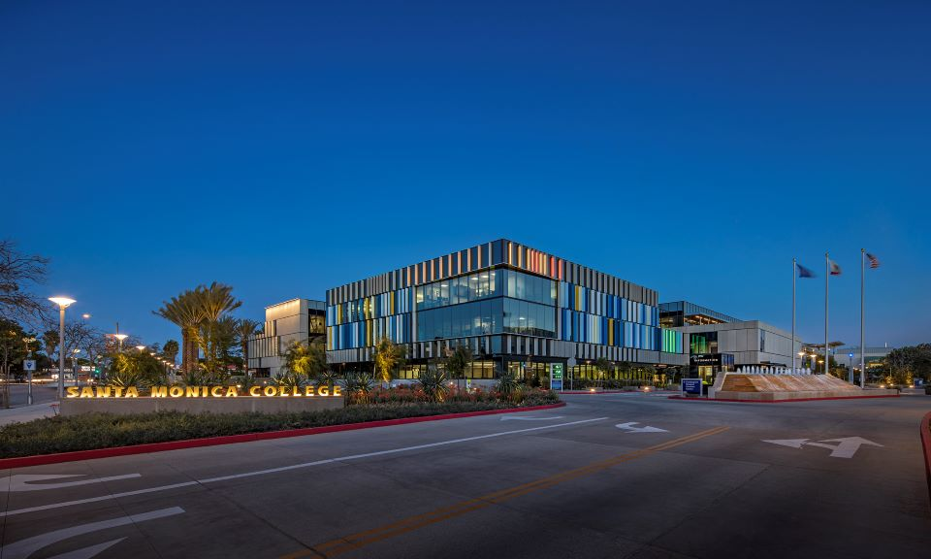
Santa Monica College
Board of Trustees
August Update
August 4, 2026

Slide 2

How can I keep up-to-date?
DPAC: Both in-person and online meetings: https://admin.smc.edu/administration/governance/district-planning-policies/meetings.php
Budget Committee: Both in-person and online meetings: https://admin.smc.edu/administration/governance/district-planning-policies/budget-planning-subcommittee.php
SMC Budget Office: Reports, presentations and guides to budget items. https://admin.smc.edu/administration/business-services/budget/
Board of Trustee Meetings: Both in-person and online meetings. https://admin.smc.edu/administration/governance/board-of-trustees/meetings.php

Slide 3
Things Are Still Developing
State Budget is systemwide and general
Trailer Bills through Summer will give more clarity on specific requirements related to funding
CCCCO August Budget Workshop
    Still Working on Allocations
Adopted Budget is September

Slide 4
COLA and Growth

Slide 5
COLA
COLA works different under SCFF
  Old method = Prior Year Apportionment times COLA = $7.2m
  SCFF method = Prior year payment per metric increased by COLA = $3.76 million (includes projected growth funding)
While Statatory COLA is 4.37%, effective COLA is 2.23%

Slide 6
Enrollment Growth
Growth works differently than prior years
  Old method = Prior year FTES time Enrollment Growth percentage
  New method = Multifaceted calculation to determine growth need:
    Adults without College Degrees within district boundaries
    Unemployed Adults within district boundaries
    Households below poverty line within district boundaries
    Pell awards
    Pell student headcount
  Guaranteed is 0.3462% growth for SMC. Unfunded FTES will be funded if other Districts don’t use their allocation

Slide 9
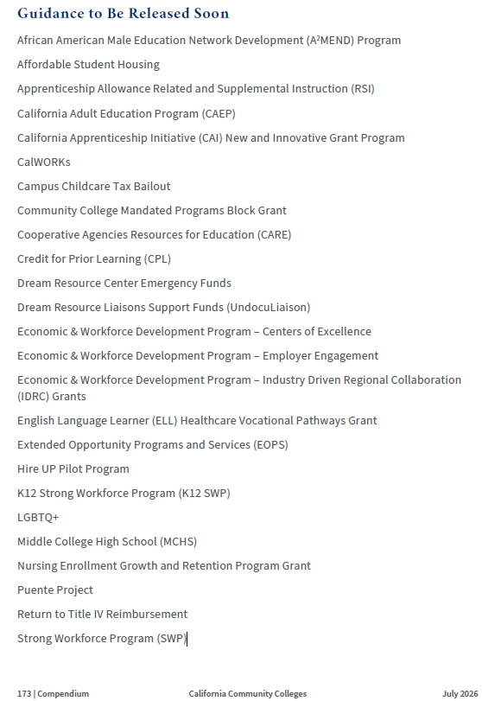
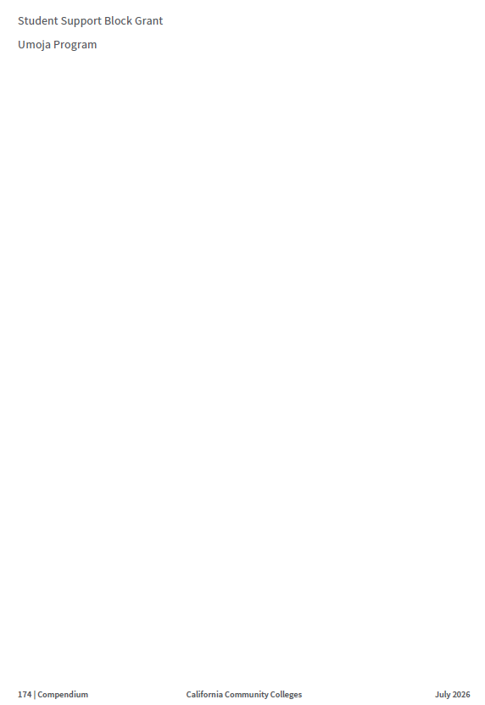
Still Outstanding

Slide 10
ACCJC Enhanced Fiscal Monitoring

Slide 11
ACCJC Enhanced Fiscal Monitoring
Letter received July 24, 2026, District placed on Enhanced Fiscal Monitoring
Factors identified for “at-risk” designation:
  Unresolved structural deficit and negative trend in Fund Balance
  Significant underfunding of Other Post-Employment Benefits (OPEB) liability
  34% decline in cash balance over reporting years of 2022-23 through 2024-25
  Multiple open collective bargaining agreements
District preparing a response to ACCJC and will share that response with the campus community

Slide 12
CCCCO
Fiscal Health Resiliency Monitoring

Slide 13
Fiscal Health Resiliency Monitoring
Letter received August 3, 2026, CCCCO will perform a fiscal and audit review
Purpose is to:
  Support proactive engagement
  Identify fiscal and enrollment trends
  Provide technical assistance that promotes long-term fiscal stability
Information may be used to update:
  Consultation Council
  Board of Governors
  FCMAT
District is working with CCCCO to schedule

Slide 14
Questions

