Slide 1
Santa Monica College
Budget Review and Discussion
Board of trustees
February 18, 2025

Slide 2

Historical Budget Review

Slide 4

Decline of <1,930> or <10.1%>

Slide 5
Increase of 177 or 24.0%

Slide 6
Decline of <1,139> or <26.7%>

Slide 7
$24,538,554 or 20.8%

Slide 8
Unrestricted General Fund
Increase in Full Time Equivalent Employees
7.4% Increase in positions
Faculty: 22.83 FTE; Administrators/Managers: 6.17 FTE; Classified NM: 25.83 FTE = Total 54.83

Slide 9
Increase in Compensation
 | 22-23 | 23-24 | 24-25 | 22-23 Longevity | 23-24 Longevity | 24-25 Longevity
Faculty | 7% On Schedule | 75% of COLA = 6.165% On Schedule | 75% of COLA = 0.8025% On Schedule | 16 Yrs = 1%; 21 Yrs = 2%; 26 Yrs =3% | 16 Yrs = 2.5%; 21 Yrs = 5.0%; 26 Yrs =7.5% | 16 Yrs = 5%; 21 Yrs = 10%; 26 Yrs =15%
 | 22-23 | 23-24 | 24-25
Classified | 7.5% On Schedule Retroactive to July 2021; 2.5% On Schedule; $3,000 OT Payment | 75% of COLA = 6.165% On Schedule | In negotiations
 | 22-23 | 23-24 | 24-25 | 22-23 Longevity | 23-24 Longevity | 24-25 Longevity
Academic Administrators and Classified Management | 7% On Schedule; $3,000 OT Payment | 75% of COLA = 6.165% On Schedule | 75% of COLA = 0.8025% On Schedule | Academic Admin: 16 Yrs = 1%; 21 Yrs = 2%; 26 Yrs =3% | Academic Admin: 16 Yrs = 2.5%; 21 Yrs = 5.0%; 26 Yrs =7.5% | Academic Admin: 16 Yrs = 5%; 21 Yrs = 10%; 26 Yrs =15%

Slide 10
$13,141,213 or 22.3%

Slide 12
$1,426,096 or 13.3%

Slide 13
$2,308,464 or 61.3%

Slide 14
$467,016 or 30.0%

Slide 15
Reduction in Fund Balance
of
<$21,338,995> or <48%>
Equivalent to
<$592,750> a month

Slide 16
Budget Actions

Slide 17
 |  | 2023-2024 Planned Reductions | 23-24 Actual Savings | Savings not Attained
BUDGET ACTIONS
 | 13xx Hourly Instruction - Benefits @ 16% | 4,158,366 | 1,286,102 | 2,872,264
 | 14xx Hourly Non-Instruction - Benefits @16% | 440,173 | 440,173 | -
 | 231x Student Help | 373,170 | 326,389 | 46,781
 | 24x4 Overtime | 144,529 | 37,216 | 107,313
 | 4xxx Supplies | 206,819 | 206,819 | -
 | 4xxx TCO | 67,070 | 67,070 | -
 | 5220 and 5250 Conference | 214,044 | 214,044 | -
 | 5xxx Contracts | 500,024 | 500,024 | -
 | Attrition - Benefits | 1,549,777 | 461,473 | 1,088,304
 | Totals | 7,653,972 | 3,539,310 | 4,114,662
2023-2024 Budget Actions
Increase in schedule efficiency
Non-faculty attrition
Contracts and Services reductions
Non-instruction reductions
Student Help reductions (Fund 01.0 only)
Conference reductions
Supplies reduction
Overtime reduction
TCO deferral

Slide 18
2024-2025 Immediate Short-term Actions
Freeze all approved hiring unless the position would stop a vital District function.
  The PBAR Committee has reviewed previously approved PBARS and have frozen several that were in or preparing for recruitment. For the remainder of the year, the PBAR Committee will not be processing PBAR requests for backfilling positions on a permanent or temporary basis unless it is clear that not doing so would result in an end to a vital function. For example, if we have three employees performing duties at the front desk and one retires, the function will continue and backfill will not be approved.
Eliminate overtime to the maximum extent possible unless the expense is reimbursed by an outside entity, is vital to the continuation of a District function, or is related to public safety.
  This means that events that would require overtime should be moved to a time where staff can work the event during their normal working hours, including staff of departments that will be supporting the event. Exception will be made if the overtime cost is covered by an outside agency or is legally appropriate to be charged to a grant. Some functions are considered vital to the continuation of a District function and overtime will be allowed on a case-by-case basis for those activities.
Freeze any new contracts unless the contract is needed to continue a vital District function or is related to public safety.
  Departments have been instructed that no new contracts should be entered into for the remainder of the year unless they are needed to continue a vital District function.
Reductions in the Spring schedule of classes and counseling hours to reflect the college’s not meeting FTES projections in the current year.
  We are making every attempt to reduce the schedule and counseling hours for the Spring semester to achieve savings.

Slide 19
Budget Scenarios

Slide 20
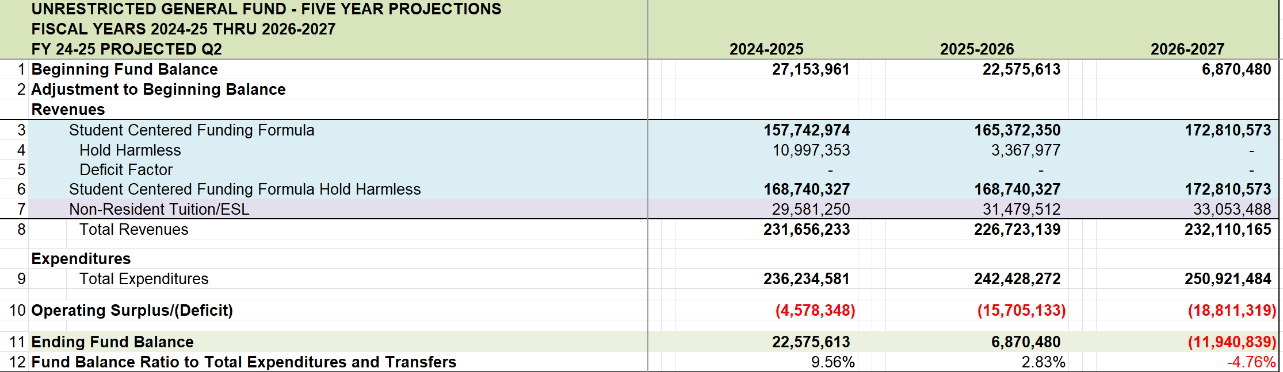
Multi-Year Projection With No Action

Slide 21
2025-2026 Budget Action Recommendations
Expected Attrition Not To Be Backfilled
Funding Shifts
  Big Blue Bus Shifted to Parking Fee Fund
    Time limited shift. Account has approximately $4.9 million balance
  Facilities Planning Staff Shifted to RDA Funds
    Time limited shift. RDA funds end in 2040
  Staff to other funds or grants if appropriate
5% Reduction in Hourly Instruction and Non-Instruction
Reimbursement from Outside Funds or Foundations
Specific Contract Reductions

Slide 22
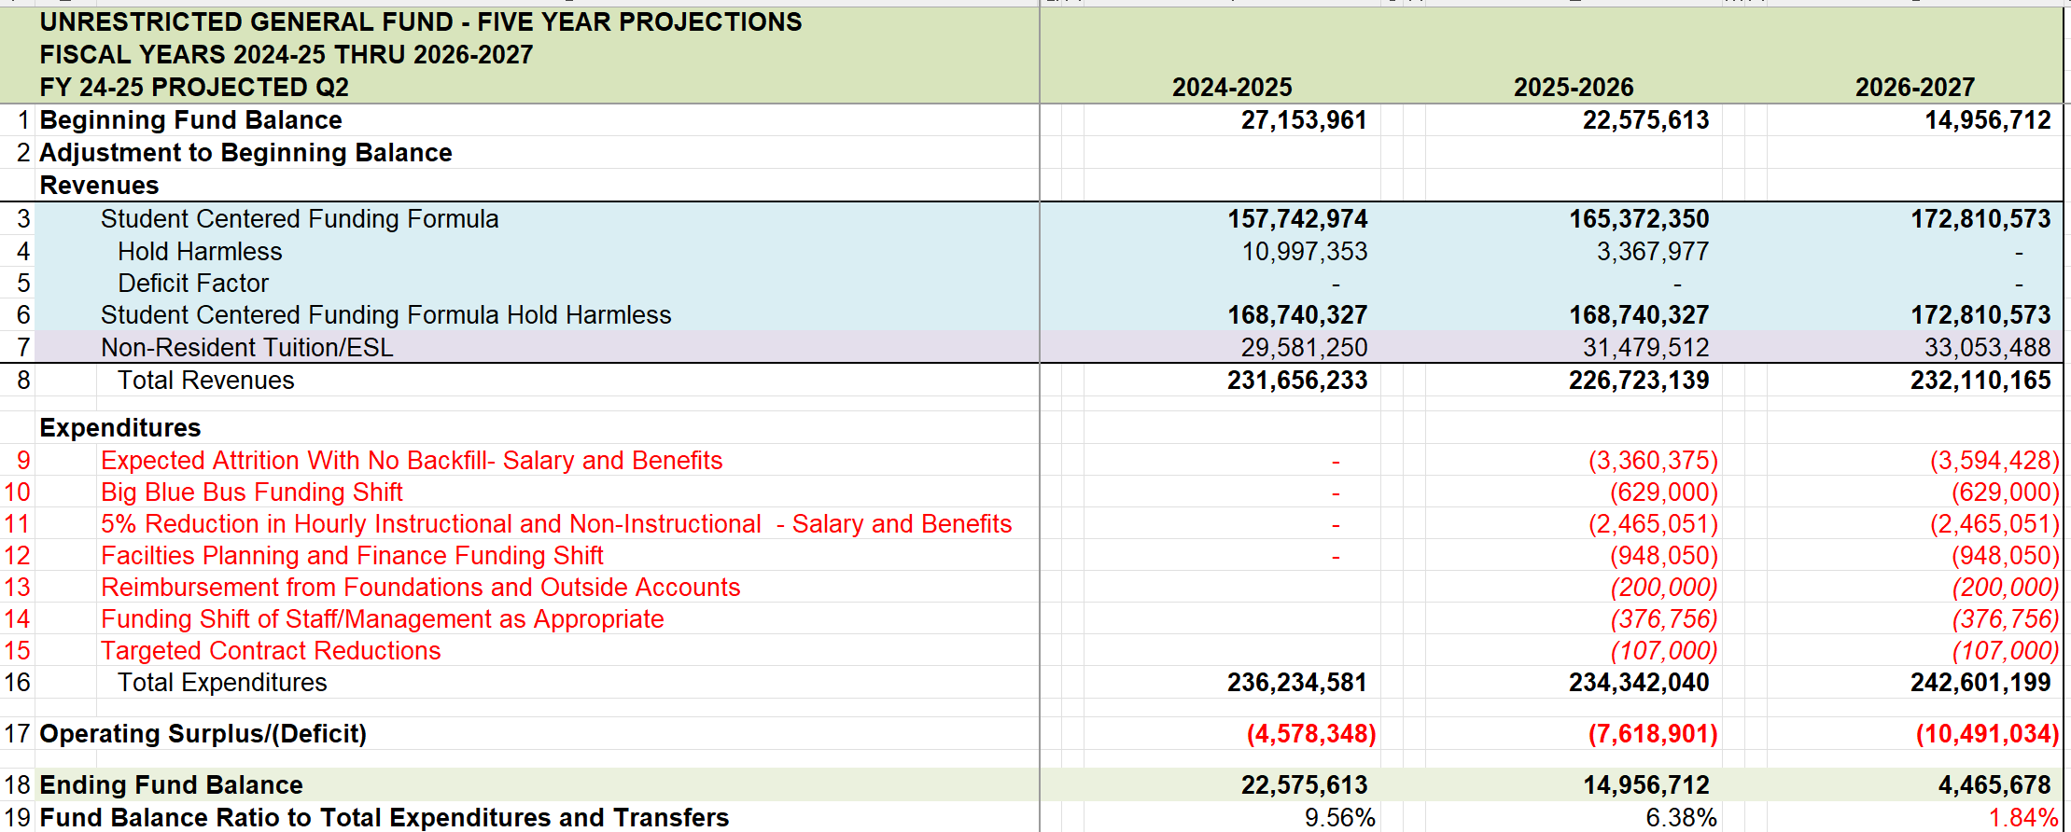
Multi-Year Projection With Recommendations

Slide 23
Possibility of Enrollment Reduction Backfill
The impact of the Pacific Palisades fire on the surrounding community has resulted in student displacement, which eventually will lead to declines in enrollment over the foreseeable future. This holds true for both current Santa Monica College students and prospective students from the feeder high schools that were in the affected burn areas.
As the hold harmless protections drop off the SCFF beginning in 2025-26, the drop in general apportionment funding for Santa Monica College will require cuts to student services, course offerings, and the high-quality instruction that has made the college a premier campus for student success. A simple extension of that sunset date for SMC would ensure no drastic measures would have to be taken to reduce the high-quality faculty and robust course offerings that have made SMC a destination college for many Angelenos.
A proposed amendment to the Education Code extends the hold harmless provision for Santa Monica College through the 2029-30 fiscal year. This would ensure there is enough time for the community affected by the fire to be rebuilt and the displaced current and prospective students to return to their course enrollment.

Slide 24
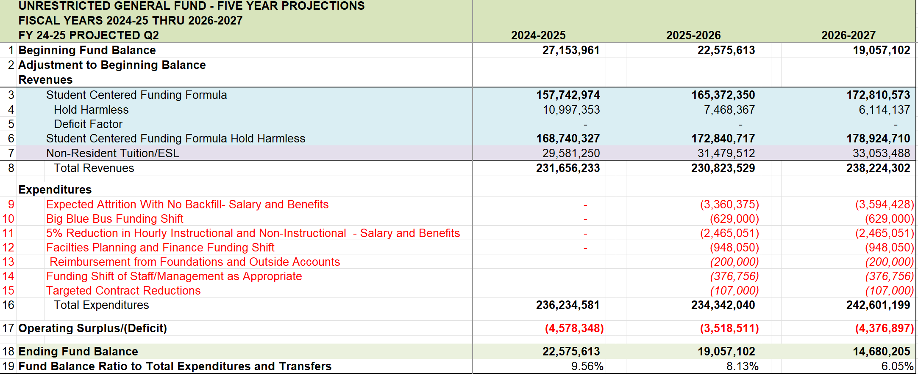
Multi-Year Projection With Recommendations and Enrollment Backfill

Slide 25
Questions and Discussion

