Slide 1
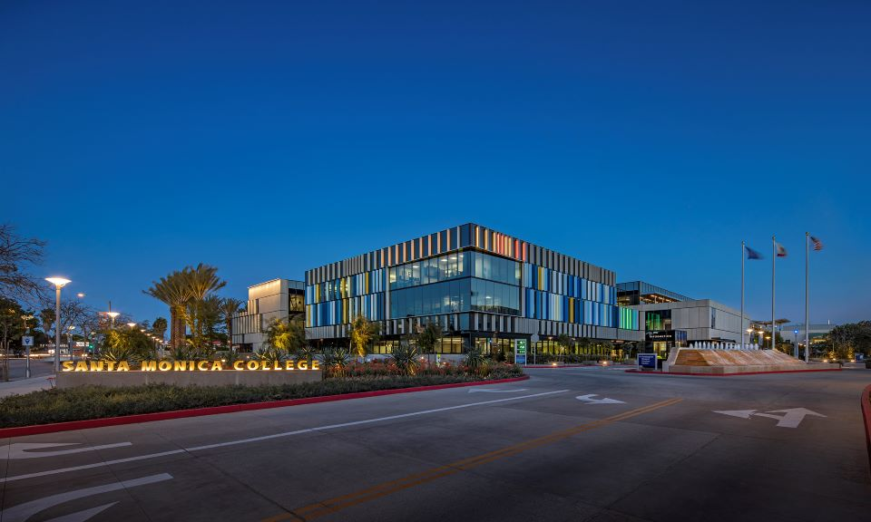
Santa Monica College
Board of trustees
Third quarter budget update
May 5, 2026

Slide 2

Things WILL Change
May Revise
DOF May Finance Bulletin
State revenues projected to be as high as $15 billion above forecast
Prop 98 $5.6 billion not recognized in Governors January proposal
Actions of the Federal Government on State finances
Governor verse Legislature
Legislature releases its own proposals
Senate proposes fully funding $5.6 billion governor ignored
District budget actions and updated projections

Slide 3
Overview
Recalculation of 2024-2025
Third Quarter Budget Update

Slide 4
Recalculation of 2024-2025

Slide 5
What is a Recalculation?
January 2024: Governor proposes next years budget
May 2024: Governor revises January proposal
June/July 2024: State passes State budget
August 2024: CCCCO projects District funding (Advanced)
February/March 2025: Period 1 update (P1)
June 2025: Period 2 update (P2)
February/March 2026: State finalizes funding allocations and makes funding adjustments (Recalculation)

Slide 6
Apportionment Recalculation Adjustments
2017-2018: <$13,026>
2018-2019: $50,655
2019-2020: $708,695
2020-2021: $1,280,923
2021-2022: $480,299
2022-2023: $1,668,898
2023-2024: $2
2024-2025: <$2>

Slide 7
2025-2026 Third Quarter Budget Update

Slide 8
Resident FTES Assumption Update
Resident Credit FTES Projections
Adopted Budget: Credit Res. FTES: 0.0% or 0 FTES
Q2 Projected Credit Res. FTES: ~<4.69%> or <794.31> FTES
Q3 Projected Credit Res. FTES: ~ <0.92%> or <155.43> FTES
2025-2026 Total Projected Credit Res. FTES = ~16,776.07

Slide 9
~<2,725> or <13.97%>
Decrease in
Credit Resident FTES
~<156> or <0.92%>
Decrease in
Credit Resident FTES

Slide 10
Non-Resident FTES Update
Adopted Budget Non-Res. FTES: ~<7.03%> or <214.92> FTES
Q2 Non-Resident FTES Proj.: ~<9.91%> or <298.39> FTES
Q3 Non-Resident FTES Proj.: ~<9.58%> or <288.44> FTES
2025-2026 Total Projected Non-resident FTES = 2,722.76

Slide 11
~<1,536> or <36.06%>
Decrease in
Non-resident FTES
~<288> or <9.58%>
Decrease in
Non-resident FTES

Slide 12

Non-Resident Tuition revenue
2021-22 = $21,657,241
2022-23 = $22,922,455
2023-24 = $25,304,446
2024-25 = $28,293,450
2025-26 = $27,693,658 projected
2025-26 reflects <9.58%> decrease in FTES and 6.42% increase in fees

Slide 13
Other Major Revenue Assumption Updates
Revenue 2.32% or $5,212,637 Above Adopted Budget
Majority of Increase Due To One-time Items/Actions
One-time SMC Foundation Support
One-time Sweep of Auxiliary
One-time Wildfire Funding
Total One-time Unrestricted General Fund: $5,701,643
Strength in Fee Based Instruction: $251,536 Increase
Decreased Ongoing Revenue in Student Fees, Interest, Lottery and Non-resident Tuition of <$841,572>

Slide 14
Major Expenditure Assumption Updates
Expenditures 0.74% or $1,744,831 above Adopted Budget
Vacation Payout: $1,172,784 Increase
Increased number of retirements submitted for June 30, 2026
Included $1,000,000 for sections related to SMCF Donation
Supplies and Contracts: $570,781 Increase
Superintendent/President Search
Human Resources Legal
Support Services for Employees
Strategic Enrollment Management Academy

Slide 15
Major Expenditure Assumption Updates
Insurance and Utilities: $745,000 Decrease
Insurance = $400,000 one-time
Schools Excess Liability Fund (SELF): 80’s to mid-2000
Self insurance JPA with most K-14 Districts as members
AB 218 – Opened window of litigation against agencies
No claims against SMC but required to fund settlements of JPA
Budgeted ~$400,000 for 25-26 funding. Recent actuarial resulted in no additional funding in 25-26. Will resume in 26-27

Slide 16
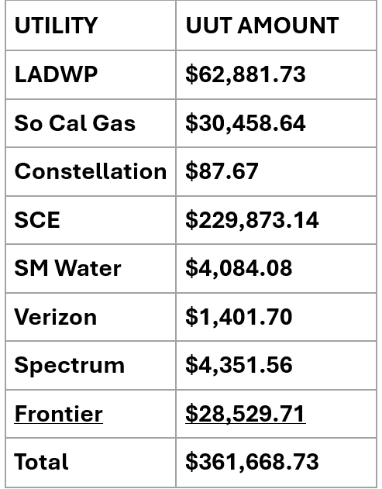
Major Expenditure Assumption Updates
Utilities = $345,000 Decrease
Utility User Tax Exemption Project – Ferris Kawar
Banking of Winter Hours: $466,801 deferred

Slide 17
<$259,979> or <0.2%>
$23,789,394 or 20.2%

Slide 18
$2,160,296 or 3.0%
$15,029,760 or 25.5%

Slide 19
$182,388 or 28.7%

Slide 20
$81,238 or <0.7%>
$528,370 or 4.9%

Slide 21
$548,830 or 9.4%
$2,620,511 or 69.6%

Slide 22
$75,897 or 3.8%

Slide 23
Fund Balance
 | Adopted Budget | Third Quarter
Beg. Fund Balance: | 23,529,795 | 23,529,795
Revenue - Ongoing | 223,080,065 | 222,681,753
Expenditures - Ongoing | 234,619,530 | 233,901,894
Structural Surplus/Deficit | <11,539,465> | <11,220,141>
One-time Revenue and Exp. (Net) | 1,453,476 | 4,601,958
Overall Surplus/Deficit | <10,085,989> | <6,618,183>
Ending Fund Balance: | 13,443,806 | 16,911,612
FB to Total Expenditure and Trfr: | 5.72% | 7.14%
*Chancellor’s Office recommended minimum fund balance is 16.67%

Slide 24
Reduction in Fund Balance
of
<$27,002,996> or <61.5%>
Equivalent to
<$562,562> a month

Slide 25
2026-2027 Projection Update

Slide 26
 | Q3 Projected 2025-2026 | Projected 2026-2027 | 2026-2027 Reduction Needed
Beg. Fund Balance: | 23,529,795 | 16,911,612 | 16,911,612
Ongoing Revenue: | 222,681,753 | 223,194,675 | 223,194,675
Ongoing Expenditure: | 233,901,894 | 237,943,726 | 237,943,726
Structural Surplus/Deficit: | <11,220,141> | <14,749,051> | <14,749,051>
Net One-time Items: | 4,601,958 | - | -
Surplus/Deficit w/OT Items: | <6,618,183> | <14,749,051> | <14,749,051>
Deficit Reduction to Balance: | - | - | 14,749,051
Ending Fund Balance: | 16,911,612 | 2,162,562 | 16,911,612
FB to Total Expenditure and Trf: *Note: 2026-27 includes Board approved furlough and freeze of longevity, step and column for management | 7.14% | 0.91% | 7.58%

Slide 27
Key Take Aways
Expenditures continue to outpace revenues
Continued budget balancing actions needs to occur
May Revise will be important but not the solution
2026-2027 Tentative Budget in June

Slide 28
Special Thank You To…
Veronica Diaz and the Budget Team
John Greenlee, Yu-Ngok Lo
and the Facilities Planning Team
Kim Tran, Irma Haro and the Accounting Team
The Budget Committee

Slide 29
Questions

