Slide 1
Santa Monica College Presentation of the Second Quarter Budget Update
Board of trustees
February 2, 2021

Slide 2
Before We Begin……
Shorter than normal!!!
Governor’s budget presented at January meeting
Change in Presentation
Separation of vacation payout
Normally ~$200,000
2020-21: $808,055
SRP: $633,001
Prior year fund balance adjustment
A/R Adjustment – Over discounting
State COVID-19 Response Block Grant
State guidance incorrect
Fund 01.0: $298,334
Fund 01.3: <$747,187> - Recognized in 2020-21
Fund 40.0: $16,793

Slide 3
2020-21 Second Quarter Budget Update

Slide 4
Major Items of Note
Deferrals for 2020-21 still in effect

Slide 5
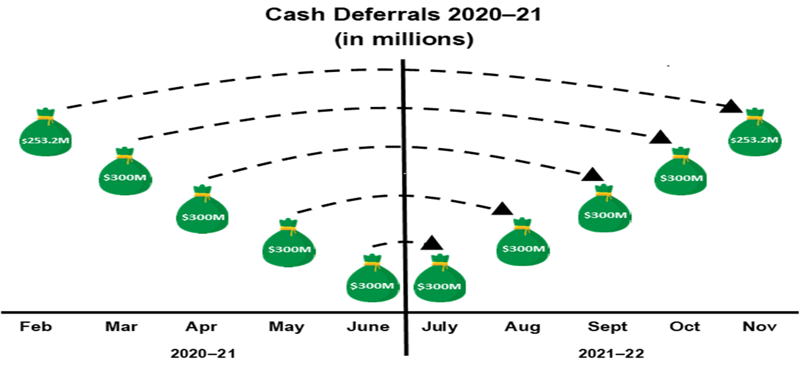
*Graph by School Service of California
Equal to $31.2 million for SMC - $23.1M UGF - $8.1 RGF

Slide 6
Major Items of Note
Deferrals for 2020-21 still in effect
Deficit Factor of 0.85% or <$1.18> M
COVID related savings
FTES projections unchanged since Adopted Budget
Reported Credit Res. FTES: ~ <3.0%> or <578> FTES Credit FTES = 18,938
Actual Non-resident FTES: <15.6%> or <577> FTES
2007-08 = 5,071 FTES; 2012-13 = 4,049; 2017-18 = 4,589; 2020-21 = 3,126
38% decrease since 2007-08; 32% since 2017-18
NR Tuition revenue decrease of ~<$4,023,686> from PY
Intensive ESL revenue decrease of ~<$210,353> from PY
2017-2018 = $33,973,786
2018-2019 = $33,029,528
2019-2020 = $28,384,549
2020-2021 = $24,150,510
3 Year Decrease of ~<$9,823,276> or <28.9%>

Slide 7
Projected Changes in Revenue 2020-2021 Adopted Budget to Second Quarter Projections
2020-2021 Adopted Budget | $177,477,796
Other Local Revenue – Excess STRS Contribution | 121,000
F1 Application Fee | -46,200
Lottery | -95,149
Other | 12,843
2020-2021 Second Quarter Revenue Projection | $177,470,290
Decrease in revenue of <$7,506> or <0.004%>

Slide 8
Projected Changes in Expenditures 2020-2021 Adopted Budget to Second Quarter Projections
2020-2021 Adopted Budget | $185,235,757
Hourly Instruction and Non-Instruction | 773,578
Hiring and Termination | 253,267
Annualization and Adjustments | 236,817
Employment/Retirement Benefits | 128,720
Health and Welfare and Retirement | -289,939
Utilities | -359,864
Vacancy List | -543,447
Supplies and Contracts | -674,748
2020-2021 Second Quarter Revenue Projection | $184,760,141
Decrease in expenditures of $475,615 or 0.3%

Slide 9
 | Adopted Budget | Second Quarter
Beg. Fund Balance: | 21,040,755 | 21,040,755
Adj. Beg. Balance: | - | 298,334
Revenue | 177,477,796 | 177,470,290
Expenditure | 185,235,756 | 184,760,141
Surplus/Deficit | <7,757,960> | <7,289,851>
Ending Fund Balance | 13,282,795 | 14,049,238
FB to Total Exp/Trfr | 7.17% | 7.60%

Slide 10
Special Thank You To…
Veronica Diaz and the Budget Team
John Greenlee, Charlie Yen and the Facilities Planning Team
Kim Tran, Irma Haro and the Accounting Team
The Budget Committee

