Slide 1
santa monica college
presentation of the 2015-2016
second quarter budget report
February 2, 2016

Slide 2
things can still change
Still waiting for P1
May Revise
Governor vs. Legislature

Slide 3
overview
Governor’s Proposed Budget
Second Quarter Report

Slide 4
2016-2017
Governor’s Proposed Budget
WARNING: RESULTS MAY VARY

Slide 5
Governor’s proposal
Record $120.6 billion
K-14 funding is $71.6B or 59%
  Community Colleges share is 10.93% or $7.9B
System increase of $330.4M or 4.3%
No enrollment fee change
2015-2016 $800M above Budget Act will go to one-time funding

Slide 6
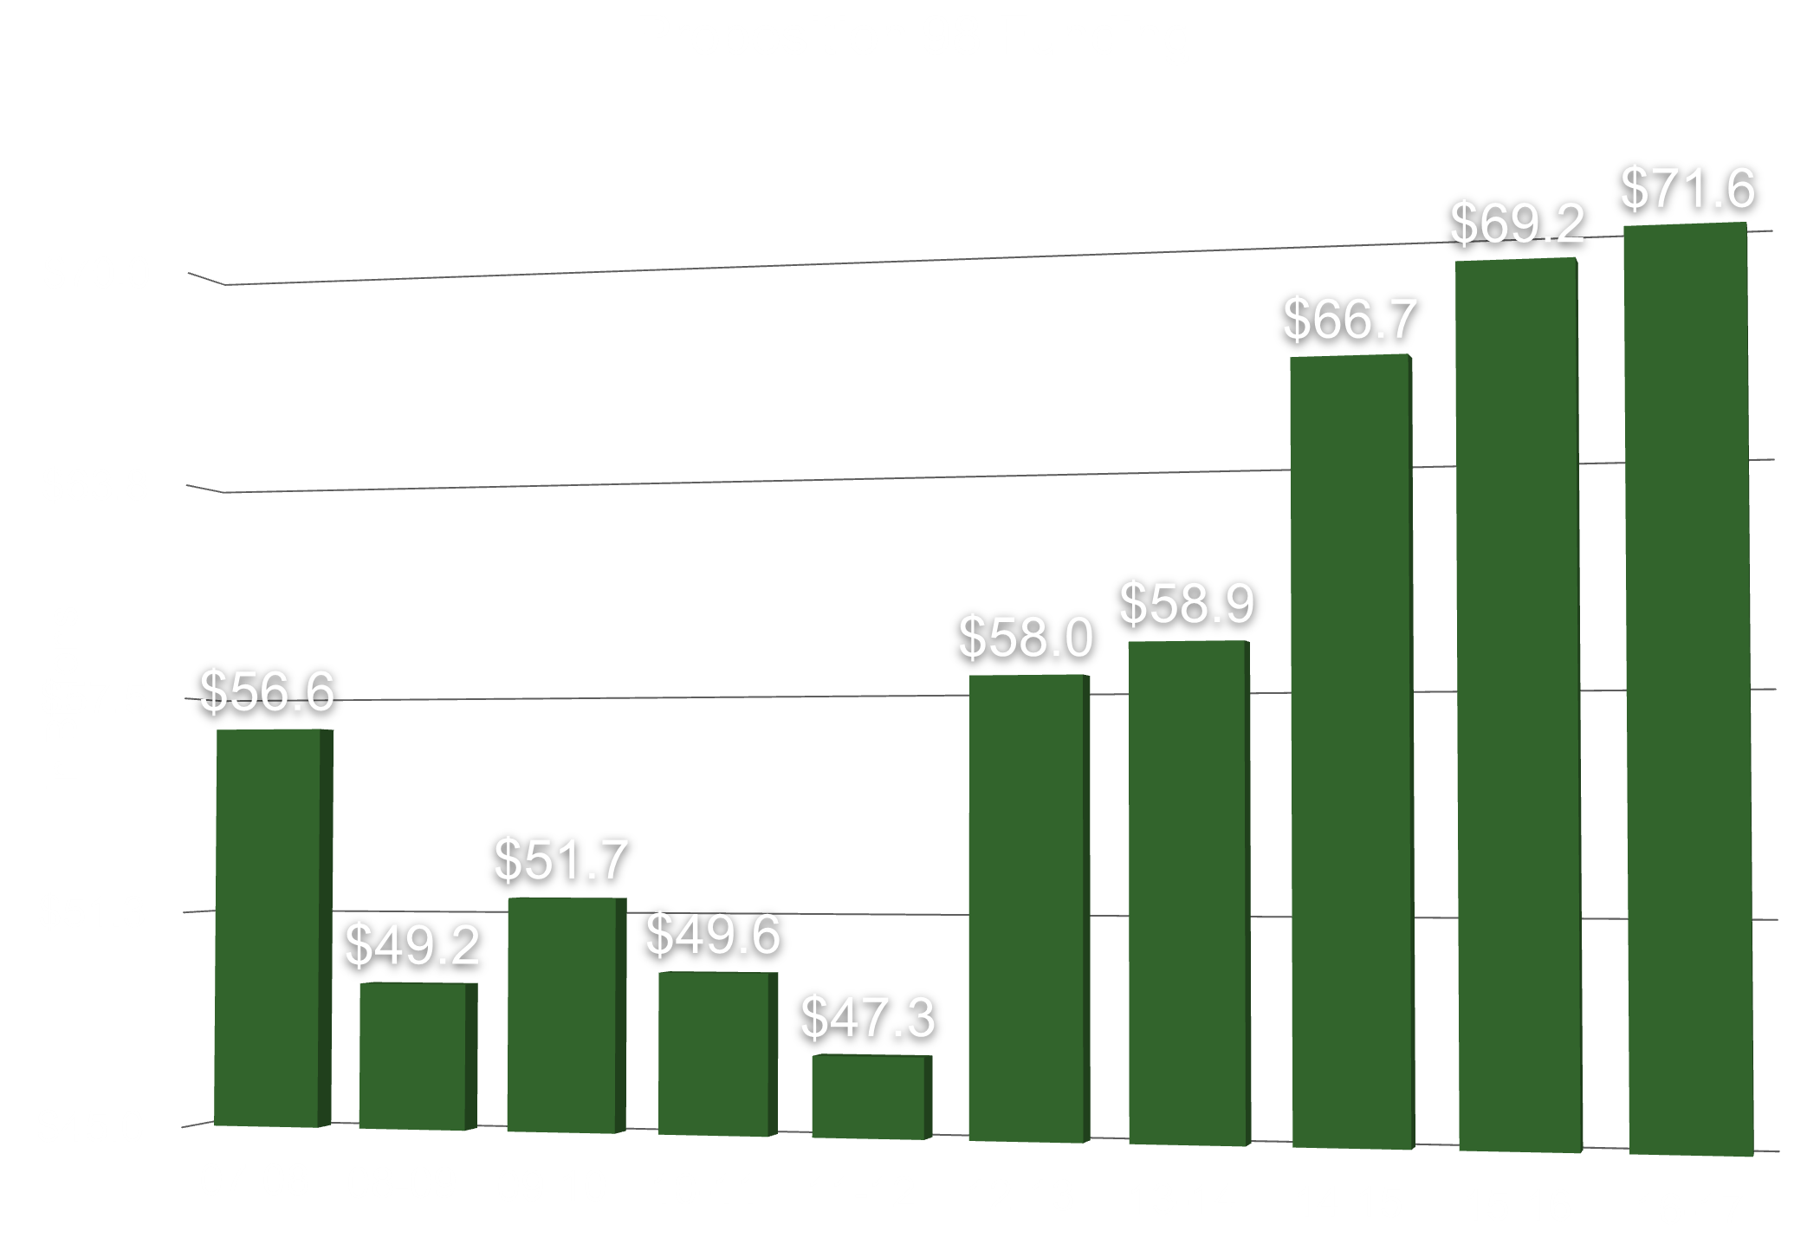

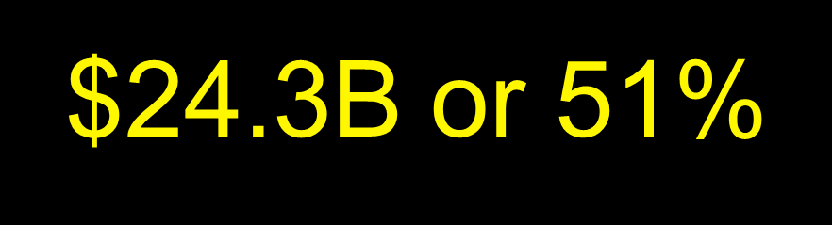

Slide 7
recap of governor’s budget
unrestricted Fund
 | ongoing | one-time | total
Access - $114.7M - 2.0%System | $1,018,311 | - | $1,018,311
COLA - $29.3M - 0.47% | $544,725 | - | $544,725
Mandated cost - $76.3m | - | 1,449,574 | 1,449,574
total | $1,563,036 | 1,449,574 | 3,012,610

Slide 8
recap of governor’s budget
restricted Fund
 | ongoing | one-time | total
Categorical COLA - $1.9m | $14,025 | - | $14,025
SM/IE Block grant - $100m | - | $5,430,970 | $5,430,970
prop 39 - $45.2m | - | $858,800 | $858,800
total | $14,025 | $6,289,770 | $6,303,795

Slide 9
recap of governor’s budget
unrestricted and restricted Fund
 | ongoing | one-time | total
unrestricted (01.0) | $1,563,036 | $1,449,574 | $3,012,610
restricted (01.3) | $14,025 | $6,289,770 | $6,303,795
total | $1,577,061 | $7,739,344 | $9,316,405

Slide 10
2015-2016
Second Quarter Report

Slide 11
Changes in Revenue

Slide 12
projected changes in revenue Adopted to 2nd quarter projections
2015-2016 Adopted Budget Revenue Projection: | 171,153,733
Decrease in Deficit Factor | 412,686
Base Allocation | 198,163
Rental Income | 78,980
Lottery | -75,718
Fee Based Tuition and Student Fees | -123,731
Non-resident Tuition | -801,535
Growth | -1,744,599
Other | 4,994
2015-2016 Second Quarter Revenue Projection: | 169,102,973
<$2,050,760> or <1.2%>

Slide 14
five year revenue trend
 | 2011-2012 | 2012-2013 | 2013-2014 | 2014-2015 | 2015-2016
Revenue | $130,256,518 | $133,916,853 | 144,945,575 | 150,646,540 | 169,102,973
$11,342,277 One-time Net Revenues
Ongoing Revenue $157,760,696

Slide 15
five year revenue trend
Including One-Time Funding

Slide 16
five year revenue trend
Including One-Time Funding

Slide 17
Changes in Expenditures

Slide 18
projected changes in Expenditures
Adopted to 2nd quarter projections
2015-2016 Adopted Budget Exp. Projection: | 163,749,942
Hourly Instruction and Non-instruction | 633,481
Health and Welfare and Retiree benefits | 440,060
Supplies and Other Operating | 406,207
Equipment and Technology | 136,753
Employment and Retirement Benefits | 32,290
Decrease in Vacancy List | -724,070
Other | -30,043
2015-2016 Second Quarter Exp. Projection: | 164,644,620
$894,678 or 0.5%

Slide 19
five year Expenditure trend
 | 2011-2012 | 2012-2013 | 2013-2014 | 2014-2015 | 2015-2016
Expenditures | $139,096,992 | $138,533,415 | $141,494,606 | $150,646,540 | $164,644,620
$2,963,941 One-time Net Expenditures
$161,162,179 Ongoing Expenditures

Slide 20
five year expenditure trend

Slide 21
Changes in Fund Balance

Slide 22
The “bottom line”
 | 2014-2015 Audited | 2014-2015 Second Q
Beg. Fund Balance | $13,971,779 | $13,781,577
Structural Surplus/Deficit | -$1,851,658 | -$3,919,983
One-Time items | $1,661,456 | $8,378,336
Ending Fund Balance | $13,781,577 | $18,239,930
Fund Balance to TTL Expenditures and Transfers | 9.15% | 11.08%

Slide 23
six year trend comparison INCLUDING ONE-TIME FUNDING
 | 2010-2011 | 2011-2012 | 2012-2013 | 2013-2014 | 2014-2015 | 2015-2016
Revenue | $136,530,922 | $130,256,518 | $133,916,853 | $144,945,575 | $150,456,338 | $169,102,973
Expenditures | $133,912,184 | $139,096,992 | $138,533,415 | $141,494,606 | $150,646,540 | $164,644,620
Surplus/Deficit | $2,618,738 | -$8,840,474 | -$4,616,562 | $3,450,969 | -$190,202 | $4,458,353
Adj. to F B | - | $889,005 | - | - | - | -
Ending F B | $23,088,841 | $15,137,372 | $10,520,810 | $13,971,779 | $13,781,577 | $18,239,930
<$4,848,911>

Slide 24
five year trend

Slide 25
major issues moving forward
FTES: Demand softening
  Adopted FTES Target:
    21,397 Credit (approx. 432 funded growth)
    4,717 Non-resident (approx. 91 growth)
  Current Projection:
    20,975 Credit (approx. 65 funded growth)
    4,600 Non-resident (approx. 26 decline)
PERS and STRS increases
Built in increases: Step and column, benefits, and contractual

Slide 26
other issues moving forward
Governor’s Warning: From the Governors Budget Summary…
  “…since 2000, the state’s short periods of balanced budgets have been followed by massive budget shortfalls.”
  “Capital gains is at an all-time high in 2015. …. however, we know capital gains will dive downward at some point.”
  “…maintaining a balanced budget for the long term will be an ongoing challenge - requiring fiscal restraint and prudence.”
  “…another recession is inevitable and should be planned for.”

Slide 27
Budget shortfalls or Surplus as Measured by the Annual Governor’s Budget

Slide 28
Thank You!!!
The Accounting Team with Special Thanks To Veronica Diaz and Jo Lau
Charlie Yen, Greg Brown and the Facilities Team
Budget Committee

