Slide 1

Institutional
Self-Evaluation Report
Presented by the
Accreditation Leadership Team
to the Board of Trustees on November 1, 2022
Santa Monica College

Slide 2
Our Team
Our Purpose
Our Success
Unity is strength… when there is teamwork and collaboration, wonderful things can be achieved.
- Mattie Stepanek, Poet

Slide 3
Accreditation Leads
CO-CHAIRS | CO-EDITORS | STANDARD CO-CHAIRS
Dione Carter Jamar London | George Davison Mitch Heskel With great support from SMC's classified professional: Warren Cancilla And, Accreditation Steering Committee members: Hannah Lawler Elisa Meyer | Standard I Elisa Meyer Teresita Rodriguez Standard II Mike Tuitasi Sal Veas Standard III Chris Bonvenuto Guido Davis Del Piccolo Standard IV: Nate Donahue Don Girard
This is where the content will go

Slide 4
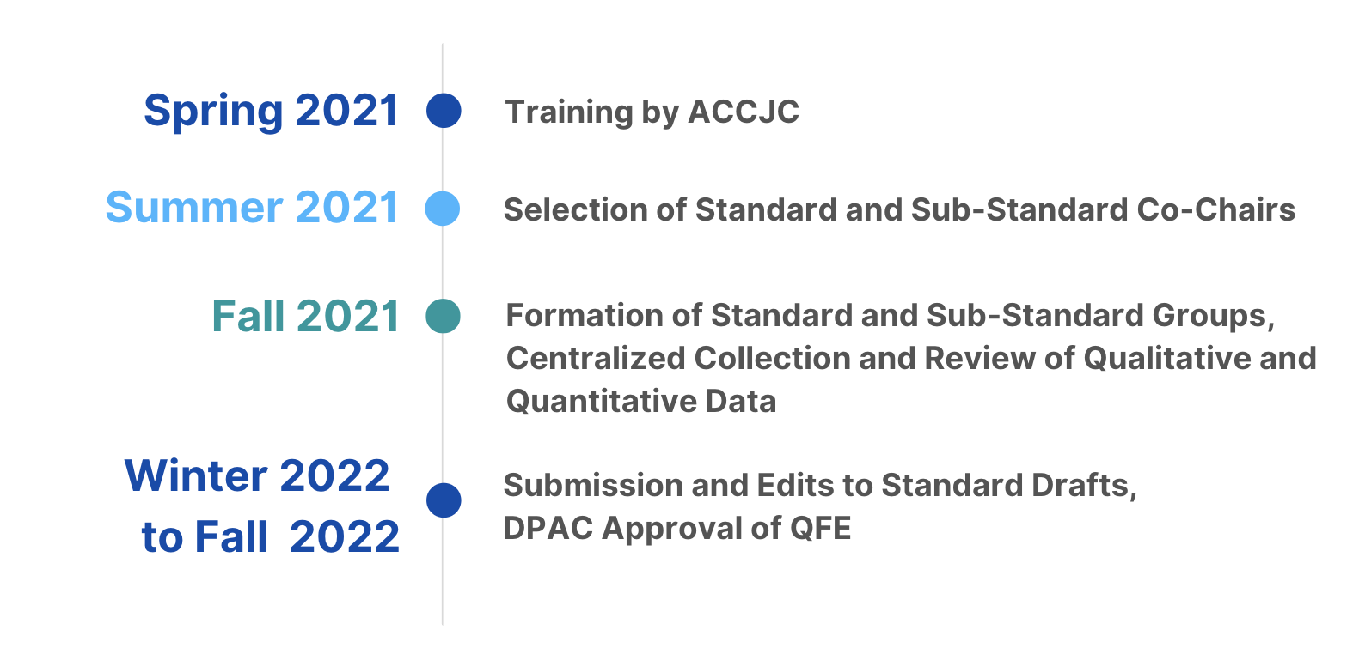
Timeline: Spring 2021 - Fall 2022

Slide 5

Standard I
Summary of Standard I improvements in alignment with the Quality Focus Essay (QFE):
SMC’s mission statement should be revised to include the College’s commitment to racial equity, which is reflected in more recent planning documents.
The College needs to strengthen the alignment of the decision making, planning, and resource allocation to the SMC mission.
The use of Program Review for resource allocation through DPAC needs further alignment.
DPAC’s role should be clarified as it relates to educational planning, more specifically the master planning cycle beyond annual plans.
Mission, Academic Quality and Institutional Effectiveness, and Integrity

Slide 6
Standard II
Summary of Standard II improvements in alignment with the Quality Focus Essay (QFE):
SMC's Hy-Flex modality pilot program should be analyzed and the results should be used to inform future delivery of Hy-flex courses while serving as a foundation for future innovative pilots.
The impact of COVID-19 has forced the college to evaluate the expansion of online services.
The College should implement new services and resources to better meet both our students' academic and basic needs.
Student Learning Programs and Support Services

Slide 7
Standard III
Summary of Standard III improvements in alignment with the Quality Focus Essay (QFE):
Continue to research and implement best practices for diverse recruitment of faculty.
Improve evaluation process for faculty.
Develop a plan to reduce absenteeism and build morale in Maintenance and Operations.
Continue focusing on improving environmental controls, cybersecurity framework compliance, enterprise resource planning, and technology required for the Redesign/Guided Pathways.
Resources

Slide 8

Standard IV
Significant accomplishments that supports Standard IV having no required or recommended improvements:
Board goals are aligned with the College’s mission statement by being “an equity -minded community.”
Board policies are publicly accessible on the College website.
Staggering elections allows for continued stability and mentoring of Board members and professional development is available.
The Board acts in accordance with its Code of Ethics.
Selection and evaluation procedures for the Superintendent/President are clearly delineated in policies.
Leadership and Governance

Slide 9

Quality Focus Essay
Two action projects to enhance
college effectiveness

Slide 10

Quality Focus Essay (QFE)
Commitment to address two or three areas for further study, improvement, and enhancement of academic quality that are hoped to enhance student outcomes and success
Notes:
The quality focus essay is a newer component of the

Slide 11
Elements of the QFE
Aligned
Flexible
Grounded and informed by the results of the self-evaluation process
Serves as a living document and timelines, responsible parties, action steps are flexible
Long-Term
Not a Standard
Focuses on long-term plans to improve student learning and achievement; progress reported in mid-term report
Guide the institutions evaluation but are not used by ACCJC to determine accreditation status

Slide 12
Action Plan #1: Planning
Rationale
Initial Steps
Expected Outcomes
Seek a planning process that moves beyond compliance to ensure planning structure that continues to foster innovation and effective practices
Clarify mission, vision, and goals of the College
Review and revise current planning structures, procedures, and practices
Develop a culture of personal and institutional responsibility for college plans
Mission, vision, and goals will more accurately reflect current values and purpose
Plans will be transparent, interrelated, and aligned to goals
Increased awareness of goals and priorities of the college and ownership of planning
Notes:
The results of our comprehensive self-evaluation indicated that the College planning processes needed to be strengthened to continue providing meaningful opportunities for self-reflection, planning, and improvement both at the macro and programmatic levels. Thus, the accreditation steering committee recommended that SMC focus on two planning-related action plans for its quality focus essays.
The first action plan focuses on revising the college planning processes and structures to enable us to be more innovative and responsive to the current and emerging needs of the college and its community, and ultimately revise a master plan for education. In the last several years, the College has faced both internal (for example, change in leadership) and external opportunities and challenges that have affected our goals, priorities, and to some extent, our daily work. Some examples of external challenges and opportunities include the introduction of the systemwide Vision for Success, the implementation of AB 705 for math, English, and ESL, the adoption of a Student-Centered Funding Formula, the integration of guided pathways and student equity frameworks, and the COVID-19 pandemic. With the changing landscape of the College and its work, it's imperative that the College adapt and re-evaluate and revise the principles and structures that underpin our planning processes.
The focus on evaluating and revising our college planning structures is supported by a finding from the Collaborative Brain Trust, an external consultant group hired to shepherd the College through its last five-year strategic planning process. In their assessment, they noted that existing college plans at SMC were not integrated or coordinated with each other, and the link to these plans to a master plan was not clear.
The initial steps:
Should better reflect conditions and factors affecting the college, including clarifying our values
Include role of DPAC, make sure plans are meaningfully connected, reflective of our college needs and priorities
Create a culture where all employees feel responsibility and accountability for college plans
Expected outcomes:
Our talk will match our walk
Plans by being more transparent and aligned to one another and college goals, relevant and meaningful
Involvement increased
Ultimate goal – laying foundation for new MPE

Slide 13
Action Plan #2: Revamping of Program Review
Rationale
Initial Steps
Expected Outcomes
Current process limits College’s ability to integrate (CBT)
Results of survey of program leaders say changes needed to meet the current and emerging needs of programs
Revise templates; develop rubrics
Review and restructure program review process and timelines
Programs will begin self-evaluation and writing process earlier
Programs will report improved attitudes and perceptions about value of program review
Better alignment with resource allocation process
Notes:
Our second action plan involves planning at the program levels.
The results of our self-evaluation activities led to a conclusion that the program review processes also needed to be rehauled so that we can more effectively use program review as a mechanism for meaningful self-reflection and integrated planning at the program, department, and college levels.
The results of a survey administered to managers and chairs and program leaders who complete program review indicated that our current processes were cumbersome and clunky and not explicitly aligned with institutional goals and resource allocation, and that program leaders lacked the support they needed to effectively complete a program review report. The steps outlined in action plan #2 address these opportunities to strengthen program review.
Ultimately, the goal is to have the new program review be an effective mechanism for departments and programs to engage in meaningful self-reflection that drives their short-term and long-term planning.
The initial step:
Revise templates, develop rubrics – already started this work; include focus group to get input
Building in time and opportunity for onboarding programs, better alignment to inform resource allocation and college planning (DPAC action plans)
Expected outcomes:
Scaffolded support
Program review will be effective in facilitating their reflection and planning
New timeline to align better with resource allocation

Slide 14
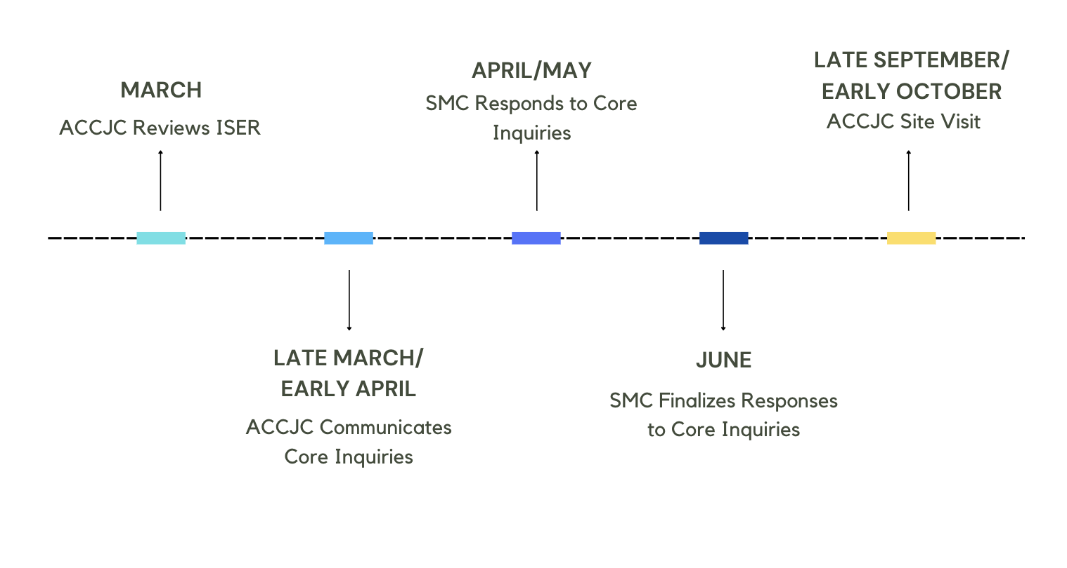
Next Steps

